Slide 1
History of Alcohol Taxation in America
Pat Oglesby
www.newrevenue.org
. . . for Lawyers: Conflict among valid concerns
Notes:
Floyd flood – 35 in NC

Slide 2
if you mean that drink, the sale of which pours into our treasuries untold millions of dollars, which are used to provide tender care for our little crippled children, our blind, our deaf, our dumb, our pitiful aged and infirm; to build highways and hospitals and schools, then certainly I am for it.

Slide 3
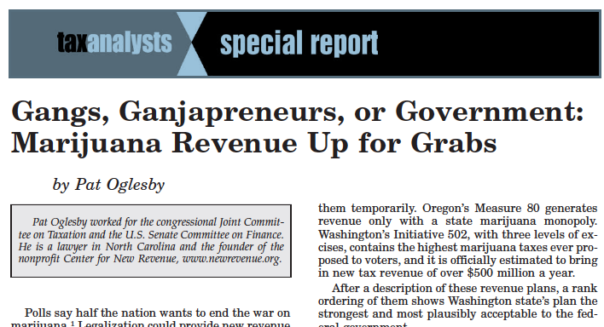

Slide 4
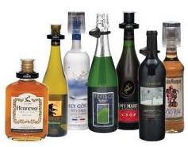
Roadmap
Goals of taxation
Conflict: Whether to tax alcohol?
How?
How much?
Whom to let off?

Slide 5

Tax: Goals beyond revenue
Fairness and simplicity
Administrability: Find, measure, collect
Encourage?: IRA, mortgage interest, hedge funds, “minister of the gospel”

Slide 6

Whether: Discourage Alcohol?
Paternalism and externalities
Elasticity: Revenue or behavior
Regressivity

Slide 7
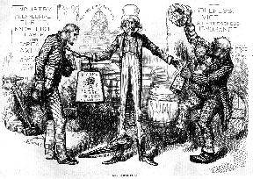

Slide 8
Whether to tax – or what to do? Federal Spirits: 8 answers
1790: no
1791: yes
1802: no
1813: yes
1817: no
1862: yes
1919: ≈ NFIB v. Sibelius
1934: yes

Slide 9
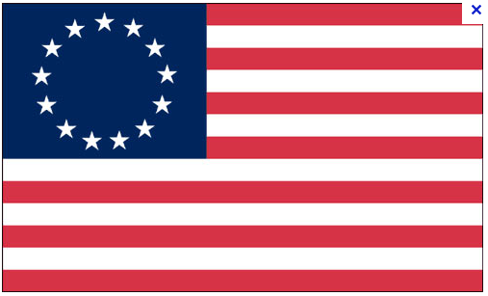
Whether: 1789
Debt of $75 million
Use the taxing power “lest a total non-exercise of it should beget an impression . . . that it ought not to be exercised.”

Slide 10
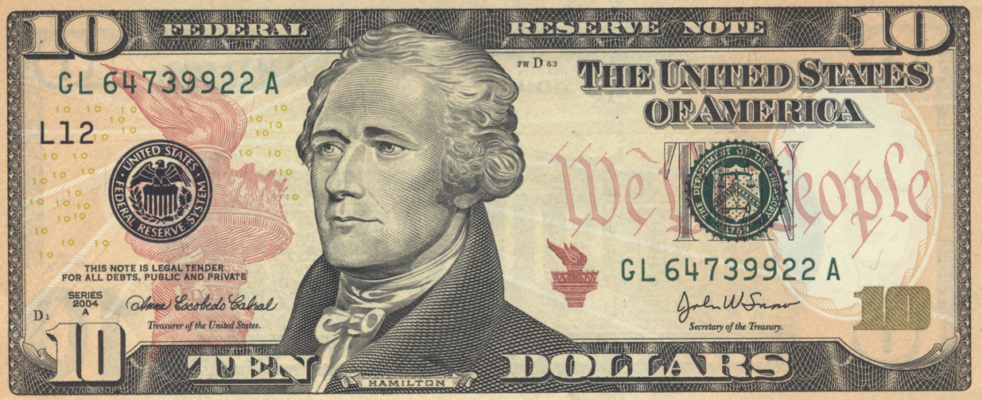
Whether
v. Burr
  No: 1790
Yes: 1791 liquor excise
Hu, The Liquor Tax, 1791-1947, page 19

Slide 11
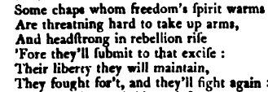
Whether: NC Planter’s Petition

Slide 12
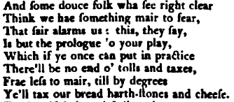
Whether
Plus: Assumption of Colonial debts and speculators . . .

Slide 13
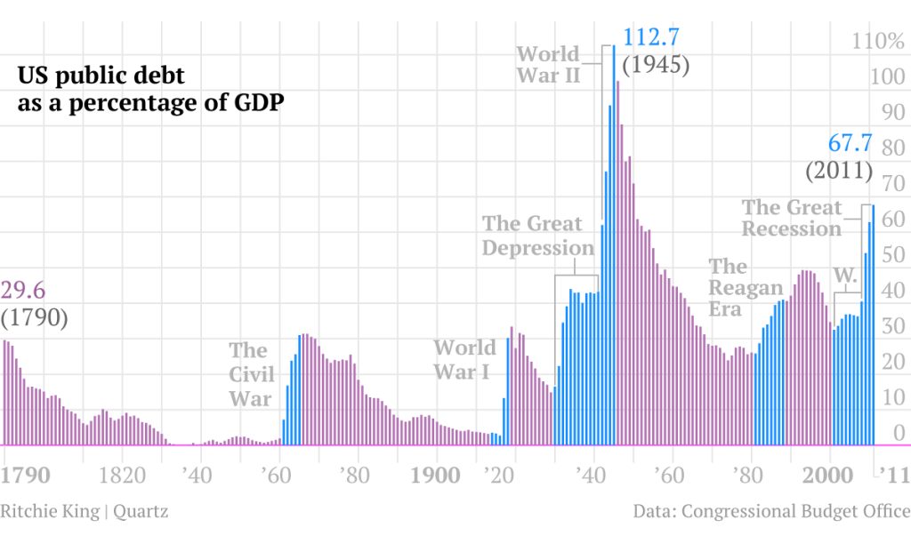

Slide 14
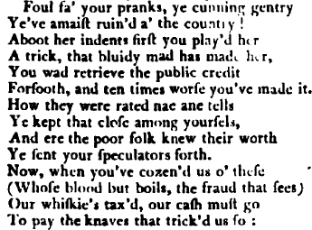

Slide 15
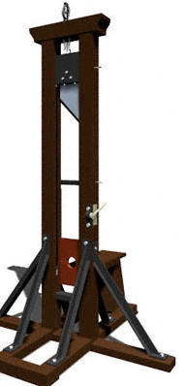
Whether: Whisk(e)y Rebellion
Tarring, feathering, burning buildings, killing civilians
Victory for the USA
Reaction to Liberté, egalité, fraternité
1794 Washington marches
The Ohio opens
Rebels flee

Slide 16
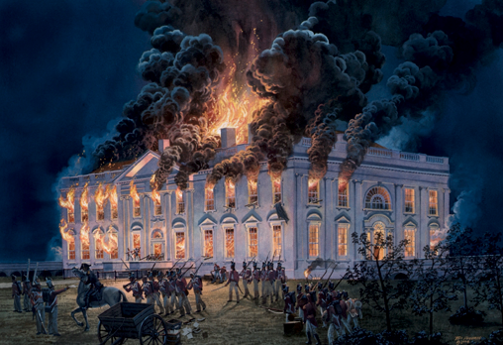
Whether
2d no -- 1802: Jefferson: Repeal of all internal revenue taxes
2d yes – War of 1812
3d no -- 1817

Slide 17
Whether: 3d yes
As the Civil War began: Without tax, retail price 25 to 50 cents
New 1862 Federal tax covered all uses, like fuel
Maintained until 1919

Slide 18
Whether
“Organized drys had supported the income tax [16th Amendment]. . . in 1913 . . . to breathe life into Prohibition.” Last Call by Dan Okrent

Slide 19
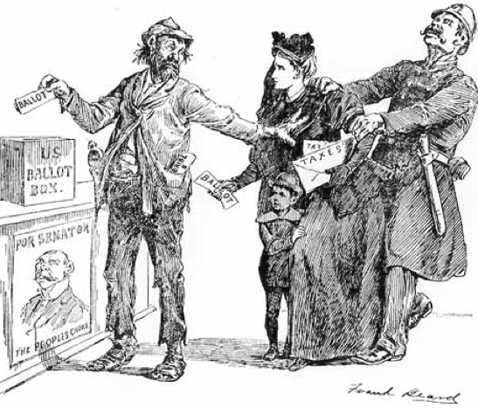

Slide 20
The Ku Klux Klan (KKK) and Woman's Christian Temperance Union (WCTU) shared a common interest in promoting and defending alcohol prohibition, women's suffrage, [and] hostility toward immigrants. http://www2.potsdam.edu/hansondj/Controversies/KKK-and-WCTU-Partners-in-Prohibition.html

Slide 21
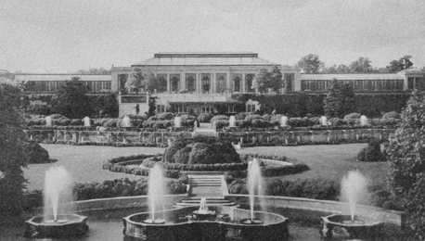
Whether: 4th yes in 1934
Pierre duPont

Slide 22
Whether: Flashback to Colonial Carolina
“During the reign of the Lords Proprietors, . . . import duties on liquors to the colony in North Carolina seem to have been negligible, or perhaps non-existent.” Parker
“Proprietors of North Carolina failed to establish an effective fiscal regime during 1680-1714.” Rabushka
1715 Tax on taverns
1734 Liquor duty, rate unknown

Slide 23
How: From primitive to sophisticated
Licenses
Duties
Excises
Farming
Proxies
More advanced tax bases

Slide 24

How: Tavern licenses

Slide 25

How: Import duties

Slide 26
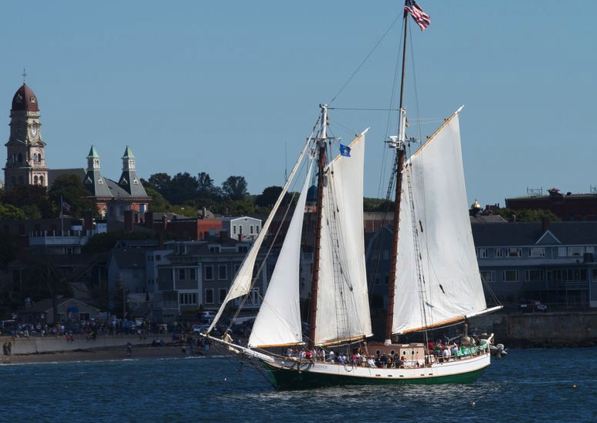
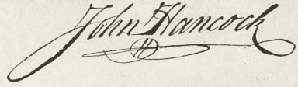
How: Forfeiture
1768 – of schooner for failure to pay British duties on Madeira; dismissal of in personam case (John Adams).

Slide 27
How: Excises – harder to find all the alcohol
First excise: New Amsterdam – 1640 – sailors and transients
Early days: Urban areas, troops

Slide 28
How: Tax base: Volume, price, or potency? Massachusetts
1641: gallonage
1645: ad valorem
1648: back to gallonage

Slide 29
How: CSA excises: 25 percent, not volume
Alabaster and spar ornaments; anchovies, sardines and all other fish preserved in oil. Brandy and other spirits distilled from grain or other materials, not otherwise provided for; billiard and bagatelle tables, and all other tables or boards on which games are played. Composition tops for tables, or other articles of furniture; confectionary, comfits, sweetmeats, or fruits preserved in sugar, molasses, brandy or other liquors; cordials, absynthe, arrack, curacoa, kirschenwesser, liquers, maraschino, ratafia, and other spirituous beverages of a similar character. Glass, cut. Manufacturers of cedar-wood, granadilla, ebony, mahogany, rosewood and satin-wood. Scagliola tops, for tables or other articles of furniture; segars, snuff, paper segars, and all other manufactures of tobacco. Wines--Burgundy, champagne, clarets, madeira, port, sherry, and all other wines or imitations of wines.

Slide 30

How in the USA: 1791 Whisky Tax
Based on potency: volume and proof strength
Alternative tax base: Still capacity

Slide 31
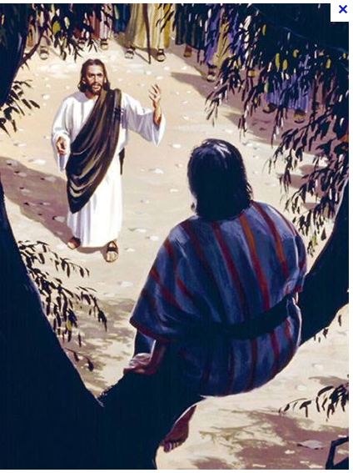
How: Tax farming
NA 1640 liquor, MA 1673 malt; NYC 1691 Liquor
NH 1721 – Revolution; tax farmers collected 2x what employees did
Zacchaeus

Slide 32
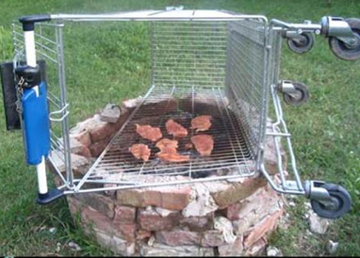
How: Proxies for alcohol
MA 1673 malt
1764 British Sugar Act: Molasses tax doubled – and enforced.

Slide 33
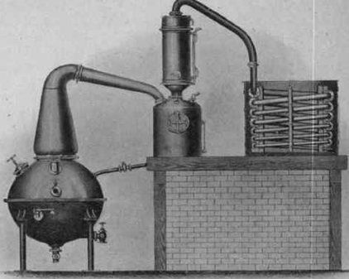
How: Military collections
Post Civil War
Fighting the KKK
1879 Posse Comitatus Act -- Democrats

Slide 34
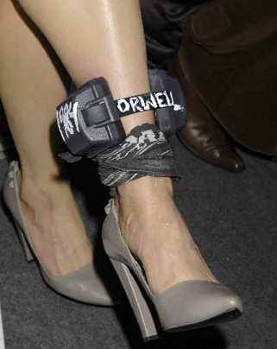
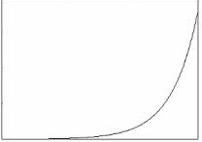
How: Economists’ Dystopia
BAC: “Healthy” drinking
Then taxed exponentially
Genetic testing?

Slide 35
How: More dystopia
Progressivity: “Using cellular phones, the police can now tap into official tax records, which in Finland are open to the public, and learn within seconds a driver's reported income and the corresponding traffic fine.” http://online.wsj.com/article/SB978398058976592586.html
Lord, help us . . .

Slide 36
How much? Receipts, then rates
Year | 1863 | 1864 | 1874 | 1884 | 1894 | 1904 | 1914 | 1924 | 1934 | 1944
Federal Alcohol taxes ($million) | $6 | $33 | $59 | $95 | $117 | $185 | $226 | $28 | $259 | $1,619
Federal Alcohol taxes over total Federal taxes | 6% | 15% | 22% | 30% | 42% | 37% | 34% | 1% | 9% | 4%

Slide 37
What percentage now?

Slide 38
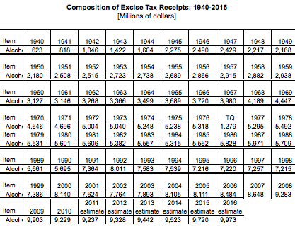

Slide 39
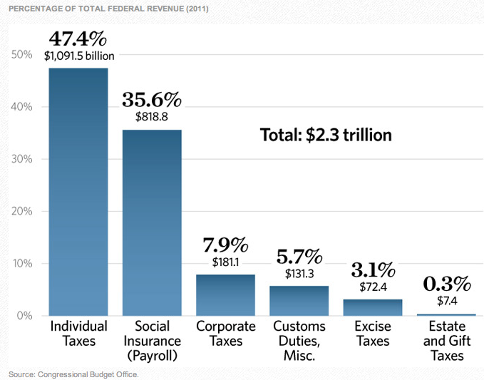

Slide 40
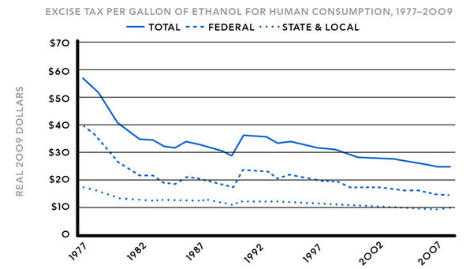

Slide 41
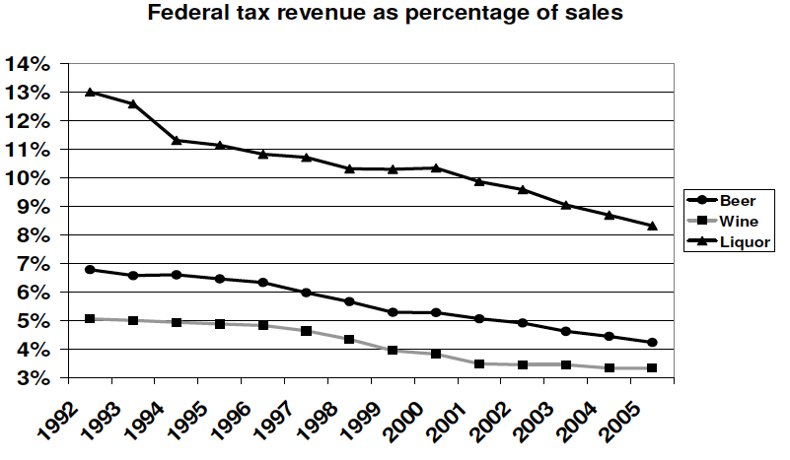

Slide 42
How much? From receipts to rates
1791:
Domestic materials: 25 cents per proof gallon
Imported materials: 30 cents per proof gallon

Slide 43
How much: rates
Spirits – Civil War
FROM | TO | per proof gallon
08/01/1862 | 03/07/1864 | $0.20
03/07/1864 | 07/01/1864 | $0.60
07/01/1864 | 01/01/1865 | $1.50
01/01/1865 | 07/20/1868 | $2.00
07/20/1868 | 06/06/1872 | $0.50

Slide 44
How much: Federal spirits rates
06/06/1872 03/03/1875 0.70
03/03/1875 08/27/1894 0.90
08/27/1894 10/03/1917 1.10
10/04/1917 02/24/1919
Basic rate 2.20
Withdrawn for beverage Use 3.20

Slide 45
How much: Recent Federal liquor tax rate per proof gallon
1934 | 1938 | 1940 | 1942 | 1944 | 1951 | 1985 | 1991
$2.00 | $2.25 | $3.00 | $6.00 | $9.00 | $10.50 | $12.50 | $13.50

Slide 46
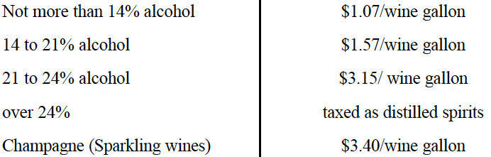
How much now? What rates?
Liquor: Potency: $13.50 per proof gallon
Beer: Volume: $18 per barrel
Wine: With lower rates for small producers:

Slide 47
How much: Federal excise rates on 0.6 oz. of pure alcohol
$.05 per 12 oz. can of 5% beer
$.04 per 5 oz. glass of 12% wine
$.12 per 1.5 oz. shot of 80 proof spirits

Slide 48
How much: Low enough to beat moonshining?
NORFOLK, Va. (AP)— Virginia alcohol regulators say the Discovery Channel's "Moonshiners" television show is misleading . . . [S]spokeswoman Kathleen Shaw told The Associated Press in an email that . . . the show is a dramatization, and no illegal liquor is actually being produced.

Slide 49

How much: Junior Johnson’s heyday
“A gallon of whiskey [bore] $11 tax. You could make it for 75 cents to a dollar and sell it for $3 or $4.” Golenbock, American Zoom

Slide 50
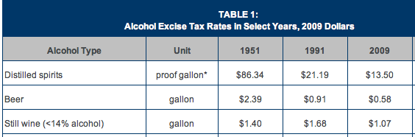
From too much to not enough?

Slide 51
How much? Over 10 years:
Increase Taxes on All Alcoholic Beverages to
$16 per Proof Gallon: $60 billion
$24 per Proof Gallon: $180 billion

Slide 52
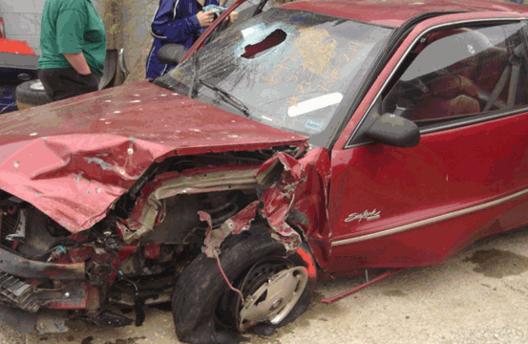
How much: Why not more? Is drunk driving the real problem?
“MADD supports an increase on wine and beer to the alcohol equivalent of taxes on distilled spirits, and the indexation of tax rates.” -- madd.org

Slide 53
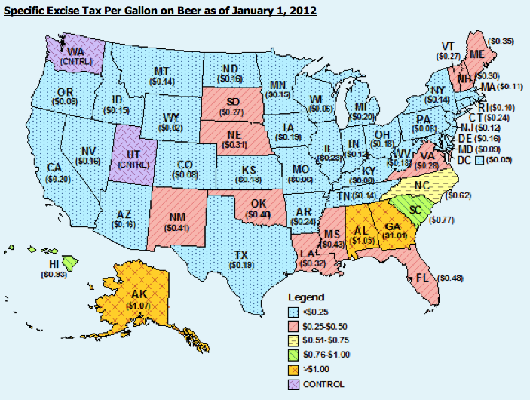

Slide 54
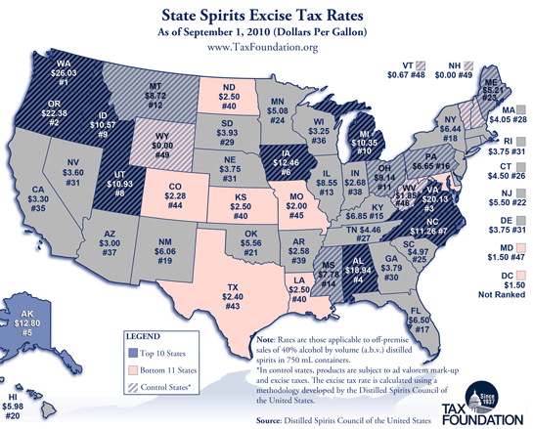

Slide 55
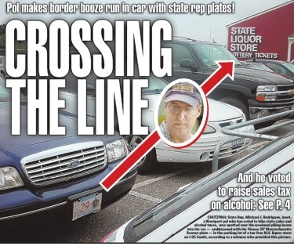
How much? Too much for one MA Rep

Slide 56
From how much to who gets a break
Special interests
Earmarks
Rifle shots
Constituents
Friends
Beneficiaries

Slide 57
Who: VA special interests
1663-4 liquor duty, 6d./gal., to reduce drunkenness -- Exemption for VA-owned ships
1691 liquor customs rates:
4d./gal. generally
2d. For VA-owned ships
Zero for VA-built ships.

Slide 58
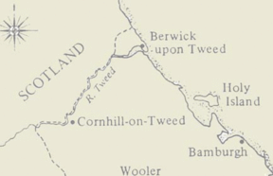
Who: VA 1695
English Government required customs exemption for all liquor imported directly from England, Wales, or the town of Berwick upon Tweed.

Slide 59
More special rules: VA
1736: exemption of 10 pipes (over 1,000 gallons) of Madeira for 3 officials
c. 1756: extra tax on liquor from non-British WI: to restrain trade in wartime – repealed in 1763

Slide 60
Pennsylvania’s friends and enemies
1713: Tax on imported hops except for “Jersey” and Delaware.
Retaliatory duties on goods imported from NY and MD

Slide 61

Special tavern licenses
“Outdoor retailers" faced a higher excise tax increase than others in NH in 1741. Alvin Rabushka, Taxation in Colonial America. Did they make more noise? Were they more mobile and harder to police?

Slide 62


Slide 63
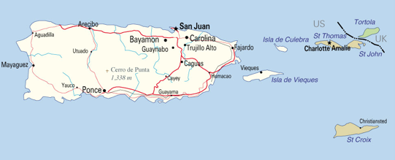
Even the Fiscal Cliff Bill: PR and VI Rum
Rum tax: “’I keep saying, let’s take the occasion to reform it,’ said Pedro Pierluisi (D), Puerto Rico’s nonvoting representative in Congress. Pierluisi believes that too much of this money gets funneled back to rum distillers.” Washington Post, Jan. 1, 2013

Slide 64
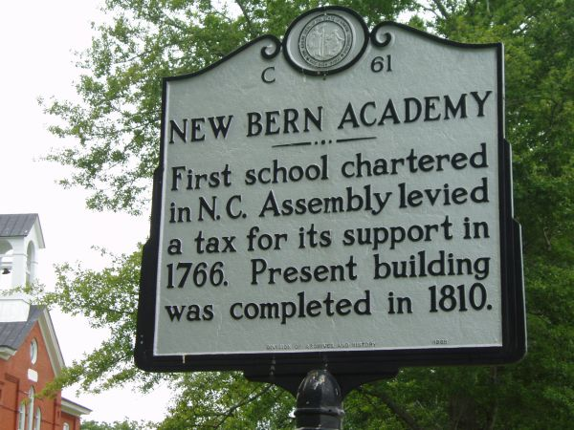
Who benefits? Alcohol revenue for education
1769: 1 penny of VA tax for
College of William & Mary

Slide 65
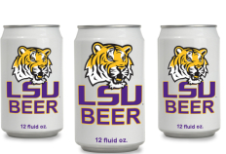
And . . . the never ending quest for revenue

Slide 66
Discussion

Slide 68
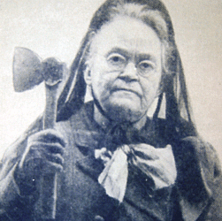

Slide 69
May 9, NCBA, Cary

Slide 70
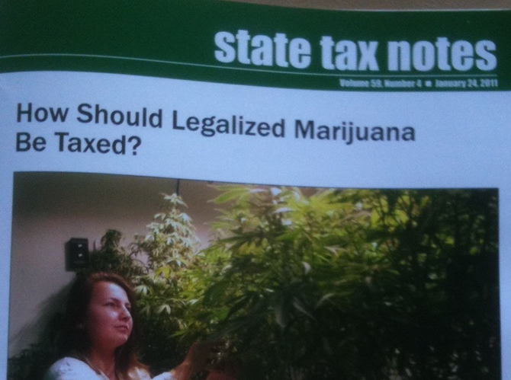
Whether? How? How much?
May 9, NCBA, Cary

Slide 71
Colonial Carolina
1584 Raleigh: 1/5 of gold and silver
1663: Lord Proprietors got Carolina for £ 13 a year, plus 25% of gold and silver.
5% customs duty, waived until 1670
“During the reign of the Lords Proprietors, . . . import duties on liquors to the colony in North Carolina seem to have been negligible, or perhaps non-existent.” Parker

Slide 72
Carolina
“Proprietors of North Carolina failed to establish an effective fiscal regime during 1680-1714.” Rabushka
1711-13 Tuscarora war financed with paper money
1715 Tax on taverns
1734 Liquor duty, rate unknown

Slide 73
North Carolina
1747: 3d. “proclamation money” duty per gallon on liquor; British exempted; rice and wine added
Increased to 7d. By 1767
1 d. for New Bern school
Other taxes: quitrents, poll, lawsuits; local for churches
1739-63: Rum excise second only to poll tax – despite smuggling

Slide 74
Background: Alternatives
Poll, Quitrents, Tonnage
NYC 1677:
Required street sweeping or 3 shilling fine
Brooklyn ferry tolls
Sale of “highly desirable waterfront lots”

Slide 75
More alternatives to AT
CT 1636: Beaver skin 1 shilling excise
CT 1653: Exported lumber duty
VA 1663: Tobacco export duty bonanza

Slide 76
Even more alternatives to AT
CT 1676: Wearing gold or silver buttons or lace, silk scarves
MA 1715-1737: Spirits and wine duties roughly doubled. Tobacco taxes increased by a factor of 25 or 30

Slide 77
An alternative in Connecticut
1729: Congregational churches could no longer tax dissenters. “Numerous residents took advantage of this loophole, becoming Baptists to avoid compulsory Congregational taxes.” Rabushka, Taxation in Colonial America

Slide 79
What will the market bear?
$2.00 per gallon in 1865 – 8 to 12 times the “average cost of manufacture” of whiskey – too much in the Civil War, bootlegging ran rampant.[1] A reduction in that tax by 75 percent in 1868, to two or three times the cost of manufacture, “practically stopped illicit distillation” and more than doubled revenues from the tax.[2] Two times the cost of manufacture was a rough standard used in the re-imposition of tax after passage of the 21st Amendment, too. Whiskey then thought to cost $1.00 or a little more per proof gallon to produce[3] bore a federal tax of $2.00[4] with the understanding that state taxes would add to the final price to the consumer. That "two times" standard turned out to be low: The federal tax increased 450 percent, to $9.00, 10 years later.

Slide 80
Transition: Whether to How

Slide 81
How much?
Crown consolidates MA, ME, NH, part of RI into Dominion of New England
“Dissolution of the popular assembly in MA was seen as the most effective way to disenfranchise the Puritan theocracy.” Rabushka
Wine duties doubled; license requirements enforced

