Slide 1
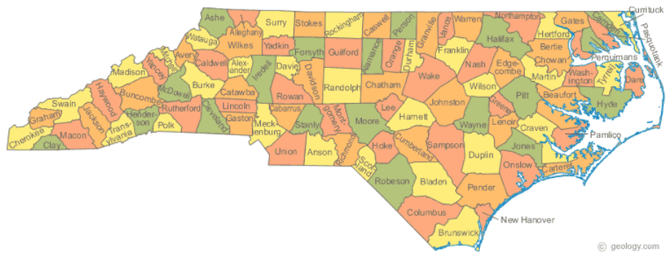
Marijuana Revenue
Pat Oglesby
NCBA May 9, 2013
Notes:
For lawyers

Slide 2
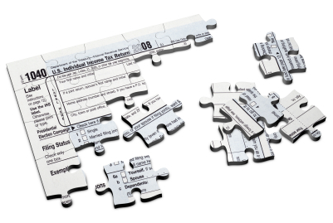


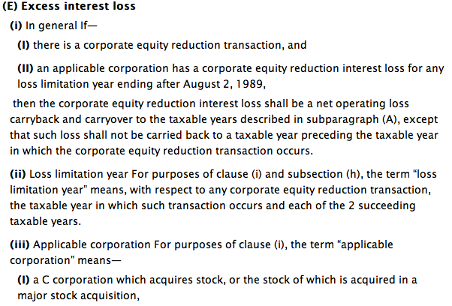


Notes:
Lawyer in Chapel Hill now.
Tax policy business DC year ago -- Helping write the I R Code
Nonpartisan Joint Tax Committee ---Senate Finance Lloyd Bentsen
Deep into capillaries -- Into complexity that made people hate tax law

Slide 3

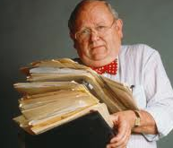
+
= ?

Slide 4
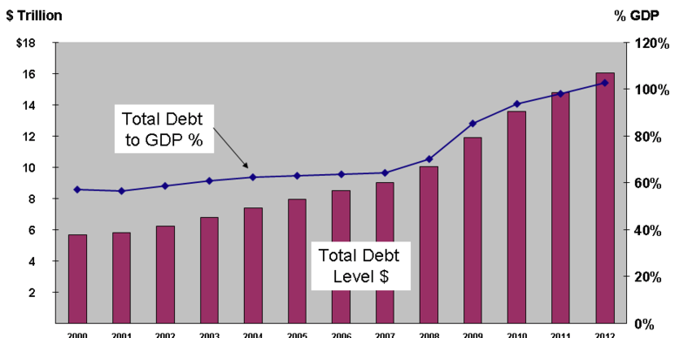
Notes:
Now lawyer in Chapel Hill
Worried that we are not paying our bills
Running up debt

Slide 5

Today’s slides online
Notes:
So have been thinking about taxes
Formed a nonprofit CNR
Slides are here

Slide 6
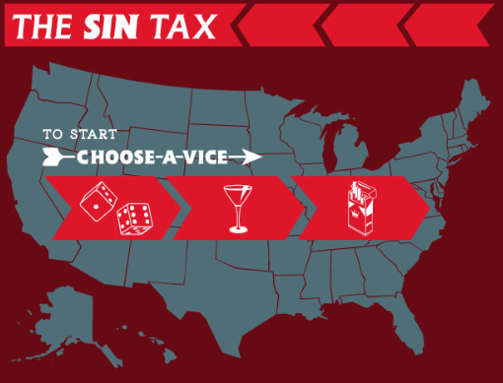
Notes:
Particularly interested in taxing things everyone doesn’t approve of
Gambling, alcohol, tobacco

Slide 7

Love?
Hate?
Think?
Notes:
Cannabis
People love marijuana or hate it or need it as medicine. changing, but slowly.
People have NOT thought a lot about the details of just how legalization would work – and thinking about those details can shine some analytical light on practical issues.

Slide 8
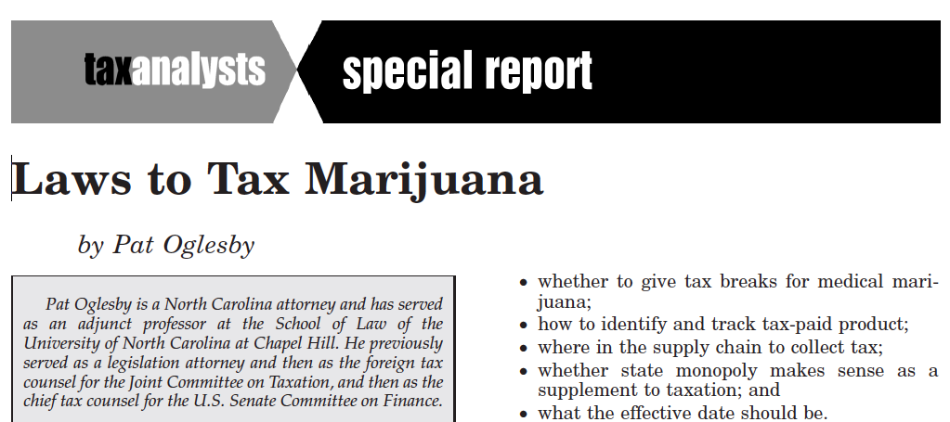
Notes:
2011 overview of how to tax cannabis – in materials

Slide 9
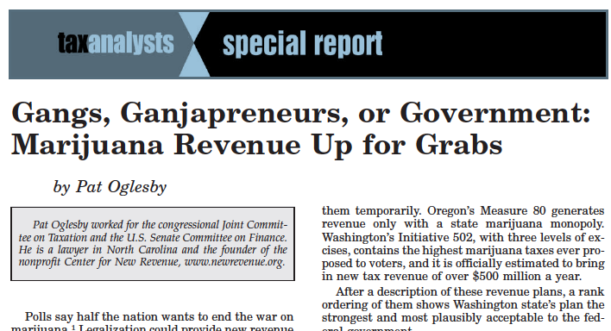
Notes:
2012 article about the details of proposals out west
Also in materials

Slide 10
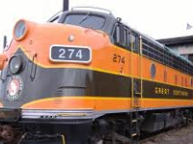
Marijuana Revenue
Goals: for you to see
Role of revenue
Options for NC
Conflict in the raw
Notes:
Today I’d like you to think about the role of revenue in marijuana law reform – and when and if full legalization comes, whether revenue is the tail on the dog or locomotive – revenue will be part of the package.
How we in North Carolina might approach this issue
Since you’re lawyers, to see fusses and disagreements that are not your own.

Slide 11


Pick a date 20??
1st NC revenue from marijuana
Notes:
A thought experiment. Please think about your best guess about when the State of North Carolina might see its first dollar of revenue from legal marijuana.
Write it down – maybe in a hidden spot
If you think never, maybe put 2099
You don’t have to show anybody.

Slide 12
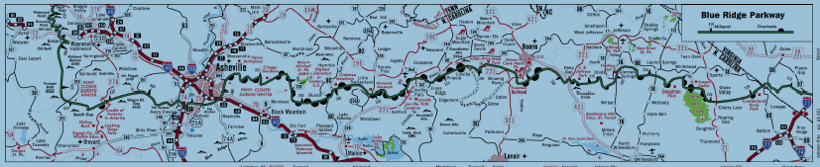
Tax policy: Balancing conflicts
Models: existing and proposed
Design issues
NC
Notes:
Here’s the RoadMap for today
We’ll start with an overview of how tax policy deals with difficult problems
We’ll look at actual revenue now being collected on marijuana and on other ways that could be tried
With those models in mind, we’ll drill down on how to design a revenue scheme
Esp for North Carolina

Slide 13

Goal of tax is revenue
Bonner Bridge
Notes:
For infrastructure

Slide 14

NC teachers of the year
Notes:
For education – whatever.

Slide 15
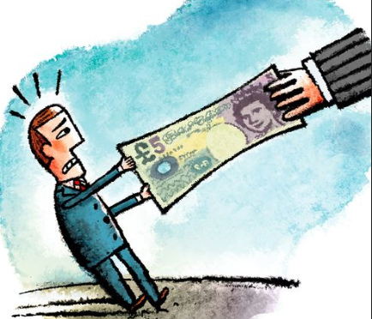
Tax Policy: Making a System Work
Target:
  Find
  Measure
  Collect
“Fairness”
Simplicity
Notes:
There’s more to it. We’d like taxes to be easily collectible, ROLL ARROW and that means we have to have a target we can find and a base we can measure. Take the real property tax. We can locate real property – no problem. The government can slap a lien on it to collect the tax. The problem there is measuring the value. No tax is easy.
We would also like taxes to be fair and simple – That’s another CLE program.

Slide 16
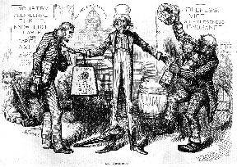
Notes:
Encourage savings etc Beyond encouragement, we don’t mind discouraging things.
Here we see Uncle Sam choosing between an income tax on the sober symbol of virtue on the left and an alcohol tax on the worthless symbol of idleness on the right.
A persuasive emotional appeal unless you resent the association of evil with a bald head. I hardly noticed.

Slide 17
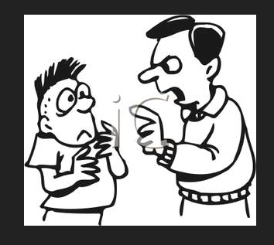
Should we discourage marijuana with taxes? Paternalism
Notes:
If you talk about government influencing people to do things for their own good, libertarians hate it. Legalization with tomato model.

Slide 18
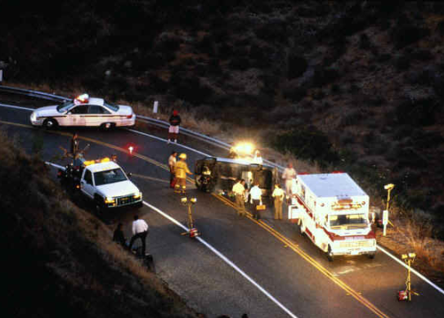
Should we discourage marijuana with taxes?
Externalities
Notes:
Most people including most libertarians think it’s acceptable to tax behavior that creates costs for society
Perception that stoned drivers like drunk drivers are bad drivers that might cause wrecks and hurt people
Or hurt themselves – and we end up paying. Or 2d hand smoke.

Slide 19

Will taxes discourage use? Win-win?
Inelastic demand: $$$
Elastic demand: Less smoking
Notes:
MAYBE this is a win-win.
If demand is inelastic, if the user doesn’t care how much it costs, we get revenue.
With elastic demand, the user consumes less, and folks who hate marijuana use get their wish.

Slide 20
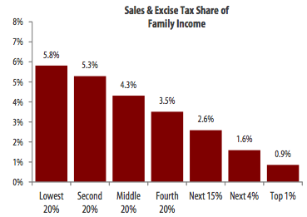

Problems with taxing marijuana
Regressivity – NC chart
Notes:
Any consumption tax imposes the same dollar burden on the poor and on the rich, but it hurts the poor and doesn’t bother the rich.

Slide 21


Problem: Public in cahoots with “sin”?
Notes:
As with the lottery or alcohol taxes, it creeps people out when undesirable behavior brings in revenue – when we feel like the state is in cahoots with activities that create problems for people.

Slide 22

Problems with taxing marijuana
Black market
Notes:
If we tax too much, folks will evade the tax and the bootlegger will prevail.

Slide 23


Goal of drug policy is control?

Slide 24
Tax policy: Balancing conflicts
Marijuana revenue
Other revenue ideas
Design issues
NC
Notes:
Back to the roadmap to see where we are
We’re done with tax policy
About to look at laws to tax marijuana

Slide 25
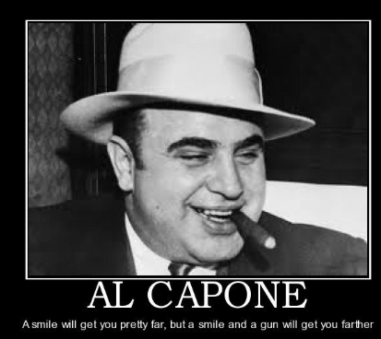

Current General Taxes
Even illegal businesses
Notes:
We should and do actually collect taxes on illegal businesses, who understand that the IRS may come after them with the net worth method of inferring income if they accumulate assets and can’t explain where those assets came from

Slide 26
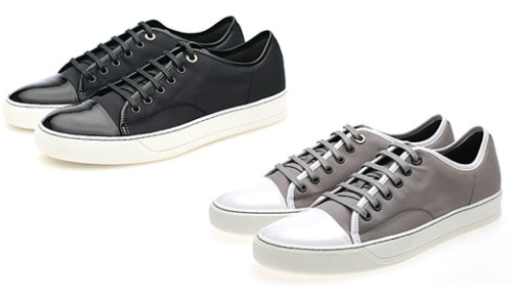
General Taxes on Medical Marijuana
Marijuana
State | Arizona | Maine
Taxes | 6.6% sales tax | 5% sales tax; 7% meals tax on edibles
Notes:
Without using the word marijuana, many states collect sales taxes on medical marijuana just like they do on shoes. In Maine, you buy a brownie, you pay 7 percent sales tax. You buy a marijuana brownie, you pay 7 percent sales tax – even though it’s medicine.

Slide 27

45% tax on electricity usage over 600% of Baseline – Arcata CA
Marijuana
Notes:
Another way of taxing marijuana without using the word marijuana is to tax indoor grow operations that use a lot of electricity – In the case of Arcata, more than 6 times the average for that size building.

Slide 28



Specific “marijuana” taxes on the books
      Being collected
        Recreational -- In limbo
Notes:
But there are taxes that use the word marijuana. Some are already being collected – on state-legal medical marijuana. Some are on the books but I describe them as limbo, because they are not being collected, because no state has implemented a scheme for recreational marijuana. Legal Businesses haven’t started operating yet.

Slide 29


Medical marijuana
Recreational marijuana
All Federally illegal drugs
Notes:
Here are symbols I’m going to use on slides to show the exact target of taxes.
Green for medical mj
Willie N in red for recreational
This for a broader category we’ll get to

Slide 30


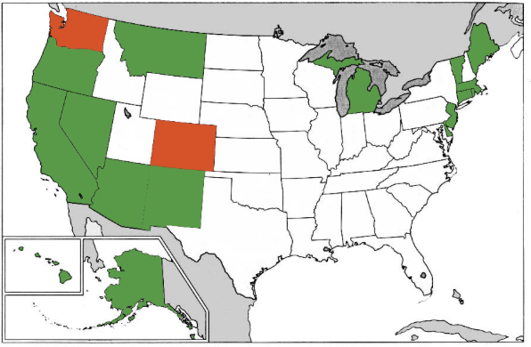
:medical
: recreational
Notes:
WA and CO voted to legalize generally in 2012.
More states have moved to legalize medical since this chart was printed. I can’t keep up. Maryland and Illinois?

Slide 31
Revenue being collected
License fees
Priced-based taxes
Other taxes
Notes:
Actual collections are from fees and taxes.

Slide 32

Oakland CA 1996 License fee:
Notes:
The first license fee I can find was 5000 dollars to set up a retail store in Oakland.

Slide 33

Notes:
Here’s the City of Northglenn Colorado that charges $2,000 just to apply to open a store.

Slide 34
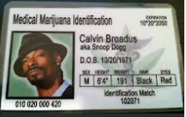
Patient licenses
Notes:
Licenses that patients have to pay for
If time color of eyes

Slide 35
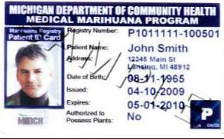
Patient licenses
Notes:
Here’s a real one from Michigan.

Slide 36
Being collected
Patient license fees:
 | State cost of Application
Arizona | $150
California | $66
Colorado | $35
Hawaii | $25
Maine | --
Michigan | $100
Montana | $75
Nevada | $150
Oregon | $200
Notes:
States charge up to $200 for a medical marijuana card.

Slide 37
Revenue being collected
So much for current fees
On to taxes . . .
  Priced-based
  Other
Notes:
Transitioning from fees to taxes

Slide 38

World’s first marijuana tax
Oakland, CA, July 21, 2009: 1.8 percent of gross receipts
Notes:
A tiny tax at retail – enacted in referendum with 80 percent of voters saying yes. Oakland has its fiscal troubles, and the marijuana community stepped up in a small way.

Slide 39
November 2010 Price-Based Taxes
Retail rates from 2.5 % to 15%
City | Albany | Berkeley | La Puente | Long Beach | Oakland | Rancho Cordova H | Richmond | Sacra-mento | San Jose | Stockton
Medical marijuana tax | 2.5% | 2.5% | 10.0% |  | 5%, up from 1.8% | 12% to 15% | 5.0% | 4.0% | Up to 10% | 2.5%
Recreational tax (if Prop 19 passed) | 2.5% | 10.0% | 10.0% | 15.0% | 10% | 12% to 15% | 5.0% | 10.0% | Up to 10% | 10%
Voters in favor | 84.2% | 82.4% | 68.0% | 73.1% | 70.8% | 68.5% | 78.2% | 71.8% | 77.7% | 66.7%
Visible at “Laws to Tax,” page 257
Notes:
You can see this data in the handout. Nobody has a rate as low as Oakland’s initial rate. Oakland is up to 5 percent

Slide 40
“Laws” p. 257: Non-price tax bases
City | Albany | Berkeley | Berkeley | Long Beach | Long Beach | Rancho Cordova H | Rancho Cordova O | Rancho Cordova O | Rancho Cordova O | Rancho Cordova O
Square footage taxpayer | Non profits | Non-profit medical marijuana operations | Non-profit medical marijuana operations | All for-profits | All not for-profits | Nonprofit entities | Individuals | Individuals | Individuals | Individuals
Square footage base | All indoor space | All property up to 3000 ft² | All property 3000 ft² and over | All indoor space | All indoor space | All indoor space | Indoor cultivated areas up to 25ft² | Indoor cultivated areas 25ft² and over | Outdoor cultivated areas up to 25ft² | Outdoor cultivated areas 25ft² and over
Square footage tax rate | $25/ft² | $25/ft² | $10/ft² | $25/ft² indexed | $10/ft² indexed | $100/ft² | $600/ft² | $900/ft² | $48/ft² | $72 ft²
Alternative per-plant tax |  |  |  |  |  |  | $600 | $900 | $600 | $900
Voters in favor | 84.2% | 82.4% | 82.4% | 73.1% | 73.1% | 68.5% | 56.4% | 56.4% | 56.4% | 56.4%
This tiny print is summarized on the next slide.
Notes:
Again in the handout, and on the next slide

Slide 41

“Laws” p. 257: Non-price tax base
Square footage taxes from $10 to $25
Some are indexed for inflation
Notes:
Taxes on grow areas. They can grow a lot of profitable product in a tiny area.

Slide 42

Mendocino: $50 per plant
Notes:
Put a RFID zip-tie tag on each plant, and charge for it.

Slide 43

Internal Revenue Code rule
lost a case
1982 statute added 280E
Federally illegal – but not prostitution
Notes:
Now the federal rule. In the early 80s there was an illegal drug dealer who went to court to deduct his travel expenses and he won. Those were ordinary business deductions, and the Tax Code didn’t discriminate against illegal activity.
So Congress changed the law for federally illegal drugs – not for gambling or prostitution, just drugs, all of them.

Slide 44

Deduct only cost of goods sold
Notes:
If you’re a grower, you can deduct wages for your horticultural employees. If you’re a retailer, you can deduct only what you pay for inventory.

Slide 45

Federal nondeductibility
No deduction for advertising or sales function
Notes:
I’ll let you read

Slide 46

Notes:
His wages are not deductible.

Slide 47
Where we are
Drug and tax policy: Balancing conflicts
Marijuana taxes on the books
  Collected
  In limbo on recreational
Other revenue ideas
Design issues
NC
Notes:
Roadmap: on to taxes on the books but not yet collected because recreational marijuana is not being sold legally.

Slide 48
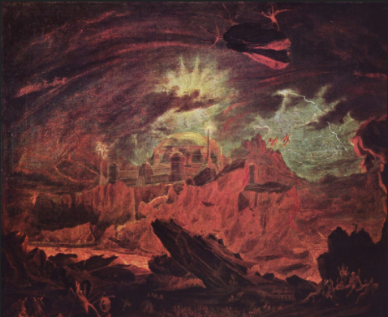
Recreational taxes in limbo
Washington
Colorado
Others
Notes:
Possession is legal, but commerce hasn’t started in WA and CO.
Some California jurisdictions passed taxes in 2010 in case that year’s legalization initiative passed, and those taxes are ready to spring into collection mode if and when CA legalizes recreational

Slide 49

Washington State
In limbo 25 percent tax at three levels:
Grower to processor
Processor to retailer
Retailer to consumer
Notes:
WA state bans vertical integration – like the tied house rules for alcohol. So WA state taxes sales all through the supply chain.
(Give time to read)

Slide 50
Washington State in limbo
Gangs at 258 Table 2
 | Pre-tax price per gram | Excise tax | Sales and business taxes | After-tax price
Producer sells to processor | $3.00 | $0.75 |  | $3.75
Processor sells to retailer | $6.00 | $1.50 |  | $7.50
Retailer sells to consumer | $12.00 | $3.00 | $1.47 | $16.47
Notes:
The prices here may not be right, but the math is. Move cursor 3 times -- 25 percent. 75 cents is 25 percent of 3 dollars etc. We apply these excise taxes three times and then we collect ordinary general sales and business taxes.

Slide 51
WA – less than cigarettes
Excise taxes | $5.25
Sales and business taxes | $1.47
Total taxes | $6.72
After tax price | $16.47
Tax burden | 41 percent
Notes:
Three levels of 25 percent taxes don’t add up to 75 percent. That’s the math. Even with sales and business taxes, we stay at 41 percent of retail price. That’s less than total tobacco taxes in most states.

Slide 52

Colorado in limbo
Initiative November 2012: proposed capped 15 percent excise on sales by producers
Legislature: 10 percent retail?
All taxes require voter OK in November -- TABOR
Notes:
CO’s burden is lighter. The 2012 initiative capped any producer excise taxes at 15 percent. As I sent these slides in, the legislature was considering adding a 10 percent retail tax. ALL those taxes have to go to the voters in November under the CO taxpayer bill of rights.

Slide 53
Possible CO tax burden
 | Pre-tax price per gram | Excise tax | Sales taxes | After-tax price
Producer sells to retailer | $6.00 | $0.90 |  | $6.90
Processor sells to retailer | $12.00 | $1.20 | $0.90 | $14.10
Notes:
Here’s the math on 15 percent at producer level and 10 percent at retail

Slide 54
Possible CO tax
Excise taxes | $2.10
Sales taxes | $0.90
Total taxes | $3.00
After tax price | $14.10
Tax burden | 21 percent
Notes:
And here’s the overall burden under that system. Pretty low.

Slide 55
Dedicated Revenue
WA:
--health and drug abuse
--56% yes
CO
--school construction
--55% yes
Notes:
Since lots of people hate taxes, the drafters of the initiatives sent tax proceeds straight into popular programs. As if money weren’t fungible.

Slide 56

WA, CO: What will the Federal Government do?

Slide 57

WA, CO: Will taxes be nimble enough?
Notes:
The Federal Government would like high prices so product that’s legal in CO doesn’t drift into Kansas and Tennessee – and so Moms won’t become irate about cheap marijuana being available for their kids

Slide 58
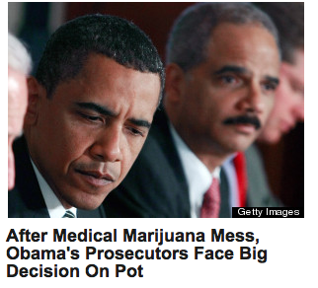
Can’t make states ban possession
Notes:
The Federal Government could shut down the tax laws in WA and CO. But it can’t make the state ban possession, so the federal government has a tough choice: if it shuts down taxation and regulation, it doesn’t have the resources to go after possession.

Slide 59


Prediction
Federal Government will not signal approval for WA or CO
Notes:
Not the green light of approval until they see how the schemes play out

Slide 60
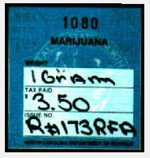
NCGS § 105-113.107. Unreal
Notes:
We have a tax on the books that no one pays unless caught for drugs. Just a fine.

Slide 61
Square footage taxes
Page 257: Rancho Cordova: $48 to $900
  Enacted IF legalization happens
  Prohibition by tax rate?
  Cf. IMT v. City of Lumberton, March 8, 2013
Notes:
Here’s a high square footage tax waiting for California to legalize recreational. There’s a NC SCt case that says a tax on video gaming was so high that it violates the Constiutional requirement that taxes be just and equitable. $5,000 per location plus $2,500 per computer. Looked at increase from $12.50 and said that’s 5,900 percent so it’s bad. I think looking at the absolute level and the burden on business would make more sense.

Slide 62

Unenacted proposals
California’s 2010: punted to localities
CA 2012 failures -- “Gangs” article
20202020
20
2010
Notes:
California has never voted to legalize fully – their tax proposals have been weak. The articles in your materials go into them.

Slide 63
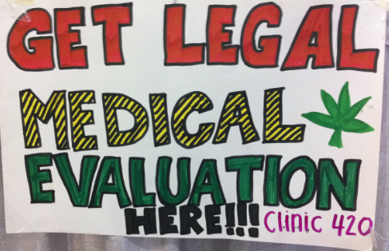
California: wide open – for now

Slide 64
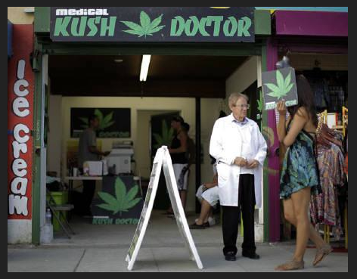
$180
Notes:
$180

Slide 65


Slide 66

California Medical Ass’n: “Help!”

Slide 67
Other proposals
Maine, RI, MD: $50 an ounce indexed
Oregon: $35 an ounce unindexed
Notes:
To tax by weight. The legislatures in ME and OR are worried that if they don’t act soon, the voters will in 2014.

Slide 68
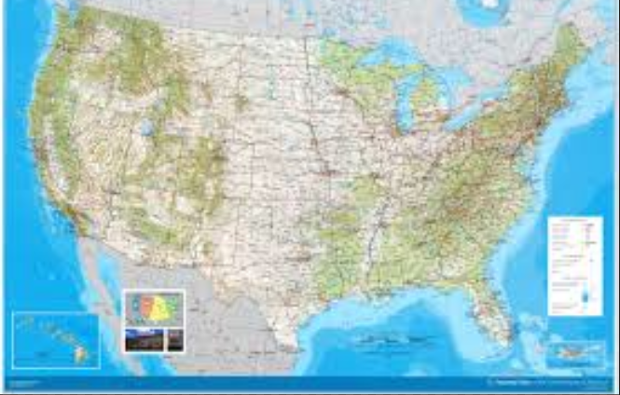
Other models – Federal taxes
Tobacco
Beer
Wine
Liquor
Notes:
So we’ve seen rules and proposals that use marijuana in statutory language. Here’s a quick look at how the FG taxes tobacco and alcohol.

Slide 69

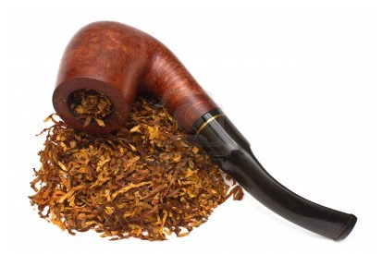
Tobacco
US: weight and type
Europe: weight, price, VAT
Notes:
Tobacco we tax only by weight. We tax tobacco in cigarettes more than we tax pipe tobacco. Europe taxes the heck out of tobacco.

Slide 70

Beer
Federal: $18 a barrel (31 gallons) – not alcohol content
Small brewer exception
Notes:
We tax Bud Light the same as Belgian beer that’s 11 percent alcohol.

Slide 71


Federal Liquor -- $13.50 per proof gallon
Fifth:
100 proof: $13.50/5= $2.70
80 proof : $2.70 X .80 = $2.14
Notes:
For liquor, we tax only alcohol. 80 proof liquor has 80 % of the alcohol of 100 proof liquor, so it bears 80 percent of the tax.

Slide 72
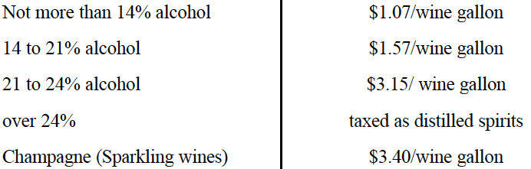
Wine – Potency by Steps or Cliffs
Notes:
We tax wine more if it has more alcohol – with thresholds. A bottle of wine with 14 percent alcohol pays about 31 cents of federal tax.

Slide 73
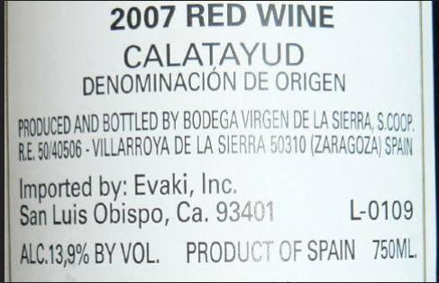

Notes:
This bottle of wine with a tiny bit less alcohol pays about 21 cents of federal tax.

Slide 74

Alcohol potency results
Notes:
I’ll let you read.

Slide 75
Roadmap
Drug and tax policy: Balancing conflicts
Marijuana taxes on the books
Other revenue ideas – Still here
Design issues
NC

Slide 76
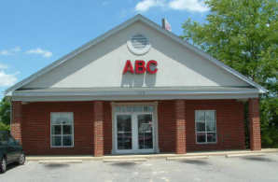
Monopoly
Notes:
We know liquor
ly in North Carolina.

Slide 77
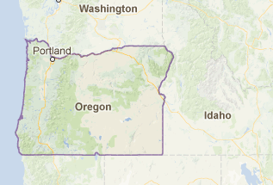
Monopoly 2012: 46 percent yes
Notes:
If you want proof that legalization is on a roll, Oregon nearly passed a crazy initiative that would have put the marijuana business in the control of a 7-member commission. The problem was that 5 of the 7 would have been marijuana growers. That’s letting the fox guard the henhouse.

Slide 78


Notes:
We know monopoly can have problems.

Slide 79


Profit Motive
Notes:
But maybe we don’t want to incentivize workers.

Slide 80
Vigorous, entrepreneurial marijuana industry
Notes:
Mom here is not necessarily in favor of a vigorous entrepreneurial marijuana industry.

Slide 81
Monopoly is nimble
Black market
Notes:
This guy will be changing prices quicker than a gasoline station.

Slide 82
Where we are -- Outline
Tax policy: Balancing conflicts
Marijuana taxes now collected – and in limbo
Pending proposals and other options
Design Issues
Prediction (and prescription?) for NC
Notes:
Having looked at models, we can look at elements of a tax scheme. These elements are things to think about even with monopoly.

Slide 83
Issues
Base: Price, Weight, Potency?
Special rules?
Rates?
Who writes?
Notes:
First issue is the tax base.

Slide 84

Review: Base: Percentage of price only:
ALL enacted marijuana excise taxes
NO tobacco and alcohol taxes
Notes:
So far, marijuana taxes are not following the model of everything else.

Slide 85

Marijuana Potency?
Notes:
Generally defined as quantity of THC, the primary pscychoactive ingredient

Slide 86

Base: Correlation with (excessive) intoxication
Potency – most
Price – some
Weight – least
Notes:
If intoxication is what the public doesn’t like about marijuana, potency – THC content – is the best tax base. Price correlates with potency if more powerful product costs more. Weight treats the most powerful concentrate like ditchweed.

Slide 87
Price base?
Price is proxy for potency.
No new equipment
Need 3d party price
Notes:
Towns know how to slap on a percentage tax. That doesn’t require setting up a weight station or a chemistry lab.

Slide 88

Weight?
Weight base would encourage high potency.
Notes:
If an ounce of ditchweed and an ounce of highly potent concentrate bear the same tax, the seller delivers more bang for the buck to the customer by selling only powerful product. That’s maybe why the tax on a pint of liquor is many times the tax on a pint of beer.

Slide 89
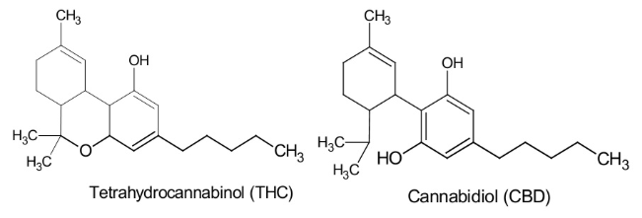
Potency?
Notes:
Measure thc

Slide 90

Why not potency?
Notes:
Just put it in the spectrometer.

Slide 91
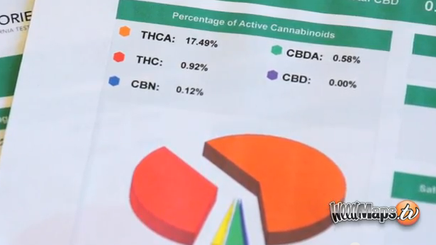
Notes:
Read the printout.

Slide 92


Why not potency?
Notes:
The answer is that this vegetable matter is not fungible. The trichomes have more THC than other parts of the plant, so two people picking out samples to put in the machine may pick samples with widely different amounts of THC.

Slide 93


Dale Gieringer, CA NORML
Notes:
The y axis shows TCH by weight. Samples from the same plant sent to different labs show results from around 11 to 7 percent. That’s not close enough for government work.

Slide 94

Fungible concentrate – Use potency?
Notes:
But chemical processes can produce highly concentrated material that is fungible. Its THC content can be measured reliably.

Slide 95
Fungible liquid or wax – Use potency?
Notes:
This material can be used for cooking – for edibles – or smoked.

Slide 96
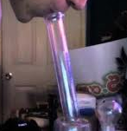
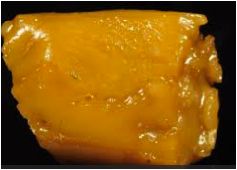
“So high that the user passes out” – sfweekly.com
Notes:
When smoked, it can be very powerful. However we tax plant matter, we may want to tax this wax and edibles made from it by potency.

Slide 97
Issues
Base: Price, Weight, Potency?
Special rules?
Rates?
Who writes?
Notes:
Transitioning – still in issues – to special rules

Slide 98
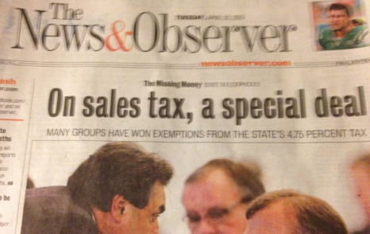
April 2013
Notes:
All parties put in special rules. Isn’t a politician’s job to take care of his people? Some people say “I’m special. My activity is doing great things for the common good, so don’t tax me.” These arguments will show up for legalized marijuana.

Slide 99
Issues: Special rules after legalization?
Medical
Environmentally friendly
Homegrown
Small business
Notes:
Here are some categories I’ll let you read.

Slide 100
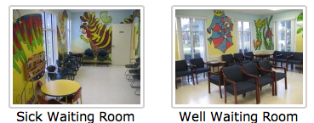
Tax break for medical?
Notes:
Start with patients. Will we have separate stores for patients, kind of like the separate rooms in pediatricians’ offices? That’s what patients in WA and CO are askiing for – different supply chains. Or different prices at the same store?

Slide 101

Argument for tax break
Don’t tax my medicine!
Notes:
I will gleefully stipulate that for some people marijuana is medicine. I’ve heard and read too many stories of miraculous cures and healing. God bless the patients.

Slide 102
God bless the patients.

Slide 103
Arguments against tax break for medical
Revenue
Impostors
Administrability
Affordability
Self-victimization
Notes:
But if marijuana is legal for everyone, there are arguments to treat the patients like everyone else.

Slide 104

Argument against medical tax break -- Revenue
Notes:
Revenue is not enough of a reason to tax patients. We don’t tax penicillin.

Slide 105

Argument against medical tax break --
Faking sickness
Notes:
If folks get a tax break for lying, they may lie. When the 1040 tax return form started requiring children’s SSNs to be claimed as dependents, millions of dependents disappeared from the tax rolls.

Slide 106

Argument against medical tax break --
Administrability
Laws To Tax, fn 213: Statutory pain levels: “chronic,” “severe,” “severe chronic,” “debilitating,” and “intractable”
Notes:
Who can say whether someone’s pain rises to these statutory thresholds? The pain question is harder than qualification for SS disability, which requires huge numbers of lawyers. At least the stakes aren’t as high for a tax break. But maybe states will do like CA and give up.

Slide 107

Argument against medical tax break -- affordability
And license fees
Notes:
Patients will pay less with full legalization – doctors’ fees and license fees will disappear.

Slide 108

Argument against medical tax break -- affordability
General price decrease with legalization
Notes:
Economies of scale should bring prices down.

Slide 109
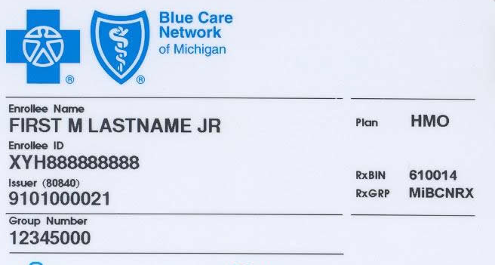
Argument against medical tax break -- affordability
????????
Notes:
Insurance hasn’t covered medical marijuana yet, but it might some day.

Slide 110


Argument against medical tax break --
Self-Victimization
Notes:
If we give you a benefit if you say you’re sick, you might not only SAY you’re sick, you might come to believe you’re sick. Having people feel bad about themselves is not good public policy.

Slide 111
Issues: Special rules?
Medical
Environmentally friendly
Homegrown
Small business
Notes:
Transition

Slide 112
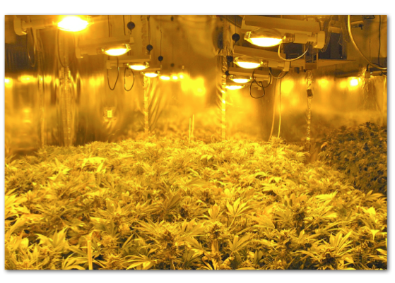
Notes:
Indoor growing – the industry standard – takes a lot of power.

Slide 113

http://evan-mills.com/energy-associates/Indoor_files/420-HSU-Talk-abbreviated.pdf
Notes:
Not just lights; Dehumidification
Ventilation
Last line: data center like Google has in Lenoir: notoriously energy intensive.

Slide 114
Rancho Cordova -- enacted
Indoor cultivated areas up to 25ft² | Indoor cultivated areas 25ft² and over | Outdoor cultivated areas up to 25ft² | Outdoor cultivated areas 25ft² and over
$600/ft² | $900/ft² | $48/ft² | $72 ft²
Notes:
RC taxes energy intensive indoor operations much more than operations that use natural light.

Slide 115
Issues: Special rules?
Medical
Environmentally friendly
Homegrown
Small business

Slide 116


Homegrown exception?
CO: yes; WA: no.
Notes:
You can brew 100 gallons tax free. Similar for wine, but zero tolerance for liquor.
CO 6 plants; WA zero

Slide 117
Issues: Special rules?
Medical
Environmentally friendly
Homegrown
Small business
Notes:
Transition

Slide 118
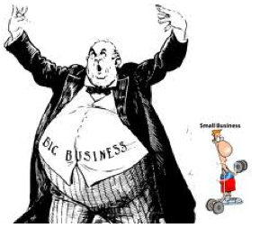
Notes:
Rancho Cordova gives a break for small grows. John Kerrey wants to help small brewers. Lots of folks in the marijuana community don’t want Philip Morris to dominate the industry.

Slide 119

Section 9.04.136 of the Berkeley CA Municipal Code
Notes:
Berkeley, though, favors bigger operators – ones it can get its arms around to regulate and tax. Collecting tax from a handful of businesses easier than collecting from hundreds.

Slide 120
Issues
Base: Price, Weight, Potency?
Special rules?
Rates?
Who writes?
Notes:
Transition

Slide 121

Rates
Notes:
Just right. Not so high that bootleggers prevail; not so low that little tax is collected or the Moms get mad.

Slide 122

Too high: Junior Johnson’s heyday
“A gallon of whiskey [bore] $11 tax. You could make it for 75 cents to a dollar and sell it for $3 or $4.” Golenbock, American Zoom
Notes:
In the early 1950s when the federal tax alone on liquor was $10.50 a proof gallon, the future stars of NASCAR were beating the system. But even with a huge price advantage for moonshine, most people bought tax paid liquor. Now after legalization, states will probably require testing, so bootleg marijuana may have pesticides and fungi that won’t be tolerated in the legal product. Still, bootleg marijuana won’t kill you like bad moonshine could.

Slide 123
Too low?
Oakland, 2009: 1.8 percent of gross receipts
Notes:
Chump change

Slide 124
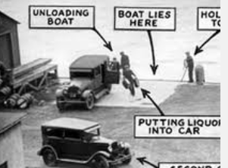
Rates depend on . . . how much enforcement
Notes:
Police activity won’t go away. But after legalization, the law breaker the police are after won’t be a freedom loving rebel. He’ll be a mean spirited tax cheater. I bet the juries that are now nullifying the law with not guilty verdicts for marijuana violators won’t be so quick to let tax cheaters go.

Slide 125

Leakage before collection
Notes:
This consumer will not be paying tax on this shoplifted merchandise.

Slide 126
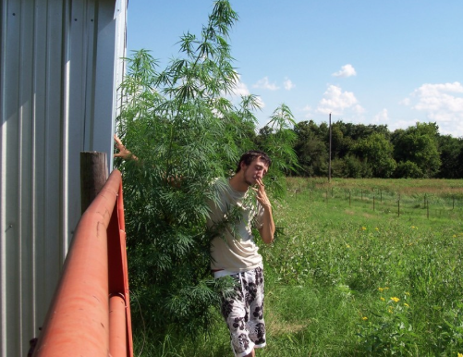
How much can we tax a weed?
Notes:
Some people say you can’t tax marijuana. It grows wild.

Slide 127
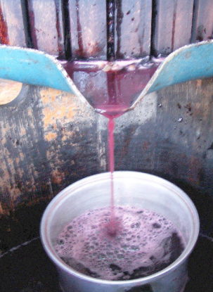
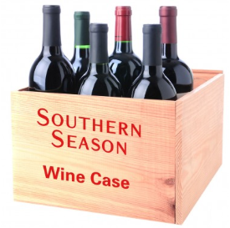
Homemade or store-bought?
Notes:
But consumers are likely to favor a product where they know what they are getting.

Slide 128


Tax evaders
Notes:
And tax evasion is a crime that will still send you to jail.

Slide 129
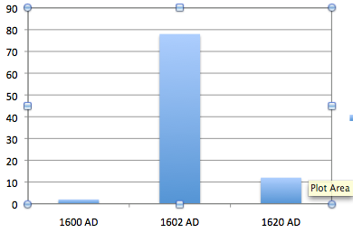
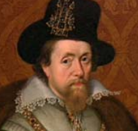
Adjusting rates – English tobacco tax
In pence/lb. 1600, 1602, 1620
Notes:
It’s almost inevitable that we will get rates wrong. There was another case when a new smoking material hit the market. King James I hated tobacco, so he raised the tax from 2 pence to 78 pence in 1602. Tax evasion was so widespread that the rate went down to 12 pence in 1620.

Slide 130
Issues
Base: Price, Weight, Potency?
Special rules?
Rates?
Who writes?

Slide 131

Notes:
Skip to 139???
The states in red allow citizens to petition for changes in the law that get on the ballot.

Slide 132

Marijuana activists?
Notes:
Who writes the laws out west?

Slide 133


So far, funded by
Billionaires paying for signature collection
Notes:
There’s a high number of signatures required to get an initiative on the ballot typically. It takes millions of dollars these days to get an initiative voted on. 2 wealthy men have provided most of the funding for those efforts – and for the media campaigns. GS and Peter L

Slide 134
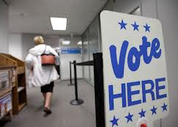
Sent to voters

Slide 135
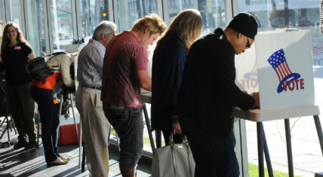
Up or down

Slide 136
Can Legislature amend initiative?
CA: never
CO: not if Constitutional amendment
WA: 2/3 of each House until after 2 years
OR: immediately
Notes:
Different states have different rules about whether the legislature can change a voter passed initiative. If you wonder why CA is dysfunctional, maybe it’s because only voters can change the laws they pass.

Slide 137
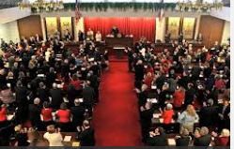
In all states . . . Legislatures

Slide 138
A.D. 20xx? 2025?
Notes:
How might NC proceed?

Slide 139
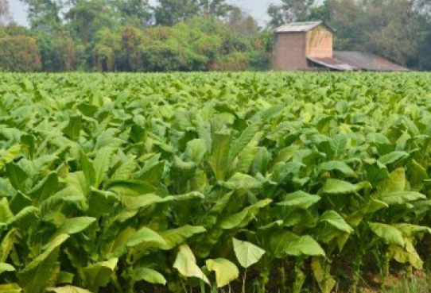
NC Advantages
Learning
Monopoly experience with alcohol
Legislature only
Tobacco heritage

Slide 140


Another NC Advantage?
No medical yet
Leapfrog
Notes:
Box canyon
Medical patients and people in the medical marijuana BUSINESS create problems for legalization. In WA state, the main opposition to legalization in 2012 was from the medical marijuana industry.

Slide 141
“If marijuana were legal in NC, do you think it should be taxed and sold in state-owned stores the way liquor is, or in private retail stores, like beer and wine are?”
(What do you think?)
Notes:
I learned from Richard W that for $100 I could get a polling company to ask 1000 voters a Q, so I did.

Slide 142

State-owned stores . 58%
Private stores......... . 19%
NC poll
March 2013, Center for New Revenue
Notes:
Better than 3 to 1. 23 percent undecided.

Slide 143

Notes:
Liberals and conservatives
Libertatian vs 11 percent

Slide 144

Notes:
Regions by area code

Slide 145

Notes:
With one exception, every demographic group – race, gender, you name it – supported state monopoly.

Slide 146

National data 1994-present
Notes:
Nationally, support for legal marijuana is the green line. Gay marriage and marijuana use are getting more popular. But views on abortion, the orange line, are not changing.

Slide 147

Put on the green eyeshade
Revenue estimating land
Notes:
Heading into unknown territory. I think it’s hard to think of a tax system. Figuring out how much revenue taxes could bring in is even foggier.

Slide 148

$30 billion a year market size

Slide 149

80% x $30 billion = $24 billion

Slide 150
Miron/Cato estimate $8.7 billion
<$30 billion market
<80 % rate
2008 dollars

Slide 151
WA: $564 million a year
<7 million people
NC: 9.7 million people
NC: Nearly $800 million per year
??????
Notes:
Official estimate. $82 per person, Not per smoker. It may not make sense to apply numbers to NC because there are more users out there.
Most people think that estimate is too high. I said so in Gangs. Unless there is a lot of tourism or unless they raise the rates to make up for the drop in price that economies of scale can bring.

Slide 152

Revenue
http://www.huffingtonpost.com/2013/04/20/marijuana-per-ounce-price_n_3094520.html
Notes:
62 cents and ounce or 10 dollars a pound. It doesn’t cost that much to grow tobacco, but you don’t need the security of a diamond mine there. Maybe it will cost $1 or $2 an ounce. There’s still a lot of profit.

Slide 153
$79.92 - $0.62 = $79.30/oz.
Notes:
$10 for 1/8 ounce or $80 an ounce is really low and reflects some economies of scale under partial legalization. There’s still a lot of profit.

Slide 154


???????????
Notes:
The only way we could get all that profit is to have State College do the growing and have a seed to store monopoly. I’m skeptical.

Slide 155

Who gets the profit? Gangs?

Slide 156

Who gets the profit? Ganjapreneurs?

Slide 157

Who gets the profit? Government?

Slide 158
Tax policy: Balancing conflicts
Models: existing and proposed
Design issues
NC

Slide 159

Goals: for you to see
Role of revenue
Options for NC
Conflict in the raw

Slide 160

20??

Slide 161
po@newrevenue.org
Thank you!
Questions and comments?

Slide 162

“Small things with great love.”

