Slide 1

Revenue from Cannabis
Pat Oglesby ISSDP Rome2014
www.newrevenue.org

Slide 2
3 Big Questions
Tax: Whether: Yes or No?
If Yes:
  How much?
  How? Measure $ (€, £, ¥)? Gm? THC?

Slide 3
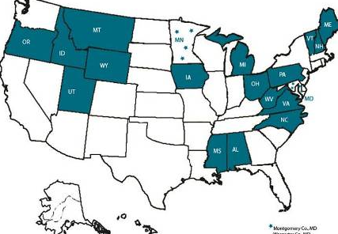
Whether?
Non-commercial alternatives: pages 12-13
Monopoly alternative: pp. 3-5
  Liquor monopolies
  Reversible
  Nimble pricing
  Limits profit motive

Slide 4
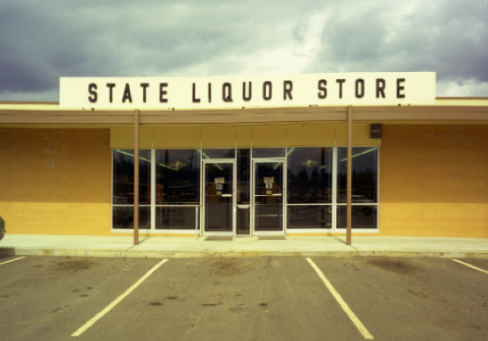

Slide 5


Slide 6
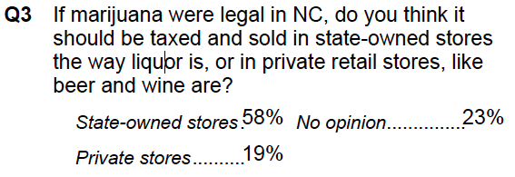
611 respondents, March 7-10, 2013, Public Policy Polling

Slide 7
¡Uruguay, Si! ¡Taxes, No!?
But U.S. Federal law prevents state monopoly
Anyway, assuming tax model: How much?
  A story

Slide 8
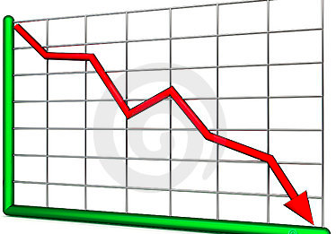
How much tax?
(Pre-tax Prices ➔)
Post-tax price:
  Not too high
  Not too low

Slide 9
Tax as % of final price
Cigarettes in Europe: 70% and more
Marijuana in Washington ≈ 35% to 40%
Marijuana in Colorado ≈ 20%
  Showing those % numbers: 2 next slides at www.newrevenue.org show rough relationship by assuming, rightly or wrongly:
  Certain markups
  $20 price per unit (1/8 oz.?) at wholesale
  $40 price per unit at retail

Slide 10
 | Washington
 | Pre-tax | Rate | Tax | After-tax
Producer | $10 | 25% | $2.5 | $12.5
Wholesaler | $20 | 25% | $5 | $25
Retailer | $40 | 25% | $10 | $50
 |  |  | $17.5
Tax = $17.5/$50 = 35%

Slide 11
 | Colorado
 | Pre-tax | Rate | Tax | After-tax
Wholesaler | $20 | 15% | $3 | $23
Retailer | $40 | 12.9% | $5.16 | $45.16
 |  |  | $8.16
Tax = $8.16/$45.16 = 18%

Slide 12
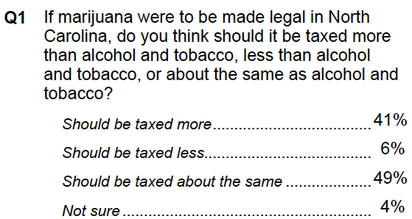
884 respondents, March 6-9, 2014, Public Policy Polling

Slide 13
Tax breaks: Medical and homegrown?
  Colorado: 64% of market still medical, ≈ tax-free

Slide 14
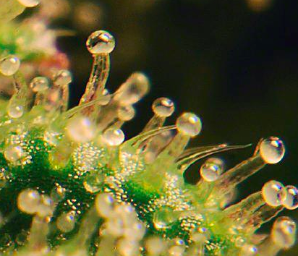
What to tax?
Potency: p. 6-7
(Price)
(Weight)

Slide 15
Price Tax Base: Problems
Bundling: p. 9 at bottom
Vertical Integration: p. 10 at n. 38
Price base amplifies problem of price drop
Tax rate | 100% | $5/gram | 100% | $5/gram
Pre-tax price | $5 | $5 | $1 | $1
Tax | $5 | $5 | $1 | $5
After-tax price | $10 | $10 | $2 | $6

Slide 16
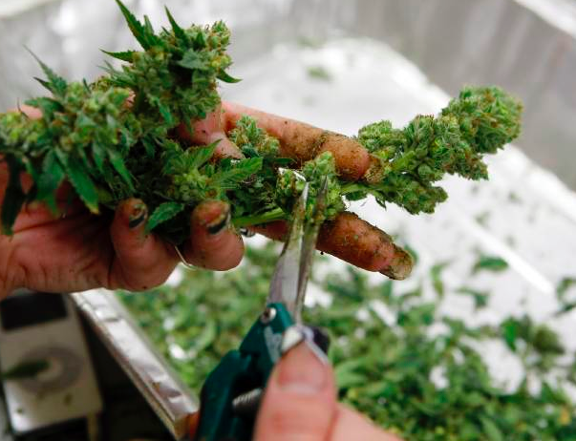
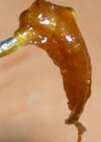
Weight: P. 7-8
  Incentive for potent marijuana
  So . . . new ideas:
    Bud vs. Trim: CO now: 62¢/gm vs. 10¢/gm
    Dry vs. Concentrated: NY proposed: $1.76 vs. $7.05/gm

Slide 17
Other Questions: P. 11
Where to collect? Early in supply chain
Environmental friendliness?
Small business?

Slide 18
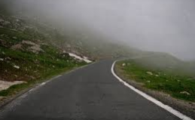
Revenue: For Gangs, Ganjapreneurs, or Government?
Surprises are coming. Nimbleness is needed.
More at www.newrevenue.org.
Suggestions to po@newrevenue.org. Thank you.

