Slide 1
Marijuana Revenue
Pat Oglesby
newrevenue.org
FTA August 18, 2014
Notes:
For lawyers

Slide 2
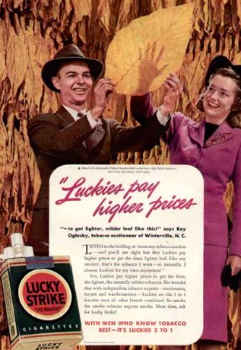


Slide 3

First U.S. marijuana tax
Oakland, CA, July 21, 2009: 1.8 percent of gross receipts
Notes:
A tiny tax at retail – enacted in referendum with 80 percent of voters saying yes. Oakland has its fiscal troubles, and the marijuana community stepped up in a small way.

Slide 4
Next?
Lots of bills
November: Oregon and Alaska vote
Vermont legislative study
California Lt. Gov. Blue Ribbon Commission

Slide 5
Questions for marijuana tax
What base?
Where collected?
What exceptions?
How much tax?
What enforcement?

Slide 6
What base?
Potency (THC) ≈ tar or nicotine
Price
Weight
Hothouse electricity
Property taxes: Plants or Square feet
Or/and . . . State monopoly sales

Slide 7

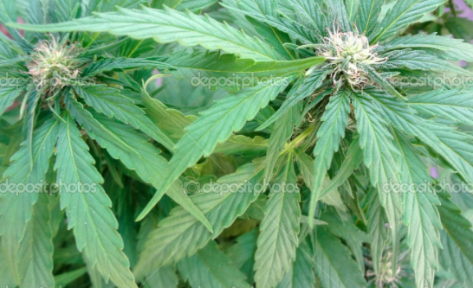
Why not THC potency?
Notes:
Just put it in the spectrometer.

Slide 8


Why not THC base?
Notes:
The answer is that this vegetable matter is not fungible. The trichomes have more THC than other parts of the plant, so two people picking out samples to put in the machine may pick samples with widely different amounts of THC.

Slide 9

Dale Gieringer, CA NORML
Notes:
The y axis shows TCH by weight. Samples from the same plant sent to different labs show results from around 11 to 7 percent. That’s not close enough for government work.

Slide 10
BOTEC

Slide 11
Liquid or wax – Use potency?
Notes:
This material can be used for cooking – for edibles – or smoked.

Slide 12

Ad valorem base?
Price ≈ proxy for potency
Don’t need indexing
No new equipment
But need 3d party price
Notes:
Towns know how to slap on a percentage tax. That doesn’t require setting up a weight station or a chemistry lab.

Slide 13
3d Party price?
??: Wholesale tax on vertically integrated company
??: Craigslist: “Be 21 or older and receive a gift of 3 grams of marijuana (free) with a $30 purchase of glass, tobacco or related item not marijuana.”

Slide 14



Weight base?
Weight base would encourage high potency.
Notes:
If an ounce of ditchweed and an ounce of highly potent concentrate bear the same tax, the seller delivers more bang for the buck to the customer by selling only powerful product. That’s maybe why the tax on a pint of liquor is many times the tax on a pint of beer.

Slide 15
Bud taxed more than trim?

Slide 16
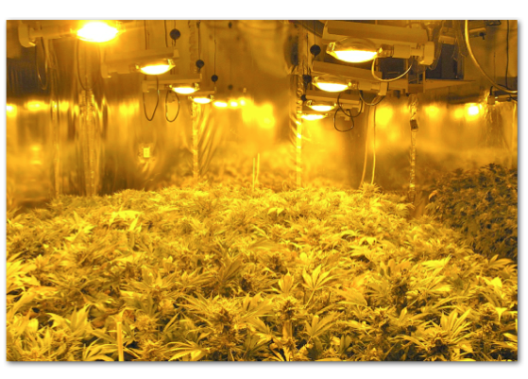
Hothouse electricity base
Notes:
Indoor growing – the industry standard – takes a lot of power.

Slide 17

http://evan-mills.com/energy-associates/Indoor_files/420-HSU-Talk-abbreviated.pdf
Notes:
Not just lights; Dehumidification
Ventilation
Last line: data center like Google has in Lenoir: notoriously energy intensive.

Slide 19
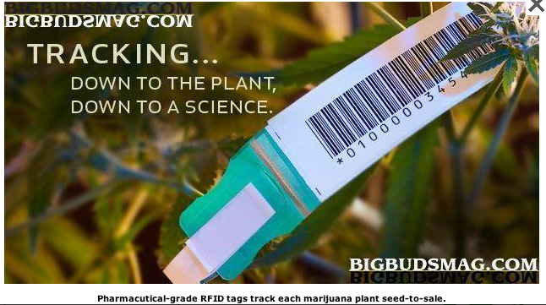
Mendocino CA: $50 per plant base
Notes:
Put a RFID zip-tie tag on each plant, and charge for it.

Slide 20
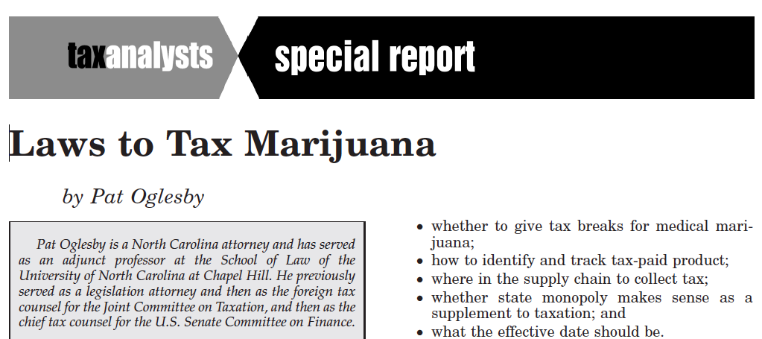

Square footage base
Medical CA localities: from $10 to $25
Rancho Cordova CA recreational: $48 to $900
Notes:
Taxes on grow areas. They can grow a lot of profitable product in a tiny area.

Slide 21


State monopoly

Slide 22

Collection (choke) point(s)
Notes:
This consumer will not be paying tax on this shoplifted merchandise.

Slide 23
Special rules
(Environmental)
Medical
Homegrown
Small business – or large

Slide 24


Slide 25

To get medical marijuana
Statutory pain levels: “chronic,” “severe,” “severe chronic,” “debilitating,” and “intractable”
Notes:
Who can say whether someone’s pain rises to these statutory thresholds? The pain question is harder than qualification for SS disability, which requires huge numbers of lawyers. At least the stakes aren’t as high for a tax break. But maybe states will do like CA and give up.

Slide 26


Homegrown exception?
CO: yes; WA: no.
Notes:
You can brew 100 gallons tax free. Similar for wine, but zero tolerance for liquor.
CO 6 plants; WA zero

Slide 27

Favoring big businesses
Section 9.04.136 of the Berkeley CA Municipal Code
Notes:
Berkeley, though, favors bigger operators – ones it can get its arms around to regulate and tax. Collecting tax from a handful of businesses easier than collecting from hundreds.

Slide 28
How much?

Slide 29

Black market will be cheaper
“A gallon of whiskey [bore] $11 tax. You could make it for 75 cents to a dollar and sell it for $3 or $4.” Golenbock, American Zoom
Notes:
In the early 1950s when the federal tax alone on liquor was $10.50 a proof gallon, the future stars of NASCAR were beating the system. But even with a huge price advantage for moonshine, most people bought tax paid liquor. Now after legalization, states will probably require testing, so bootleg marijuana may have pesticides and fungi that won’t be tolerated in the legal product. Still, bootleg marijuana won’t kill you like bad moonshine could.

Slide 30
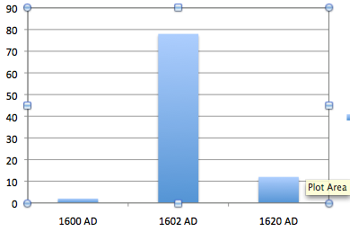
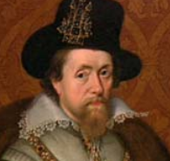
Adjusting rates – English tobacco tax
In pence/lb. 1600, 1602, 1620
Notes:
It’s almost inevitable that we will get rates wrong. There was another case when a new smoking material hit the market. King James I hated tobacco, so he raised the tax from 2 pence to 78 pence in 1602. Tax evasion was so widespread that the rate went down to 12 pence in 1620.

Slide 31
U.S. Marijuana market:
-- $30 to $40 billion?
-- At $200/oz., about 5,000 tons.
(World tobacco market
-- $500 billion?
-- 7 million tons?)

Slide 32
Enforcement against Evaders
Illegal to possess non-tax paid marijuana?
Lots of small producers? Leakage?
Genetic markers?
1933 plan – wipe out efficient bootleggers

Slide 33
Please send corrections, questions, and comments to po@newrevenue.org.
Thank you.
Pat Oglesby

