Slide 1
Excise Taxes, Including Cannabis
Pat Oglesby
www.newrevenue.org
Duke
Peter Barnes’s class
27 October 2105
Notes:
Floyd flood – 35 in NC

Slide 2
Singling out goods and services
4 Rationales
Sin
Externalities
Benefit
Luxury/Progressivity

Slide 3
Better than income or sales?
Tobacco
Alcohol
Cannabis
Carbon and Pollution

Slide 4
Problems with excise taxes
Fairness over simplicity
Substitutes and arbitrariness (soda and cake)
Unintended consequences (carbon and cannabis)
Revenue or behavior
Regressivity
State profiting from “sin”

Slide 5

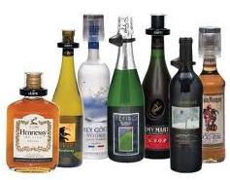
Excise Design
History
What to tax -- Base
Collection point
How much -- Rate
Exceptions

Slide 6

History: From primitive to sophisticated
Licenses
Duties
Proxies

Slide 7

History: Tavern licenses

Slide 8

History: Customs duties

Slide 9
History: Proxies for alcohol
MA 1673: malt
1764 British Sugar Act: Molasses tax
1790s: Still capacity

Slide 10
Base:
Alcohol excise: Volume or price?
Massachusetts
  1641 – volume
  1645 – price
  1648 – volume

Slide 11

Base in the USA: 1791 Whisky
Based on alcohol content (proof), not price

Slide 12
Federal taxes 2015
Liquor: Potency: $13.50 per proof gallon ($6.25 per gal. of alcohol)
Beer: Volume: $18/barrel not matter the alcohol content

Slide 13
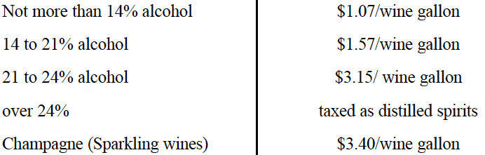
Wine – Potency by Steps or Cliffs
Notes:
We tax wine more if it has more alcohol – with thresholds. A bottle of wine with 14 percent alcohol pays about 31 cents of federal tax.

Slide 14
How much: rates in history
Case study: Spirits -- USA
FROM | TO | per proof gallon
08/01/1862 | 03/07/1864 | $0.20
03/07/1864 | 07/01/1864 | $0.60
07/01/1864 | 01/01/1865 | $1.50
01/01/1865 | 07/20/1868 | $2.00
07/20/1868 | 06/06/1872 | $0.50

Slide 15
How much: Recent Federal liquor tax rate per proof gallon
1934 | 1938 | 1940 | 1942 | 1944 | 1951 | 1985 | 1991
$2.00 | $2.25 | $3.00 | $6.00 | $9.00 | $10.50 | $12.50 | $13.50

Slide 16
Federal liquor tax -- potency
Fifth of liquor:
100 proof: $13.50/5= $2.70
80 proof : $2.70 X .80 = $2.14
Notes:
For liquor, we tax only alcohol. 80 proof liquor has 80 % of the alcohol of 100 proof liquor, so it bears 80 percent of the tax.

Slide 17
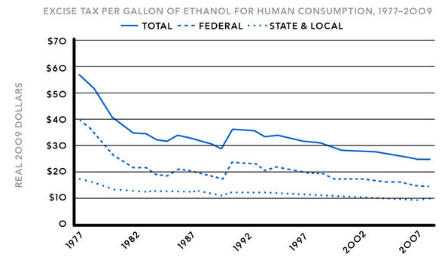
Unindexed

Slide 18
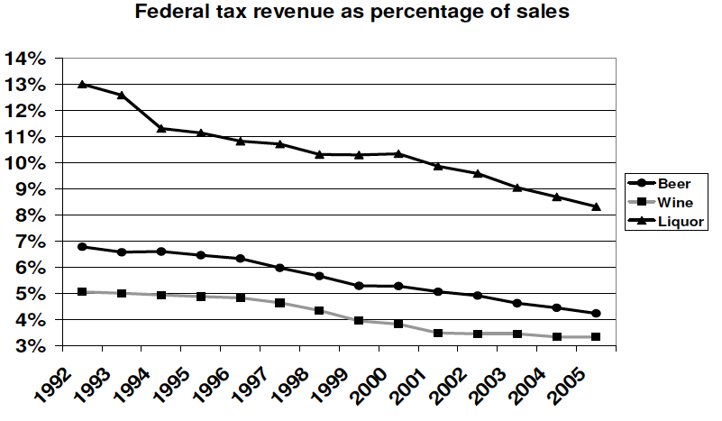

Slide 19

How much: Junior Johnson’s heyday
“A gallon of whiskey [bore] $11 tax. You could make it for 75 cents to a dollar and sell it for $3 or $4.” Golenbock, American Zoom

Slide 20
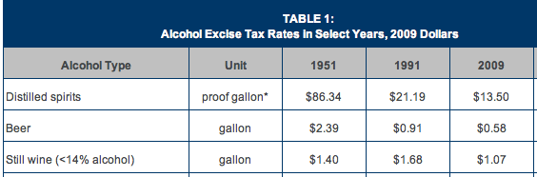
From too much to not enough?

Slide 21
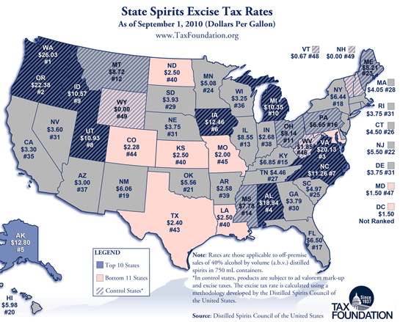

Slide 22
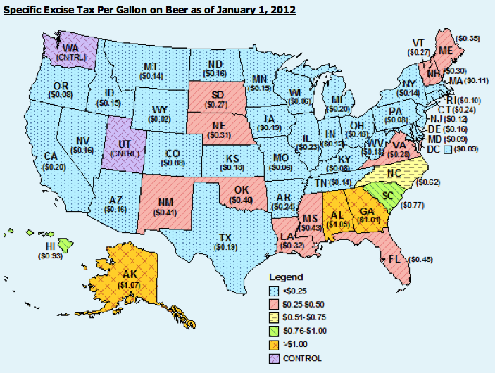

Slide 23
Tax breaks: VA special interests
1691 liquor customs rates:
4 pence/gal. generally
2 pence/gal. for VA-owned ships
Zero for VA-built ships.

Slide 24

Special tavern licenses
“Outdoor retailers" faced a higher excise tax increase than others in NH in 1741. Alvin Rabushka, Taxation in Colonial America. Did they make more noise? Were they more mobile and harder to police?

Slide 25


Slide 26

Now to cannabis
Light weight
Easy to grow
Spray marker – like red dye
Cameras

Slide 27
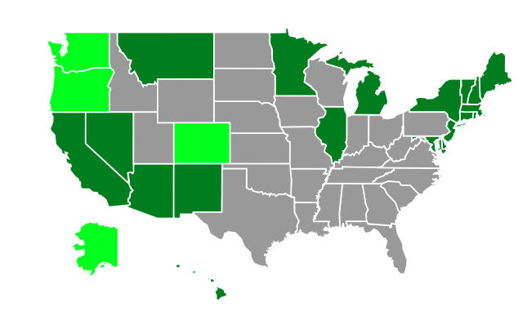

Slide 28
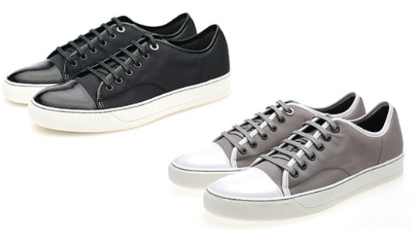
General Sales Taxes on Medical Marijuana
State | Arizona | Maine
Taxes | 6.6% sales tax | 5% sales tax; 7% meals tax on edibles
Notes:
Without using the word marijuana, many states collect sales taxes on medical marijuana just like they do on shoes. In Maine, you buy a brownie, you pay 7 percent sales tax. You buy a marijuana brownie, you pay 7 percent sales tax – even though it’s medicine.

Slide 29

All electricity usage over 600% of Baseline – general Arcata CA tax
Notes:
Another way of taxing marijuana without using the word marijuana is to tax indoor grow operations that use a lot of electricity – In the case of Arcata, more than 6 times the average for that size building.

Slide 30
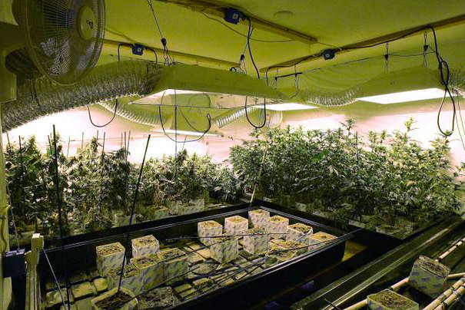

Slide 31

http://evan-mills.com/energy-associates/Indoor_files/420-HSU-Talk-abbreviated.pdf
Notes:
Some highlights: Grow lights; Dehumidification
Ventilation
Last line: data center like Google has in Lenoir: notoriously energy intensive.

Slide 32
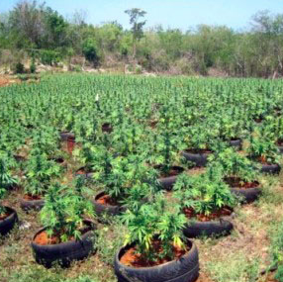

Slide 33
Taxing cannabis by name
3 main bases
Price
Weight
Potency

Slide 34

Base: Correlation with intoxication
Potency – most
Price – some
Weight – least
Notes:
If intoxication is what the public doesn’t like about marijuana, potency – THC content – is the best tax base. Price correlates with potency if more powerful product costs more. Weight treats the most powerful concentrate like ditchweed.

Slide 35

Advantages of price base
Municipal know-how
Easy to measure
Price is proxy for potency?
Notes:
Towns know
to slap on a percentage tax. That doesn’t require setting up a weight station or a chemistry lab.

Slide 36
Price base problems
Predictable price collapse
Free pot with pipe (bundling)
Related party discount
One solution: Sell only cannabis

Slide 37



Why not weight?
Weight base would encourage high potency.
Notes:
If an ounce of ditchweed and an ounce of highly potent concentrate bear the same tax, the seller delivers more bang for the buck to the customer by selling only powerful product. That’s maybe why the tax on a pint of liquor is many times the tax on a pint of beer.

Slide 38

Why not potency?

Slide 39

Why not potency?

Slide 40
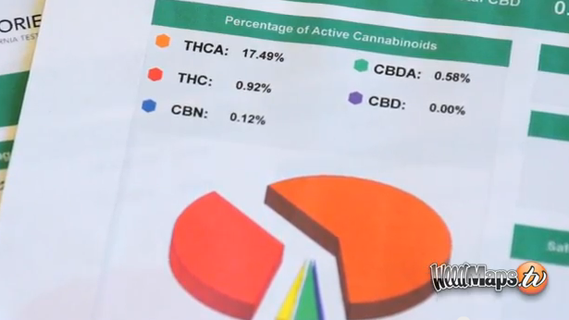

Slide 41


Why not potency?
Notes:
The answer is that this vegetable matter is not fungible. The trichomes have more THC than other parts of the plant, so two people picking out samples to put in the machine may pick samples with widely different amounts of THC.

Slide 42


Dale Gieringer, CA NORML
Notes:
The y axis shows TCH by weight. Samples from the same plant sent to different labs show results from around 11 to 7 percent. That’s not close enough for government work.

Slide 43


Fungible concentrate – Use potency?

Slide 44
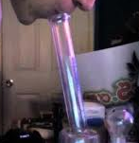
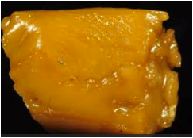
“So high that the user passes out” – sfweekly.com
Notes:
When smoked, it can be very powerful. However we tax plant matter, we may want to tax this wax and edibles made from it by potency.

Slide 45
From theory to practice

Slide 46


World’s first marijuana tax
Oakland, CA, July 21, 2009: 1.8 percent of gross medical receipts
Notes:
A tiny tax at retail – enacted in referendum with 80 percent of voters saying yes. Oakland has its fiscal troubles, and the marijuana community stepped up in a small way.

Slide 47
Nov. 2010 California Price-Based Taxes
Medical retail rates from 2.5 % to 15%
City | Albany | Berkeley | La Puente | Long Beach | Oakland | Rancho Cordova H | Richmond | Sacra-mento | San Jose | Stockton
Medical marijuana tax | 2.5% | 2.5% | 10% |  | 5%, up from 1.8% | 12% to 15% | 5.0% | 4.0% | Up to 10% | 2.5%
Recreational tax (if Prop 19 passed) | 2.5% | 10% | 10.0% | 15.0% | 10% | 12% to 15% | 5.0% | 10.0% | Up to 10% | 10%
Voters in favor | 84.2% | 82.4% | 68.0% | 73.1% | 70.8% | 68.5% | 78.2% | 71.8% | 77.7% | 66.7%
Notes:
You can see this data in the handout. Nobody has a rate as low as Oakland’s initial rate. Oakland is up to 5 percent

Slide 48
2010 CA medical: Non-price tax bases
City | Albany | Berkeley | Berkeley | Long Beach | Long Beach | Rancho Cordova H | Rancho Cordova O | Rancho Cordova O | Rancho Cordova O | Rancho Cordova O
Square footage taxpayer | Non profits | Non-profit medical marijuana operations | Non-profit medical marijuana operations | All for-profits | All not for-profits | Nonprofit entities | Individuals | Individuals | Individuals | Individuals
Square footage base | All indoor space | All property up to 3000 ft² | All property 3000 ft² and over | All indoor space | All indoor space | All indoor space | Indoor cultivated areas up to 25ft² | Indoor cultivated areas 25ft² and over | Outdoor cultivated areas up to 25ft² | Outdoor cultivated areas 25ft² and over
Square footage tax rate | $25/ft² | $25/ft² | $10/ft² | $25/ft² indexed | $10/ft² indexed | $100/ft² | $600/ft² | $900/ft² | $48/ft² | $72 ft²
Alternative per-plant tax |  |  |  |  |  |  | $600 | $900 | $600 | $900
Voters in favor | 84.2% | 82.4% | 82.4% | 73.1% | 73.1% | 68.5% | 56.4% | 56.4% | 56.4% | 56.4%
This tiny print is summarized on the next slide.
Notes:
Again in the handout, and on the next slide

Slide 49

California canopy tax bases
Square footage taxes from $10 to $900
Some are indexed for inflation
Notes:
Taxes on grow areas. They can grow a lot of profitable product in a tiny area.

Slide 50
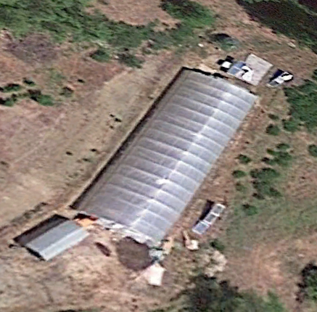
Google Earth Garberville, California

Slide 51
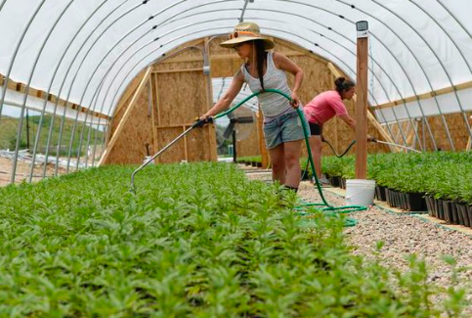

Slide 53

Mendocino: $50 per plant
Notes:
Put a RFID zip-tie tag on each plant, and charge for it.

Slide 54

Colorado
15 percent producer
  Vertical integration
  Converted to weight
  7 categories
10 percent retail
General sales taxes, also on medical

Slide 55

Bud (flowers) v. Trim (leaves)

Slide 56
Washington State passed – 3 x 25%
 | Pre-tax price per gram | Excise tax | Sales and business taxes | After-tax price
Producer sells to processor | $3.00 | $0.75 |  | $3.75
Processor sells to retailer | $6.00 | $1.50 |  | $7.50
Retailer sells to consumer | $12.00 | $3.00 | $1.47 | $16.47
Notes:
The prices here may not be right, but the math is. Move cursor 3 times -- 25 percent. 75 cents is 25 percent of 3 dollars etc. We apply these excise taxes three times and then we collect ordinary general sales and business taxes.

Slide 57

WA tax
Excise taxes | $5.25
Sales and business taxes | $1.47
Total taxes | $6.72
After tax price | $16.47
Tax burden | 41 percent
Notes:
Three levels of 25 percent taxes don’t add up to 75 percent. That’s the math. Even with sales and business taxes, we stay at 41 percent of retail price. That’s less than tobacco taxes in most states.

Slide 58
Oregon
Voters: $35 for bud, $10 for trim -- producer
Legislature: up to 20 percent retail
Rationale: protect growers and patients
Effective 1-1-2016

Slide 59
Alaska
$50 generally; exceptions for weaker parts of the plant
Not effective yet – no legal sales

Slide 60
New York PROPOSAL
$50 per ounce for plant matter, $200 for concentrates

Slide 61
Massachusetts PROPOSAL
By ounce for plant matter, by ounce of THC for concentrates
Tobacco – not by tar and nicotine content anywhere

Slide 62
Indexing

Slide 63
Special rules

Slide 64


Slide 65
Medical patients
Colorado – sales tax only
Washington – all taxes except sales tax

Slide 66
Issues: Special rules after legalization?
Medical
Environmentally friendly
Homegrown
Small business
Notes:
Here are some categories I’ll let you read.

Slide 67

Argument for tax break
Don’t tax my medicine!
Notes:
I will gleefully stipulate that for some people marijuana is medicine. I’ve heard and read too many stories of miraculous cures and healing. God bless the patients.

Slide 68
Arguments against tax break for medical
Revenue
Impostors
Administrability
Affordability
Self-victimization
Notes:
But if marijuana is legal for everyone, there are arguments to treat the patients like everyone else.

Slide 69

Argument against medical tax break -- Revenue
Notes:
Revenue is not enough of a reason to tax patients. We don’t tax penicillin.

Slide 70

Argument against medical tax break --
Faking sickness
Notes:
If folks get a tax break for lying, they may lie. When the 1040 tax return form started requiring children’s SSNs to be claimed as dependents, millions of dependents disappeared from the tax rolls.

Slide 71

Argument against medical tax break --
Administrability
Laws To Tax, fn 213: Statutory pain levels: “chronic,” “severe,” “severe chronic,” “debilitating,” and “intractable”
Notes:
Who can say whether someone’s pain rises to these statutory thresholds? The pain question is harder than qualification for SS disability, which requires huge numbers of lawyers. At least the stakes aren’t as high for a tax break. But maybe states will do like CA and give up.

Slide 72

Argument against medical tax break -- affordability
And license fees
Notes:
Patients will pay less with full legalization – doctors’ fees and license fees will disappear.

Slide 73

Argument against medical tax break -- affordability
General price decrease with legalization
Notes:
Economies of scale should bring prices down.

Slide 74

Argument against medical tax break --
Self-Victimization
Notes:
If we give you a benefit if you say you’re sick, you might not only SAY you’re sick, you might come to believe you’re sick. Having people feel bad about themselves is not good public policy.

Slide 75
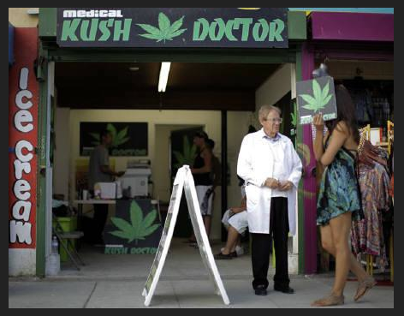

Slide 76
Small business rules
Humboldt County, CA, proposal for canopy – under 600 feet, no tax; 600 and over: $1 per foot.
California proposal: first 500 pounds at a lower rate (?)
Another California proposal: lower per-gram rate for small farms (creates cliff).

Slide 77

Section 9.04.136 of the Berkeley CA Municipal Code
Notes:
Berkeley, though, favors bigger operators – ones it can get its arms around to regulate and tax. Collecting tax from a handful of businesses easier than collecting from hundreds.

Slide 78


Homegrown exception?
CO: yes; WA: no.
Notes:
You can brew 100 gallons tax free
CO 6 plants; WA zero

Slide 79
Monopolies
North Bonneville, Washington
Louisiana State University

Slide 80

Colletion point
Choke point
Notes:
Ideally, where commerce is naturally concentrated.

Slide 81

Notes:
This consumer will not be paying tax on this shoplifted merchandise.

Slide 82
Who writes the rules?

Slide 83


Slide 84

Marijuana activists?

Slide 85


So far, funded by
Billionaires paying for signature collection

Slide 86

Revenue
http://www.huffingtonpost.com/2013/04/20/marijuana-per-ounce-price_n_3094520.html

Slide 87

$79.92 - $0.62 = $99.30/oz.

Slide 88
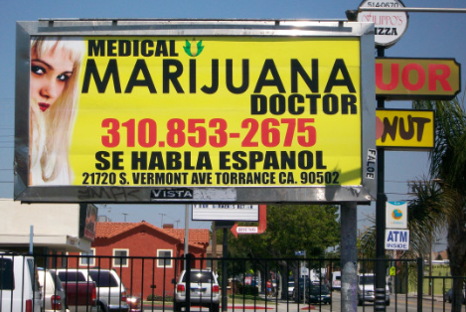

Slide 89
Progressivity
“Using cellular phones, the police can now tap into official tax records, which in Finland are open to the public, and learn within seconds a driver's reported income and the corresponding traffic fine.” http://online.wsj.com/article/SB978398058976592586.html

