Slide 1
Excise Taxes
Duke Law and Public Policy
Peter Barnes’s class
8 November 2016
Pat Oglesby, M.B.A, J.D.
www.newrevenue.org
Notes:
Floyd flood – 35 in NC

Slide 2
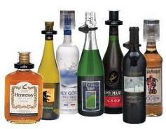

Outline
Overview of excises
2 case studies:
  Alcohol
  Marijuana

Slide 3

Excise defined
A special inland tax levied on specific products sold within a country. [And services]
Vs. VAT or sales:
Narrower range of product
- Typically heavier
Often per unit (weight or volume)
Derivation:

Slide 4
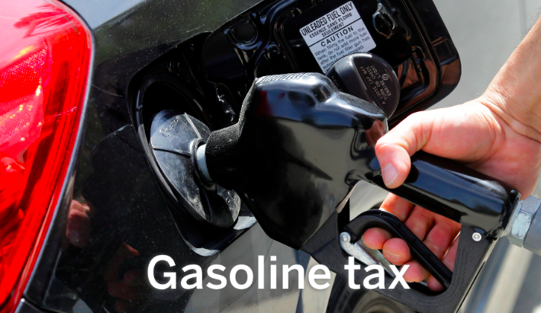
Excise examples
“What are we mad at?”
Tobacco/Alcohol/Marijuana
Sugar
Carbon and Pollution
Rental Cars

Slide 5
Why single out goods or services?
Rationales
Sin
Internalities
Externalities
Benefit
Luxury/Progressivity
Non-residents
Ease of Administration

Slide 6
Problems with excise taxes – (& VAT)?
Line drawing: Categorization needed
Categories unjust (soda and cake)
Bad consequences (lost jobs), like any tax
Get either $ or changed behavior
Regressivity
State profiting from “sin”

Slide 7

Compare taxing payrolls
Pros:
  Ease of administration
  Association with benefits for workers
Con
  Discourages jobs

Slide 8
Alcohol Outline
  What to tax -- Base
  How much -- Rate
  Exceptions

Slide 9

Base history: From primitive to sophisticated
Licenses
Duties
Proxies
Alcohol itself

Slide 10

Primitive base: Tavern licenses

Slide 11

Early base: Customs duties

Slide 12
Proxy bases for alcohol
MA 1673: malt
1764 British Sugar Act: Molasses tax
1790s: Still capacity

Slide 13

Base in the USA: 1791 Whisky
Alcohol content (proof)

Slide 14
Federal taxes base and rates 2016
Liquor: Potency: $13.50 per proof gallon ($6.25 per gal. of alcohol)
Beer: Volume: $18/barrel no matter the alcohol content

Slide 15
How much: rates in history
Spirits -- USA
FROM | TO | per proof gallon
08/01/1862 | 03/07/1864 | $0.20
03/07/1864 | 07/01/1864 | $0.60
07/01/1864 | 01/01/1865 | $1.50
01/01/1865 | 07/20/1868 | $2.00
07/20/1868 | 06/06/1872 | $0.50

Slide 16
How much: Recent Federal liquor tax rate per proof gallon
1934 | 1938 | 1940 | 1942 | 1944 | 1951 | 1985 | 1991
$2.00 | $2.25 | $3.00 | $6.00 | $9.00 | $10.50 | $12.50 | $13.50

Slide 17

Overtaxing: Junior Johnson’s heyday
“A gallon of whiskey [bore] $11 tax. You could make it for 75 cents to a dollar and sell it for $3 or $4.” Golenbock, American Zoom

Slide 18
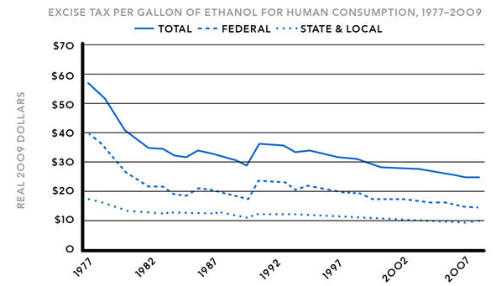
Alcohol taxes – Rate
Unindexed

Slide 19
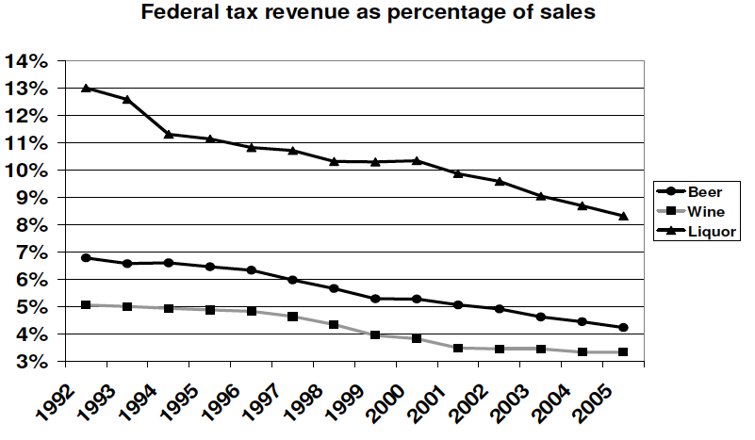

Slide 20
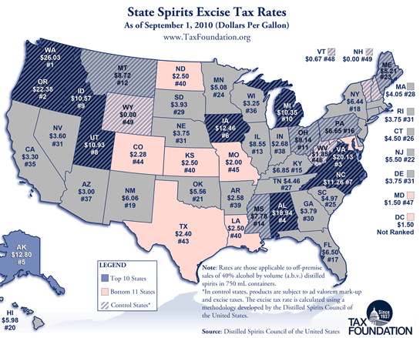

Slide 21
Alcohol Exceptions: Virginia special interests
1691 liquor customs rates:
4 pence/gal. generally
But
  2 pence/gal. for VA-owned ships
  Zero for VA-built ships.

Slide 22

Special tavern licenses
“Outdoor retailers" faced a higher excise tax increase than others in NH in 1741. Alvin Rabushka, Taxation in Colonial America. Did they make more noise? Were they more mobile and harder to police?

Slide 23


Slide 24
Marijuana Outline
  State of play
  Existing taxes -- examples
  What to tax -- Base
  How much -- Rate
  Exceptions

Slide 25
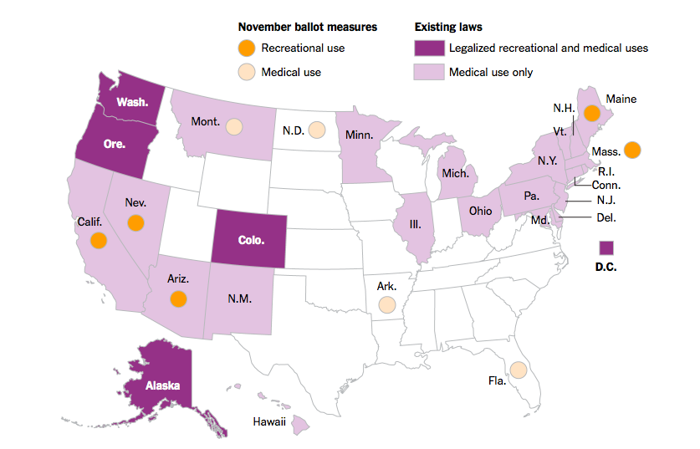

Now to cannabis
Light weight
Easy to grow
Expensive under prohibition

Slide 26


Slide 27

Marijuana activists?

Slide 28

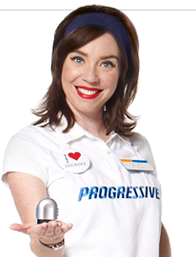
So far, funded by
Billionaires paying for signature collection

Slide 29
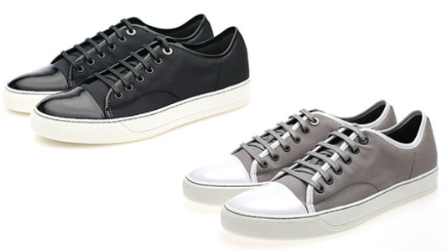
Examples of General Sales Taxes on Medical Marijuana – Some states exempt
State | Arizona | Maine
Taxes | 6.6% sales tax | 5% sales tax; 7% meals tax on edibles
Notes:
Without using the word marijuana, many states collect sales taxes on medical marijuana just like they do on shoes. In Maine, you buy a brownie, you pay 7 percent sales tax. You buy a marijuana brownie, you pay 7 percent sales tax – even though it’s medicine.

Slide 30


World’s first marijuana tax
Oakland, CA, July 21, 2009: 1.8 percent of gross medical receipts
Notes:
A tiny tax at retail – enacted in referendum with 80 percent of voters saying yes. Oakland has its fiscal troubles, and the marijuana community stepped up in a small way.

Slide 31
Nov. 2010 California Price-Based Taxes
Medical retail rates from 2.5 % to 15%
City | Albany | Berkeley | La Puente | Long Beach | Oakland | Rancho Cordova H | Richmond | Sacra-mento | San Jose | Stockton
Medical marijuana tax | 2.5% | 2.5% | 10% |  | 5%, up from 1.8% | 12% to 15% | 5.0% | 4.0% | Up to 10% | 2.5%
Recreational tax (if Prop 19 passed) | 2.5% | 10% | 10.0% | 15.0% | 10% | 12% to 15% | 5.0% | 10.0% | Up to 10% | 10%
Voters in favor | 84.2% | 82.4% | 68.0% | 73.1% | 70.8% | 68.5% | 78.2% | 71.8% | 77.7% | 66.7%
Notes:
You can see this data in the handout. Nobody has a rate as low as Oakland’s initial rate. Oakland is up to 5 percent

Slide 32

California canopy taxes on medical marijuana
Square footage taxes from $10 to $900
Some are indexed for inflation
Notes:
Taxes on grow areas. They can grow a lot of profitable product in a tiny area.

Slide 33
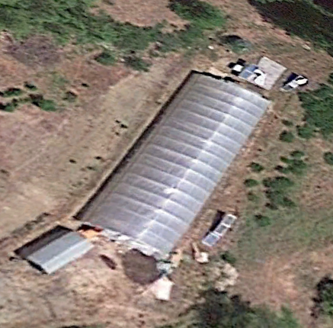
Google Earth Garberville, California

Slide 34
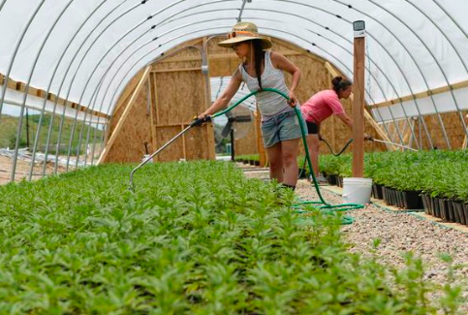

Slide 35
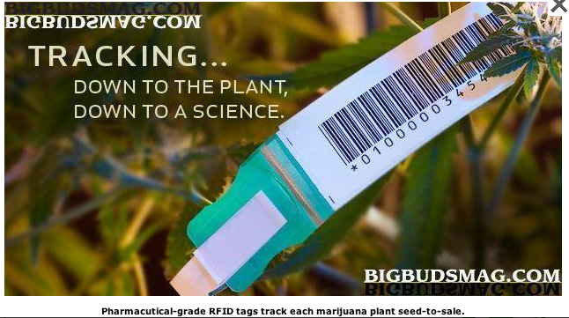
Mendocino: $50 per plant
Notes:
Put a RFID zip-tie tag on each plant, and charge for it.

Slide 36

Colorado
15 percent producer
  Vertical integration
  Converted to weight
  6 categories
10 percent retail
General sales taxes, also on medical

Slide 37

CO: Bud (flowers) – 60 cents/gram v. Trim (leaves) -- 17 cents/gram

Slide 38
Washington State passed – 3 x 25%
 | Pre-tax price per gram | Excise tax | Sales and business taxes | After-tax price
Producer sells to processor | $3.00 | $0.75 |  | $3.75
Processor sells to retailer | $6.00 | $1.50 |  | $7.50
Retailer sells to consumer | $12.00 | $3.00 | $1.47 | $16.47
Notes:
The prices here may not be right, but the math is. Move cursor 3 times -- 25 percent. 75 cents is 25 percent of 3 dollars etc. We apply these excise taxes three times and then we collect ordinary general sales and business taxes.

Slide 39

WA tax now
Recreational 43.5% retail
Medical 37% retail
Notes:
Three levels of 25 percent taxes don’t add up to 75 percent. That’s the math. Even with sales and business taxes, we stay at 41 percent of retail price. That’s less than tobacco taxes in most states.

Slide 40
Oregon
Voters: $35 for bud, $10 for trim -- producer
Legislature amended: up to 20 percent retail
Rationale: protect growers and patients
Effective 1-1-2016

Slide 41
Alaska
$50 generally; lower for weaker parts of the plant

Slide 42

All electricity usage over 600% of Baseline – Arcata California tax
Notes:
Another way of taxing marijuana without using the word marijuana is to tax indoor grow operations that use a lot of electricity – In the case of Arcata, more than 6 times the average for that size building.

Slide 43

http://evan-mills.com/energy-associates/Indoor_files/420-HSU-Talk-abbreviated.pdf
Notes:
Some highlights: Grow lights; Dehumidification
Ventilation
Last line: data center like Google has in Lenoir: notoriously energy intensive.

Slide 44
That’s the state of play.
Now, Theory: Cannabis tax base?
Price
Weight
Potency

Slide 45
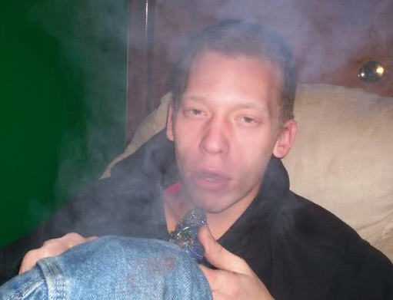
Base: Correlation with intoxication
Potency – most
Price – some
Weight – least
Notes:
If intoxication is what the public doesn’t like about marijuana, potency – THC content – is the best tax base. Price correlates with potency if more powerful product costs more. Weight treats the most powerful concentrate like ditchweed.

Slide 46

Advantages of price base
Municipal know-how
Easy to measure
Price is proxy for potency?
Notes:
Towns know
to slap on a percentage tax. That doesn’t require setting up a weight station or a chemistry lab.

Slide 47
Price base problems
Predictable price collapse
Free pot with pipe (bundling)
Relationship discounts

Slide 48



Why not weight?
Weight base would encourage high potency.
Notes:
If an ounce of ditchweed and an ounce of highly potent concentrate bear the same tax, the seller delivers more bang for the buck to the customer by selling only powerful product. That’s maybe why the tax on a pint of liquor is many times the tax on a pint of beer.

Slide 49

Why not potency?

Slide 50

Why not potency?
Tobacco – not by tar and nicotine content anywhere

Slide 51
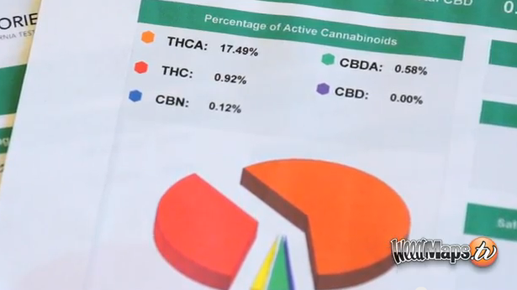

Slide 52


Why not potency?
Notes:
The answer is that this vegetable matter is not fungible. The trichomes have more THC than other parts of the plant, so two people picking out samples to put in the machine may pick samples with widely different amounts of THC.

Slide 53


Dale Gieringer, CA NORML
Notes:
The y axis shows TCH by weight. Samples from the same plant sent to different labs show results from around 11 to 7 percent. That’s not close enough for government work.

Slide 54


Fungible concentrate – Use potency?

Slide 55
New York PROPOSAL for potency proxy
$50 per ounce for plant matter, $200 per ounce for concentrates

Slide 56
Massachusetts Potency PROPOSAL
By ounce for plant matter, by ounce of THC for concentrates

Slide 57
Weight and THC bases need Indexing

Slide 58
Special tax rules after legalization?
Medical
Small business
Homegrown
Notes:
Here are some categories I’ll let you read.

Slide 59


Slide 60
Medical patients
Colorado – sales tax only
Washington – all taxes except sales tax

Slide 61
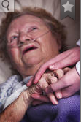
Argument for tax break
Don’t tax my medicine!
Notes:
I will gleefully stipulate that for some people marijuana is medicine. I’ve heard and read too many stories of miraculous cures and healing. God bless the patients.

Slide 62
Arguments against tax break for medical
Revenue
Impostors
Administrability
Affordability
Self-victimization
Notes:
But if marijuana is legal for everyone, there are arguments to treat the patients like everyone else.

Slide 63
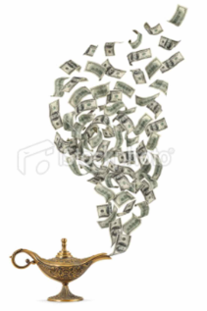
Argument against medical tax break -- Revenue
Notes:
Revenue is not enough of a reason to tax patients. We don’t tax penicillin.

Slide 64

Argument against medical tax break --
Faking sickness
Notes:
If folks get a tax break for lying, they may lie. When the 1040 tax return form started requiring children’s SSNs to be claimed as dependents, millions of dependents disappeared from the tax rolls.

Slide 65

Argument against medical tax break --
Administrability
Laws To Tax, fn 213: Statutory pain levels: “chronic,” “severe,” “severe chronic,” “debilitating,” and “intractable”
Notes:
Who can say whether someone’s pain rises to these statutory thresholds? The pain question is harder than qualification for SS disability, which requires huge numbers of lawyers. At least the stakes aren’t as high for a tax break. But maybe states will do like CA and give up.

Slide 66

Argument against medical tax break -- affordability
And license fees
Notes:
Patients will pay less with full legalization – doctors’ fees and license fees will disappear.

Slide 67

Argument against medical tax break -- affordability
General price decrease with legalization
Notes:
Economies of scale should bring prices down.

Slide 68
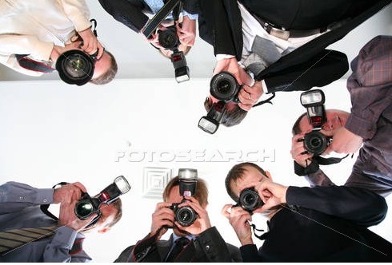
Argument against medical tax break --
Self-Victimization
Notes:
If we give you a benefit if you say you’re sick, you might not only SAY you’re sick, you might come to believe you’re sick. Having people feel bad about themselves is not good public policy.

Slide 69
Special tax rules after legalization?
Medical
Small business
Homegrown
Notes:
Here are some categories I’ll let you read.

Slide 70
Small business rules
Humboldt County, CA, proposal for canopy – under 600 feet, no tax; 600 and over: $1 per foot.
California proposal: first 500 pounds at a lower rate (?)
Another California proposal: lower per-gram rate for small farms (creates cliff).

Slide 71

Favor Big Business?
Section 9.04.136 of the Berkeley CA Municipal Code
Notes:
Berkeley, though, favors bigger operators – ones it can get its arms around to regulate and tax. Collecting tax from a handful of businesses easier than collecting from hundreds.

Slide 72
Special tax rules after legalization?
Medical
Small business
Homegrown
Notes:
Here are some categories I’ll let you read.

Slide 73


Homegrown exception?
CO: yes; WA: no.
Notes:
You can brew 100 gallons tax free
CO 6 plants; WA zero

Slide 74
Government Monopolies?
North Bonneville, Washington
Louisiana State University

Slide 75

Collection point
Choke point
Notes:
Ideally, where commerce is naturally concentrated.

Slide 76

Notes:
This consumer will not be paying tax on this shoplifted merchandise.

Slide 77

Revenue
http://www.huffingtonpost.com/2013/04/20/marijuana-per-ounce-price_n_3094520.html

Slide 78

$79.92 - $0.62 = $79.30/oz.

Slide 79
Lower jurisdictions tax weakly
Eric Garner NY cigarette case
Highest jurisdiction’s tax can deter
-- interior smuggling
-- race to the bottom

Slide 80
NYT November 7, 2016
“Soda taxes are on the ballots in San Francisco and Oakland, and spending to persuade voters to vote for or against them has topped $50 million.”

Slide 81
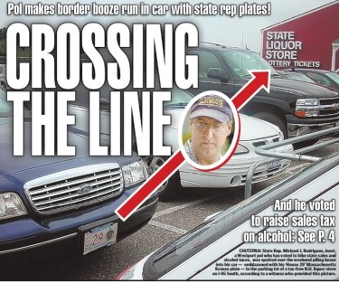
How much? Too much for one MA Rep

