Slide 1

How State and Federal Revenue Tools Might Nudge Cannabis Policy
Pat Oglesby
Center for New Revenue
Www.newrevenue.org
Notes:
Godfatther
Airplane Code
2009

Slide 2
Looking for controversy
Cannabis revenue design = public policy issue; government revenue = afterthought.
Optimal size of black market > 0.
Taxing only by price is untenable in the long run.
Government monopoly is best.
Marijuana advertising should stay non-tax-deductible.
Taxing bud or flower by THC is not realistic.
Medical marijuana should not be tax exempt.

Slide 3
What drug policy can revenue nudge?
Price – sweet spot
Products – nudge toward safer ones
Promotion – keep the noise down
(Revenue = Afterthought)

Slide 4
For Price, Products, Promotion: The Non-tax Option
Government sellers
  Alcohol sales in many states and countries
  North Bonneville, Washington, retail
  Louisiana medical growing
Cf. economic (not drug) policy concern: Who gets rich?
Drug Policy: Pros and Cons?

Slide 5
For All 3: The Monopoly Option
Pros: Control of ALL policy, high revenue
Cons: Inefficiency, distrust, federal law

Slide 6
The tax tool is trickier
Price – sweet spot
Products – support safer ones
Promotion – keep the noise down

Slide 7
Taxes: Find Consumer Price Sweet Spot?
Rationale:
  Externalities
  Internalities
Constrained by black market price

Slide 8
Taxes to Nudge Prices Higher -- Considerations
Burden – How much?
Base – What to tax?
Big Boy – What about Uncle Sam?

Slide 9
Tax burden -- to nudge prices
How much will the legal market bear?
  What will public accept?
  Moving target:
    Enforcement vs. black market can strengthen over time.
    Legal price declines over time.

Slide 10
Base Options – What to Tax
Price
Weight
THC
Carbon footprint
[Fees]
[Income – covered under Promotion]

Slide 11
What base to tax? Price?
Easy first tax
Correlation with potency (somewhat)
Downsides
  Base evaporates over time
  Relationships and Shenanignans
    Related parties
    Related products
      Bundling
      Quantity discounts

Slide 12
What to Base tax? Weight?
Gold standard for alcohol and tobacco
Only tax base in AK; de facto in CO and NV
But
  Incentivizes potent product
  Requires set up
  Requires tricky categories

Slide 13
What to Base tax? Weight?
Gold standard for alcohol and tobacco
Only tax base in AK; de facto in CO and NV
But
  Incentivizes potent product
  Requires set up
  Requires tricky categories

Slide 14
Categories in Nevada
1. Flower
2. Small Bud
3. Trim
4. Wet Whole Plants
5. Immature Plants
6. Pre-Rolls
7. Seeds

Slide 15
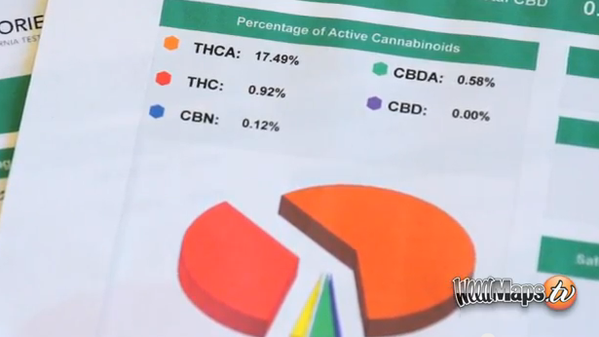
What Base to tax? THC content?

Slide 16


What to Tax? THC in bud?
Notes:
The answer is that this vegetable matter is not fungible. The trichomes have more THC than other parts of the plant, so two people picking out samples to put in the machine may pick samples with widely different amounts of THC.

Slide 17


What Base to Tax? THC in bud?
Dale Gieringer, CA NORML
Notes:
The y axis shows TCH by weight. Samples from the same plant sent to different labs show results from around 11 to 7 percent. That’s not close enough for government work.

Slide 18

What Base to Tax? THC in Concentrates? More homogeneous

Slide 19

What Base to tax? Carbon footprint?
Arcata CA excess electricity tax on everyone
Boulder County CO -- marijuana growers only

Slide 20
The Big Boy
Federal legalization =
  Federal tax
  Interstate commerce and race to bottom
    Less freedom for subnational taxes
    Like local canopy taxes

Slide 21
Nudging Products
Adjust tax to favor certain products over others?
Lungs and 2d hand smoke?
Uncalibrated kid-available edibles?
Blumenauer: FDA + sold “solely” as medicine

Slide 22
Nudging against Promotion
No deduction for selling expenses (280E)
  Retail vs. Grower
  Hits advertising and marketing
  Constitutionally OK
  But overbroad
    Expense of trucking cash to bank

Slide 23
Tax breaks
Small producer?
Home grown?
Medical?

Slide 24
Looking for controversy
Cannabis revenue design = public policy issue; government revenue = afterthought.
Optimal size of black market > 0.
Taxing only by price is untenable in the long run.
Government monopoly is best.
Marijuana advertising should remain non-tax-deductible.
Taxing bud or flower by THC is not realistic.
Medical marijuana should not be tax exempt.

Slide 25
Questions and Comments
Pat Oglesby
po@newrevenue.org
Www.newrevenue.org

