Slide 1
Taxing Marijuana
Pat Oglesby, M.B.A, J.D.
www.newrevenue.org
NTA New Orleans
Notes:
Floyd flood – 35 in NC

Slide 2
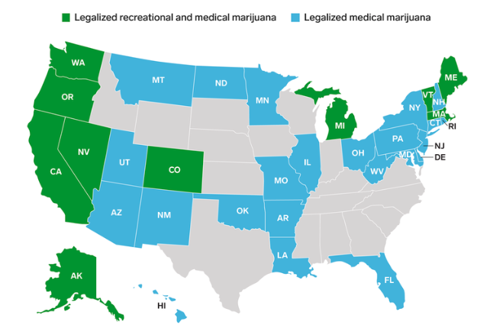

Slide 3
Issues
  1. Base:
  THC (potency)?
  Weight of plant?
  Price -- Ad valorem?
  2. Exempt medical?
  3. 280E advertising tax?

Slide 4


Base: THC potency?

Slide 5
Base: Price (Ad valorem)? Problems
Relationship & quantity discounts
Free pot with pipe (bundling)
Predictable price collapse

Slide 6


Slide 7

Base: Weight?
CO: Bud (flowers): 25¢/gram v. Trim (leaves): 11¢/gram

Slide 8
Base in Nevada
Flower — 75 cents a gram
Trim — 20 cents a gram
Small bud — 50 cents a gram
Wet whole plant — 7 cents a gram.
NV taxes by the unit
immature plants ($15)
seeds (($0.90)
pre-rolls ($0.75)
https://tax.nv.gov/uploadedFiles/taxnvgov/Content/Forms/Retail-Marijuana-Fair-Market-Value-Jan-1-2018.pdf

Slide 9
Base: Weight AND Price in Canada
National tax: Greater of $1 per gram or 10% of price
Provincial: Monopoly profits

Slide 10
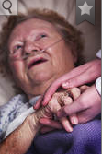

Exempt medical from tax?
!
Notes:
I will gleefully stipulate that for some people marijuana is medicine. I’ve heard and read too many stories of miraculous cures and healing. God bless the patients.

Slide 11

Www.newrevenue.org

Slide 12
Revenue amounts -- 2017 only
Colorado: $217 million
Washington $314 million
Both > $43 per capita per year

Slide 13
Mature states
“all of our evidence suggests that we are to the left of the peak of the Laffer curve”
“considerable state revenue may be left on the table”
-- Hansen, Miller, & Weber, U. of Oregon
Notes:
Towns know
to slap on a percentage tax. That doesn’t require setting up a weight station or a chemistry lab.

Slide 14

IRC § 280E & Ads
1982: For federally illegal drugs, no income tax deduction except cost of goods sold

Slide 15
Tax cannabis . . . tentatively
Www.newrevenue.org
po@newrevenue.org
Twitter @OglesbyPat

Slide 16
SCRAPS

Slide 17
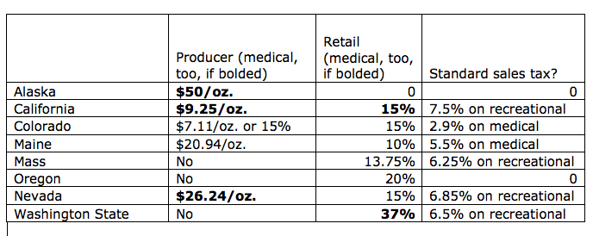

Slide 18


Fungible concentrate – Use potency?

Slide 19
Mature states are undertaxing
“all of our evidence suggests that we are to the left of the peak of the Laffer curve”
“considerable state revenue may be left on the table”
-- Hansen, Miller, & Weber, U. of Oregon
Notes:
Towns know
to slap on a percentage tax. That doesn’t require setting up a weight station or a chemistry lab.

Slide 20
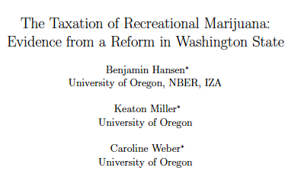
Mature states are undertaxing
“all of our evidence suggests that we are to the left of the peak of the Laffer curve”
“considerable state revenue may be left on the table”
Notes:
Towns know
to slap on a percentage tax. That doesn’t require setting up a weight station or a chemistry lab.

Slide 21
Hansen, Miller, & Weber, U. of Oregon
“all of our evidence suggests that we are to the left of the peak of the Laffer curve”
“considerable state revenue may be left on the table”
Notes:
Towns know
to slap on a percentage tax. That doesn’t require setting up a weight station or a chemistry lab.

Slide 22

Taxing by price (Ad valorem, like sales tax): Advantages
Municipal know-how
Easy to measure
Price is proxy for potency?
Notes:
Towns know
to slap on a percentage tax. That doesn’t require setting up a weight station or a chemistry lab.

Slide 23
www.Newrevenue.org

Slide 24
Alaska
(1) mature bud will be taxed at $50 an ounce
(2) immature bud will be taxed at $25 an ounce;
(3) abnormal bud will be taxed at $25 an ounce;
(4) the remainder of the plant will be taxed at $15 an ounce; and
(5) clones will be taxed at $1 per plant.

Slide 25
Alaska
(14) “immature bud” means an immature flower formed on a flowering marijuana plant, . . . that generally
  (A) appear loose, wispy, or leafy; and
  (B) are not dense to sight or touch;

Slide 26
EU tobacco taxes
  Specific – weight
  Ad valorem
  VAT

