Slide 1
Let’s Tax Weed
Patrick Oglesby, J.D., M.B.A., Founder, Center for New Revenue

Slide 2
Hey Public Health People:
Let’s Tax Weed
Patrick Oglesby, J.D., M.B.A., Founder, Center for New Revenue

Slide 3
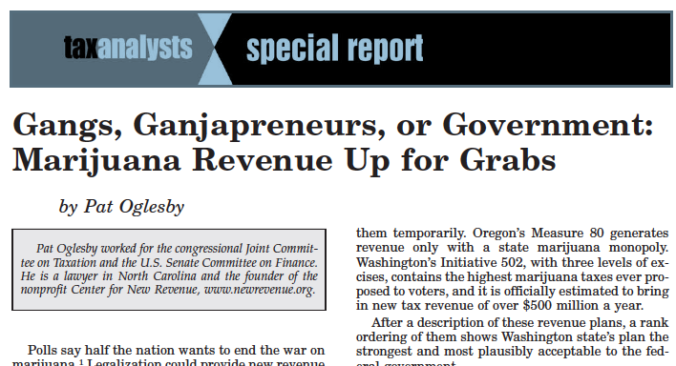
Notes:
2012 article about the details of proposals out west
Also in materials

Slide 4
Public Health Criteria for Taxing Cannabis
Patrick Oglesby, J.D., M.B.A., Founder, Center for New Revenue

Slide 5
How Can Revenue Serve Cannabis Policy?
Patrick Oglesby, J.D., M.B.A., Founder, Center for New Revenue

Slide 6
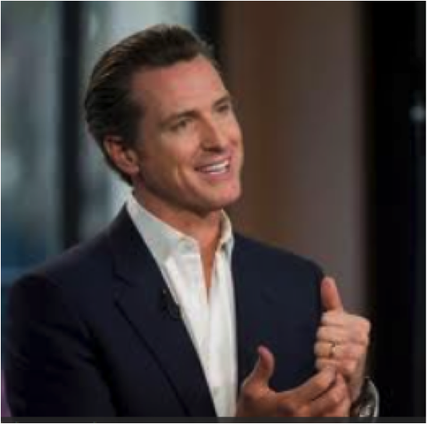
California Blue Ribbon Marijuana Commission

Slide 7
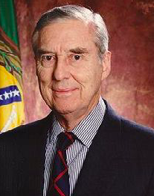
U.S. Senate Finance Committee

Slide 8
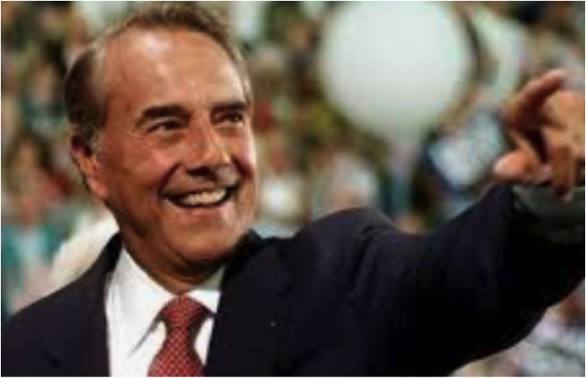
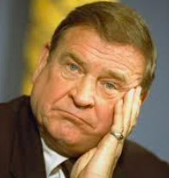
Joint Committee on Taxation

Slide 9
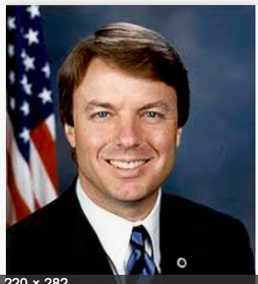
North Carolina Law Review

Slide 10
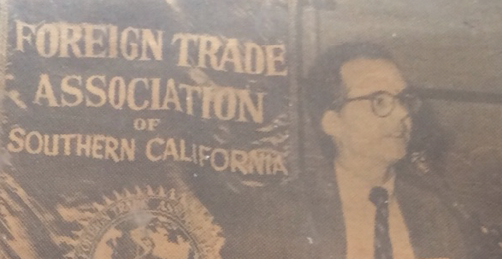
Center for New Revenue/P. Oglesby

Slide 11


Slide 12
What do you need to hear?

Slide 13
Cannabis revenue
  Why?
  What kind?
  How much?
  $
  Exernalities
  Internalites

Slide 14
Why?
[Revenue]
What are we mad at?
Externalities?
Internalities?
Big Marijuana?
Notes:
Towns know
to slap on a percentage tax. That doesn’t require setting up a weight station or a chemistry lab.

Slide 15
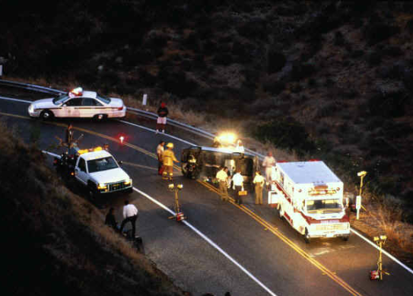
Externalities
“Dangerous”?

Slide 16

Externalities
“how many people can get stoned and still have a great state or a great nation?”

Slide 17
Other Externalities
Kids
Smell
Unintended consequences of legalization, like Mexican gangs turn to harder drugs

Slide 18

Internalities?

Slide 19
Internalities?
One panel here:
  perception:
  “lazy . . . and stupid.”
  https://ahp.expoplanner.com/index.cfm?do=expomap.sess&event_id=1&session_id=236

Slide 20
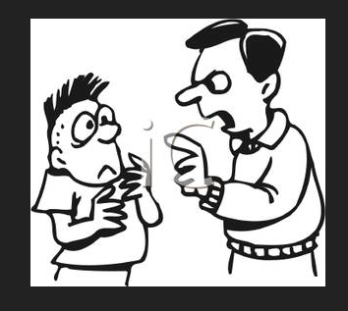
Internalities
Is paternalism OK?
(Special case of youth)
What about positive internalities?

Slide 21
Why?
[Revenue]
Externalities
+
Internalities
=
Big Marijuana
Notes:
Towns know
to slap on a percentage tax. That doesn’t require setting up a weight station or a chemistry lab.

Slide 22
Will taxes discourage use?
Inelastic demand: $$$ Revenue
Elastic demand: Less consumption
Win-win?
Notes:
MAYBE this is a win-win.
If demand is inelastic, if the user doesn’t care how much it costs, we get revenue.
With elastic demand, the user consumes less, and folks who hate marijuana use get their wish.

Slide 23
Goals of revenue tools:
Price – keep it up
Products – nudge toward safer ones
Promotion – keep it down
[Revenue for programs]
BUT marginalize illegal market
Notes:
Rabbi
John Prine

Slide 24
Other Cannabis Revenue Players
  Consumers
  Sellers
  Public

Slide 25

A problem with taxing cannabis?
Regressivity
Notes:
Any consumption tax imposes the same dollar burden on the poor and on the rich, but it hurts the poor and doesn’t bother the rich.
Another association of bad fortune with the bald man. Harmless, and

Slide 26
Cannabis revenue
  Why?
  What kind?
  How much?
  $
  Exernalities
  Internalites

Slide 27
Revenue Sources from Weed
Monopoly profits
Excise taxes
  Medical exception?
280E – nondeductibility of selling expenses
General taxes
Fines
Fees
[Exceptions beyond medical cannabis]

Slide 28
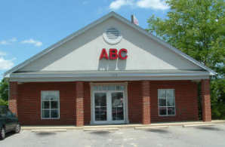
Not Just Tax: Government Monopoly
Notes:
We know liquor monopoly in North Carolina.

Slide 29
Government Monopoly = Safety + Revenue?
But
Culture
Consumer preferences
Federal law
Notes:
We know liquor monopoly in North Carolina.

Slide 30
Government Sales and Federal Legality
North Bonneville, Washington
LSU and Southern U.
Cease and desist?
Notes:
We know liquor monopoly in North Carolina.

Slide 31
Uruguay (hearsay)
$1.30 retail price per gram
~ $0.90 to producer
~ $0.40 to pharmacy – retailer
“A small fraction goes to the government”
Is government losing money?

Slide 32
Canada
Government wholesalers in many provinces
Government retail stores in (?)
Quebec
Nova Scotia
PEI
New Brunswick
BC (alongside private)
Ontario (online government; private storefronts)

Slide 33
Hollenbeck (UCLA) and Uetake (Yale)
“An examination of Washington’s
experience even suggests
state ownership of pot
stores might boost the
public coffers”

Slide 34
Medical cannabis & revenue
  $
  Exernalities
  Internalites

Slide 35
Tax medical cannabis?
(Or charge more in government stores?)

Slide 36
Tax medical cannabis?
Medical: Positive internalities
But
Recreational: Negative externalities
  $
  Exernalities
  Internalites

Slide 37

Tax medical cannabis?
How do we know it’s medical?
  $
  Exernalities
  Internalites

Slide 38


Exempt medical from tax?
!
Notes:
I will gleefully stipulate that for some people marijuana is medicine. I’ve heard and read too many stories of miraculous cures and healing. God bless the patients.

Slide 39
Federal alcohol tax exemption
“medicines, medicinal preparations, food
products, flavors, flavoring extracts, or perfume containing
distilled spirits, which are unfit for beverage
purposes.’’

Slide 40
Blumenauer bill medical tax exemption
“approved by the Food and Drug Administration for sale for therapeutic purposes and is marketed and sold solely for such purpose.” -- H.R. 1823, last Congress

Slide 41
Arguments against tax break for medical
Revenue
Impostors
Administrability
Affordability
Self-victimization
Notes:
But if marijuana is legal for everyone, there are arguments to treat the patients like everyone else.

Slide 42

Argument against medical tax break -- Revenue
Notes:
Revenue is not enough of a reason to tax patients. We don’t tax penicillin.

Slide 43

Argument against medical tax break --
Faking sickness
Notes:
If folks get a tax break for lying, they may lie. When the 1040 tax return form started requiring children’s SSNs to be claimed as dependents, millions of dependents disappeared from the tax rolls.

Slide 44

Argument against medical tax break --
Administrability
Laws To Tax, fn 213: Statutory pain levels: “chronic,” “severe,” “severe chronic,” “debilitating,” and “intractable”
Notes:
Who can say whether someone’s pain rises to these statutory thresholds? The pain question is harder than qualification for SS disability, which requires huge numbers of lawyers. At least the stakes aren’t as high for a tax break. But maybe states will do like CA and give up.

Slide 45

Argument against medical tax break -- affordability
And license fees
Notes:
Patients will pay less with full legalization – doctors’ fees and license fees will disappear.

Slide 46

Argument against medical tax break -- affordability
General price decrease with legalization
Notes:
Economies of scale should bring prices down.

Slide 47
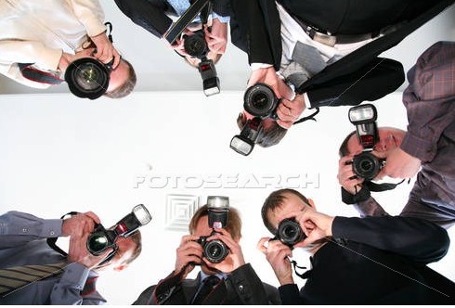
Argument against medical tax break --
Self-Victimization?
Notes:
If we give you a benefit if you say you’re sick, you might not only SAY you’re sick, you might come to believe you’re sick. Having people feel bad about themselves is not good public policy.

Slide 49
WHAT to excise-tax?
  Price – “Ad valorem”?
  THC?
  Weight of plant parts?
  Number of plants?
  Square feet of canopy?
  Electricity used?
  $
  Exernalities
  Internalites

Slide 50

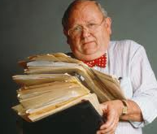
+
= ?

Slide 51
Taxing by price
E.g.,15% of retail price
Easy to start
Sophisticated methods need pre-collection cash flow
May piggyback on retail sales tax
(Salience – does customer see tax amount?)

Slide 52


New World’s 1st marijuana tax
Oakland, CA, July 21, 2009: 1.8 percent of gross receipts
Notes:
A tiny tax at retail – enacted in referendum with 80 percent of voters saying yes. Oakland has its fiscal troubles, and the marijuana community stepped up in a small way.

Slide 53
Taxing by price
Critique of Vermont proposal – “knowingly implement a policy which is defective by design simply because any alternative would require the Vermont Department of Taxes to work a little bit harder than they’d like to.”
https://vtdigger.org/2018/11/29/dave-silberman-governors-cannabis-advisory-commission-report-mixed-bag/

Slide 54
Price (Ad valorem) Base: Problems
Relationship & quantity discounts
Free pot with pipe (bundling)
Predictable price collapse

Slide 55
Price (Ad valorem) Base: Problems
Relationship & quantity discounts
  Employees, friends
  But tax on 1 gallon of liquor = tax on 8 pints

Slide 56
Price (Ad valorem) Base: Problems
Bundling discounts: (Free pot with pipe or membership deals)

Slide 57
Price (Ad valorem) Base: Problems
Predictable price collapse

Slide 58


Slide 59


Slide 60
Taxing by price
Correlation with potency?
Doubling potency from 10 to 20 percent increases the price by much less than 2X.
-- Drs. Ben Hansen, Keaton Miller, & Caroline Weber:

Slide 61
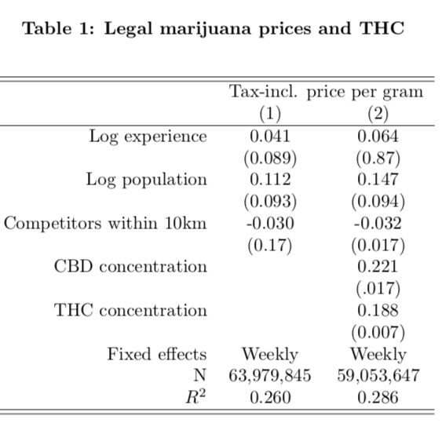

Slide 62
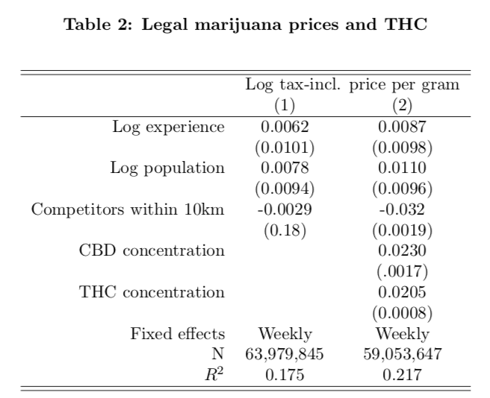

Slide 63
Tax base – THC Potency?

Slide 64

Tax Marijuana by Potency?
Notes:
Generally defined as quantity of THC, the primary pscychoactive ingredient

Slide 65

Federal liquor tax, per proof gallon -- potency
1934 | 1938 | 1940 | 1942 | 1944 | 1951 | 1985 | 1991
$2.00 | $2.25 | $3.00 | $6.00 | $9.00 | $10.50 | $12.50 | $13.50
Notes:
Federal alcohol tax has not kept up with inflation.

Slide 66

Federal liquor tax -- potency
Fifth of liquor:
100 proof: $13.50/5= $2.70
80 proof : $2.70 X .80 = $2.14
Notes:
For liquor, we tax only alcohol. 80 proof liquor has 80 % of the alcohol of 100 proof liquor, so it bears 80 percent of the tax.

Slide 67


Why not potency?
Notes:
The answer is that this vegetable matter is not fungible. The trichomes have more THC than other parts of the plant, so two people picking out samples to put in the machine may pick samples with widely different amounts of THC.

Slide 68


Notes:
The y axis shows TCH by weight. Samples from the same plant sent to different labs show results from around 11 to 7 percent. That’s not close enough for government work.

Slide 69

Fungible concentrate – Use potency?
Notes:
But chemical processes can produce highly concentrated material that is fungible. Its THC content can be measured reliably.

Slide 70
Tax base – Weight of various parts of plant?

Slide 71
Taxing by weight
Correlation with potency?

Slide 72

Base: Weight?
CO: Bud (flowers): 25¢/gram v. Trim (leaves): 11¢/gram

Slide 73
Base in Nevada
Flower — 75 cents a gram
Trim — 20 cents a gram
Small or “popcorn” bud — 50 cents a gram
Wet whole plant — 7 cents a gram.
NV taxes by the unit
immature plants ($15)
seeds (($0.90)
pre-rolls ($0.75)
https://tax.nv.gov/uploadedFiles/taxnvgov/Content/Forms/Retail-Marijuana-Fair-Market-Value-Jan-1-2018.pdf

Slide 74
Notes:
Some highlights: Grow lights; Dehumidification
Ventilation
Last line: data center like Google has in Lenoir: notoriously energy intensive.

Slide 75
Alaska
“A new rate has been added at $25 per ounce for bud/flower that is considered immature or abnormal. This is bud/flower that didn't fully mature or develop, contains seeds, or failed testing.”
http://tax.alaska.gov/programs/programs/help/faq/faq.aspx?60000

Slide 76
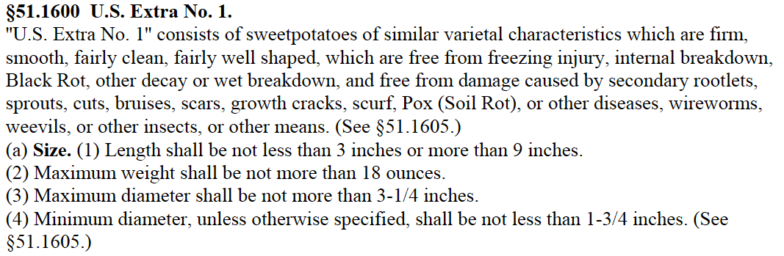

Slide 77
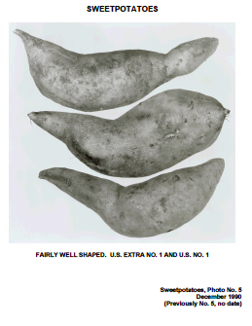
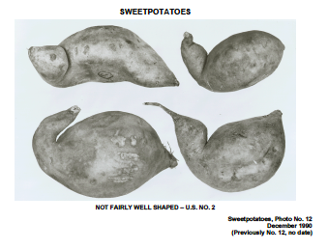

Slide 78
Base: Weight AND Price in Canada
National tax: Greater of $1 per gram or 10% of price
Some provinces: Monopoly profits

Slide 79
Weight
India Papers > Medicine - Drugs > Report of the Indian Hemp Drugs Commission, 1894-1895 > Volume I Permanent URL: http://digital.nls.uk/74464868 [Volume 1]: Report. From: (1) Title page To: (20) Page 2 (Note: Blank pages will not be included in this PDF file.) Images and transcriptions on this page, including medium image downloads, may be used under the Creative Commons Attribution 4.0 International Licence unless otherwise stated.
REPORT
OF THE
INDIAN HEMP DRUGS COMMISSION,
1893-94. volume 3 page 5
President:
The Hon'ble W. MACKWORTH YOUNG, M.A., C.S.I., First Financial Commissioner, Punjab.
Members:
1. Mr. H. T. OMMANNEY, Collector, Panch Mahals, Bombay.
2. Mr. A. H. L. FRASER, M.A., Commissioner, Chhattisgarh Division, Central Provinces..
3. Surgeon-Major C. J. H. WARDEN, Professor of Chemistry, Medical College, and Chemical
  Examiner to Government, Calcutta; Officiating Medical Storekeeper to Government, Calcutta.
4. Raja SOSHI SIKHARESWAR ROY, of Tahirpur, Bengal.
5. KANWAR HARNAM SINGH, Ahluwalia, C.I.E., Punjab.
6. LALA NIHAL CHAND, of Muzaffarnagar, North-Western Provinces.
            Secretary:
      Mr. H. J. McINTOSH, Under-Secretary to the Government of Bengal, Financial and Municipal Departments.
SIMLA|: PRINTED AT THE GOVERNMENT CENTRAL PRINTING OFFICE.
            1894.
CONTENTS.
CHAPTER I. INTRODUCTORY. PARA. PAGE.
1. Appointment of the Commission : its object 1
2. Constitution of the Commission ib.
3. Instructions to the Commission 2
4. Commission's method of inquiry 4
5. Invitation to persons interested to lay their views before the Commis
sion ib.
6. Selection of witnesses by Local Governments 5
7. Information from official and other sources 6
8. Preliminary tour : Objects and reasons of — ib.
9. Lunatic asylums 7
10. Connection between hemp drugs and violent crime 8
11. Native States ib.
12. The Army ib.
13. Sketch of the proceedings of the Commission ib.
14. Attendance of Members 11
15. The witnesses ib.
16. The evidence : Method of treatment of— 13

Slide 80


Slide 81


Slide 82
Other excise tax bases
  Number of plants

Slide 83

Mendocino: $50 per plant
Notes:
Put a RFID zip-tie tag on each plant, and charge for it.

Slide 84
Other excise tax bases
  Canopy area

Slide 85

2010 1st California wave Non-price tax base
Square footage taxes from $10 to $25
Some indexed for inflation
Can take on Big Marijuana
Notes:
Taxes on grow areas. They can grow a lot of profitable product in a tiny area.

Slide 86
Other excise tax bases
  Electricity

Slide 87
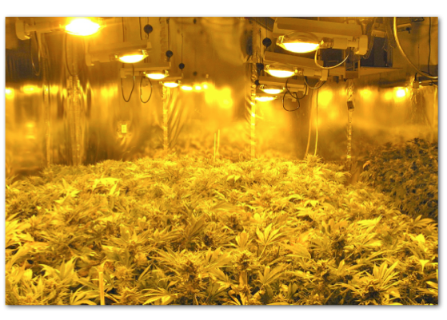
Notes:
Indoor growing – the industry standard – takes a lot of power.

Slide 88

http://evan-mills.com/energy-associates/Indoor_files/420-HSU-Talk-abbreviated.pdf
Notes:
Some highlights: Grow lights; Dehumidification
Ventilation
Last line: data center like Google has in Lenoir: notoriously energy intensive.

Slide 89

45% tax on electricity usage over 600% of Baseline – Arcata CA
Notes:
Another way of taxing marijuana without using the word marijuana is to tax indoor grow operations that use a lot of electricity – In the case of Arcata, more than 6 times the average for that size building.

Slide 90
Revenue Sources from Weed
Excise taxes
Monopoly profits
280E – nondeductibility of selling expenses
General taxes
Fines
Fees

Slide 91
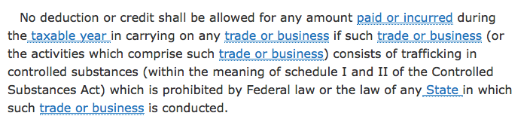
280E

Slide 92

Federal nondeductibility
No deduction for advertising or sales function
Notes:
I’ll let you read

Slide 93
IRC § 280E & Ads
1982: For federally illegal drugs, no income tax deduction except cost of goods sold
Images from Lynn Silver

Slide 94
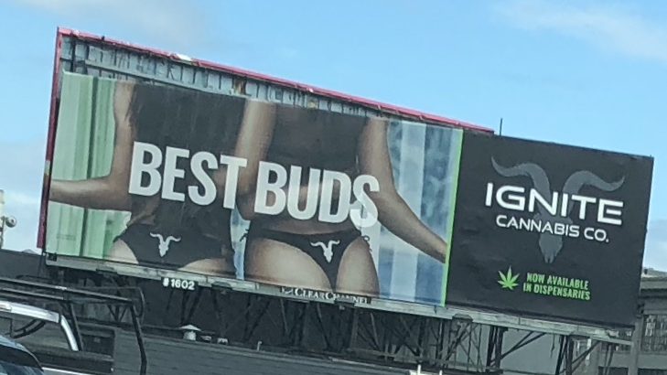
Sex Appeal

Slide 95
Snob Appeal

Slide 96
Happiness

Slide 97
Appeal to youth

Slide 98
280E tax deductions
  Advertising and maybe marketing
  But
  Insurance, transportation, rent, clerks’ wages

Slide 99
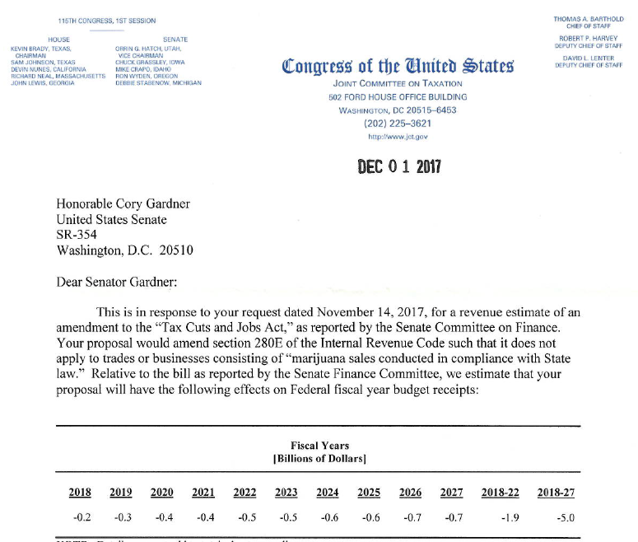

Slide 100
Selling expenses
  Retailers – high
  Mom & Pop growers and processors – high
  Big Tobacco (Big Marijuana) – high
  So let only retailers deduct selling expenses?
  But what about farm-to-market?

Slide 101
280E conformity and state income tax returns

Slide 102
Revenue Sources from Weed
Excise taxes
Monopoly profits
280E – nondeductibility of selling expenses
[General taxes]
[Fines]
Fees

Slide 103
Fees

Slide 104

Oakland CA 1996 License fee:
Notes:
The first license fee I can find was 5000 dollars to set up a retail store in Oakland.

Slide 105
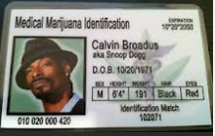
Patient licenses
Notes:
Licenses that patients have to pay for
If time color of eyes

Slide 106
Fees?

Slide 107
Business license fees
A barrier to entry

Slide 108
Exceptions beyond medical
Homegrown?
Small business?

Slide 109


Homegrown exception?
CO: yes; WA: no.
Notes:
You can brew 100 gallons tax free
CO 6 plants; WA zero

Slide 110
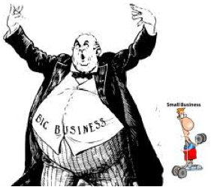
Notes:
John Kerrey wants to help small brewers. Lots of folks in the marijuana community don’t want Philip Morris to dominate the industry.

Slide 111

Section 9.04.136 of the Berkeley CA Municipal Code
Notes:
Berkeley, though, favors bigger operators – ones it can get its arms around to regulate and tax. Collecting tax from a handful of businesses easier than collecting from hundreds.

Slide 112

Notes:
Almost-President John Kerry is looking out for his microbrewers by proposing a liberalization of the current tax break for small brewers.

Slide 113
How much?
Low rates ≈ Good enforcement
What do externalities and internalities warrant?
How do we maximize revenue (Laffer curve)?
Adjust over time?
Voter views
Amounts
Conflicting views

Slide 114
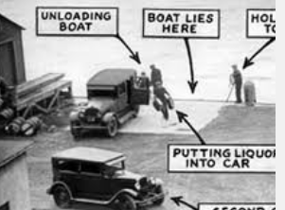
Rates depend on . . . how much enforcement

Slide 115
How much?
What do externalities and internalities warrant?
For alcohol, we have numbers.
“Research question”

Slide 116
How much?
How do we maximize revenue (Laffer curve)?

Slide 117

Laffer curve: Junior Johnson’s heyday
“A gallon of whiskey [bore] $11 tax. You could make it for 75 cents to a dollar and sell it for $3 or $4.” Golenbock, American Zoom

Slide 118
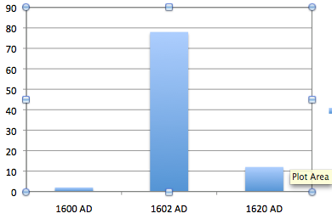
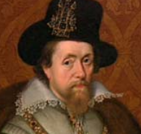
Adjusting rates – English tobacco tax
In pence/lb. 1600, 1602, 1620

Slide 119
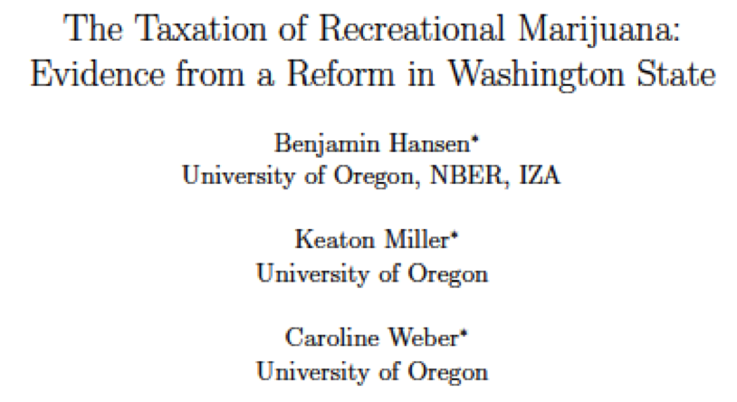
How much?
We conclude a retail tax rate on marijuana of 37 percent remains on the correct side of the Laffer curve.

Slide 120
“UCLA Anderson’s Brett Hollenbeck and Yale’s Kosuke Uetake . . . suggest that around the country, states could pull more money from retail weed than their current tax structures allow.”
(Documents/sites/faculty/reviewpublications/research/wa_taxation.pdf)

Slide 121
Voter views
In California in 2016, every stand-alone marijuana tax increase passed, except the town of Colfax, which voted 63% for a tax measure that required a 2/3 majority.

Slide 122
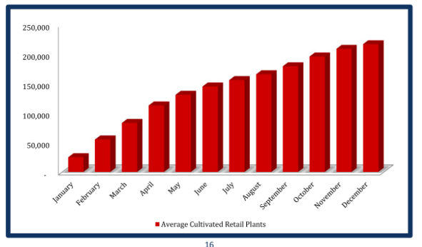
Tax receipts go up as market matures

Slide 123
Revenue amounts -- 2017 only
Colorado: $217 million
Washington $314 million
Both > $43 per capita per year

Slide 125
Conflicts
Social Justice vs. Free Enterprise
Consumers vs. Businesses
Tax Foundation vs. Institute for Tax and Economic Policy
Center for New Revenue vs. Misinformation

Slide 126
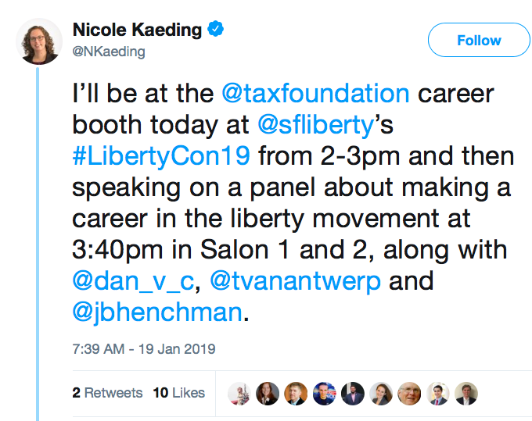

Slide 127

“A modest ‪#wealthtax on families with net worth of $32.2M+ could raise $1.3T by 2029.”

Slide 128
Center for New Revenue vs. Misinformation
Cutting taxes “has been shown to actually increase overall tax revenue in other states.” -- California tax cut sponsors
Looking for pushback -- po@newrevenue.org

Slide 131
Final message
Law enforcement is critical.
Federal legalization is coming slowly.
Taxing only by price is untenable in the long run.
Taxing flower by THC won’t happen soon.
Cannabis’s lobbyists are lined up.

Slide 132
Patrick Oglesby, MBA, JD
Founder and CEO
Center for New Revenue
po@newrevenue.org
www.newrevenue.org
@OglesbyPat

