Slide 1
Follow the Cannabis Money
Patrick Oglesby, J.D., M.B.A., Center for New Revenue
Www.newrevenue.org
po@newrevenue.org
@OglesbyPat
13th Conference of the International Society for the Study of Drug Policy
Paris
24 Mai 2019

Slide 2

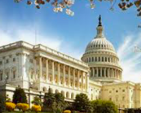
Center for New Revenue/Pat Oglesby

Slide 3
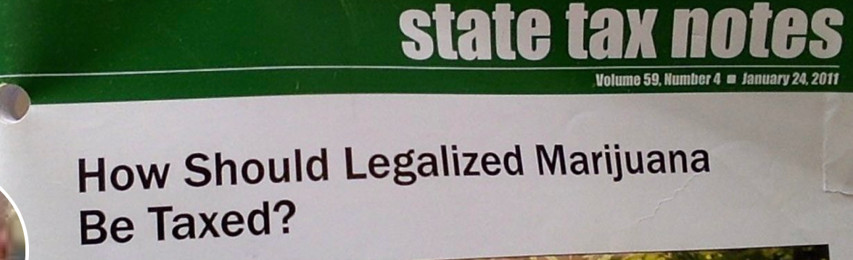

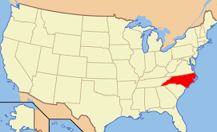


Slide 4
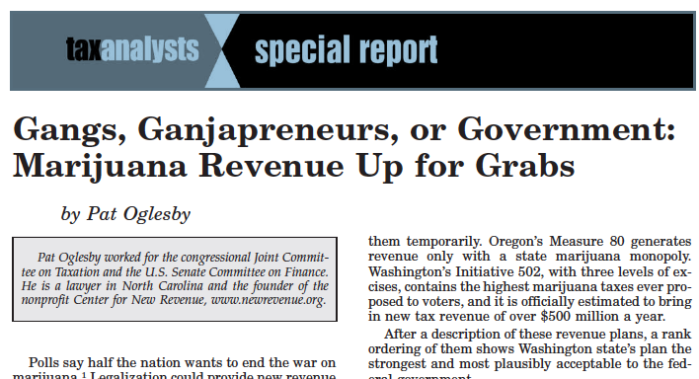
Notes:
2012 article about the details of proposals out west
Also in materials

Slide 5
Outline
How Can Revenue Serve Drug Policy?
State of Play in USA
What to Measure and Tax?
(Price, Potency, or Pounds?)
Wrap-up

Slide 6
Drug Policy Goal:
Final after-tax consumer price?
-- Too low – Kids and problem-users use too much.
(But Externalities < Alcohol.)
-- Too high – Black market prevails IF enforcement is weak.

Slide 7
State of Play in the USA

Slide 8

US state taxes – ITEP (federal, too)
  50 out of 50 states tax cigarettes per pack
  50 out of 50 states tax motor fuel per gallon
  50 out of 50 states tax beer per gallon
  47 out of 47 states tax wine per gallon
    Three states sell wine through state stores instead of taxing private sales
  33 out of 33 states tax liquor per gallon
    17 states sell through state stores instead of taxing private sales
  Sometimes these states add price-based taxes on top of their quantity-based taxes. But quantity-based tax rates form the foundation of their excise tax systems.
Notes:
Certain amount of harm per unit. It doesn’t matter if you’re drinking Busch Lite or craft beer. Charge the same amount for the same amount of intoxicant.

Slide 9


Slide 10
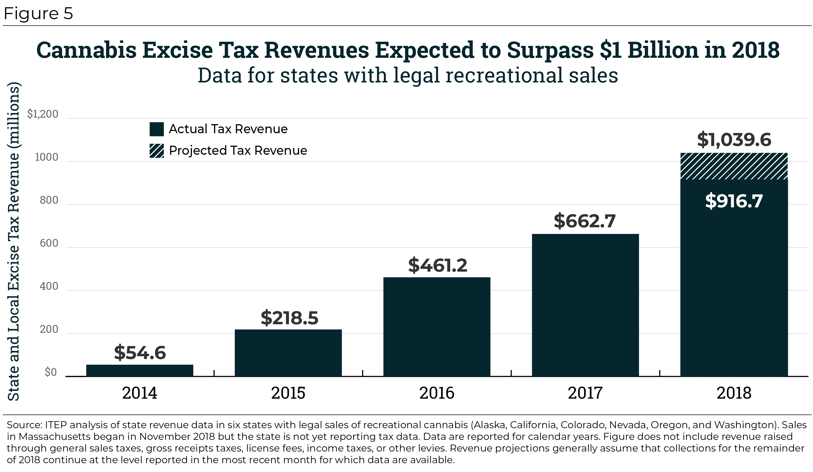
Slide source: Institute for Taxation and Economic Policy, Washington DC
Notes:
Rapid growth partly fueled by more states authorizing legal sales and partly by rapid growth in the early legalizer states.
Note that this chart excludes general sales taxes collected from cannabis sales, and the 2018 total would have been more than $1.3 billion if we had added those in.

Slide 11
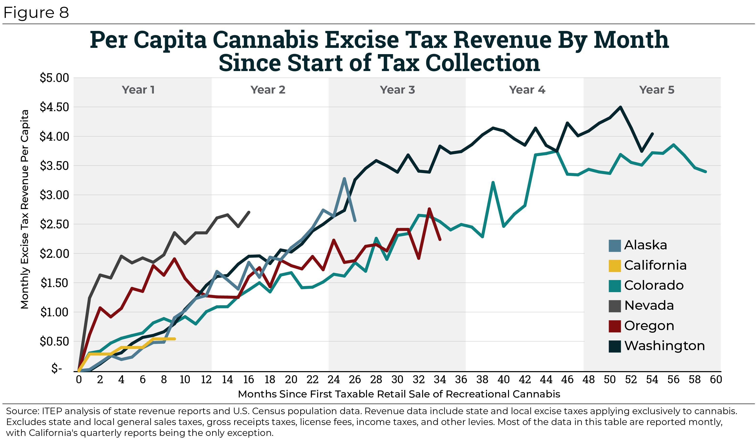
Slide source: Institute for Taxation and Economic Policy, Washington DC
Notes:
If you want a bit more detail, here’s the revenue experience of the first half dozen states to legalize recreational sales. The amounts here are monthly revenues and are expresses per capita, in order to make it possible to achieve comparisons across states.

Slide 12


Slide 13
U.S. Voter Views
“Initiatives to legalize and tax cannabis tend to max out at around 57% of the vote, if they pass at all. Standalone cannabis tax initiatives, meanwhile, routinely get 75% to 80%.”
https://www.leafly.com/news/industry/opinion-theres-a-better-way-to-tax-legal-cannabis
But to spend on what? Equity? Schools?

Slide 14
WHAT to measure and tax?
  Price – “Ad valorem”?
  Potency -- THC?
  Pounds (grams) -- Of plant parts?
  Number of plants?
  Square feet of canopy?
  Electricity used?
  Advertising (USA 280E)?
  $
  Exernalities
  Internalites

Slide 15
Drug Policy Goal:
Final after-tax consumer price?
No tax (price, potency, or pounds) works perfectly. 😢

Slide 16
Taxing by price (“ad valorem”)
E.g.,15% of retail price
Easy to start
May piggyback on retail sales tax

Slide 17


New World’s 1st marijuana tax
Oakland, CA, July 21, 2009: 1.8 percent of gross receipts
Notes:
A tiny tax at retail – enacted in referendum with 80 percent of voters saying yes. Oakland has its fiscal troubles, and the marijuana community stepped up in a small way.

Slide 18
Price (Ad valorem) Base: 3 Problems
Relationship & quantity discounts
Free pot with pipe (bundling)
Predictable price plunge

Slide 19
Price (Ad valorem) Base: Problems
Tax Cut for Price Discounts:
  Employees, friends, frequent buyers
  Quantity:
    But tax on 6 single beers = tax on a 6-pack.

Slide 20
Price (Ad valorem) Base: Problems
Bundling discounts: (Free pot with pipe or with membership)

Slide 21
Price (Ad valorem) Base: Problems
Predictable pre-tax price plunge
  15% of $200 = $30 tax
  15% of $40 = $6 tax

Slide 22


Slide 24
Taxing by price
People say:
“Correlation with potency.”
Oops! Not much!
Doubling potency (say from 10 to 20%):
increases the price much < 2X. Www.newrevenue.org
-- Data from Ben Hansen (U. Oregon) from 60 million WA transactions:

Slide 25
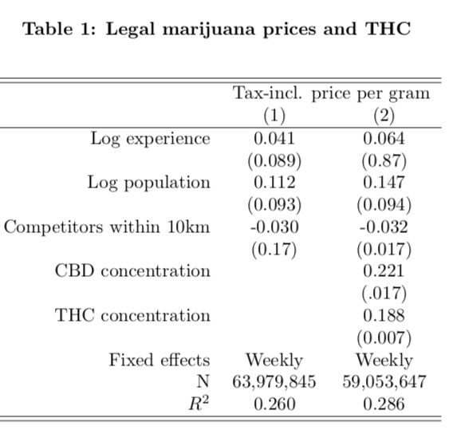

Slide 26
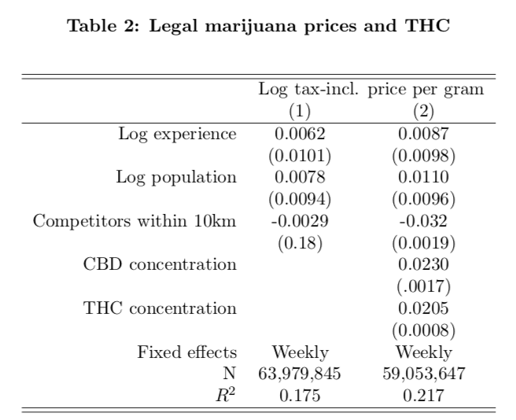

Slide 27
Dear Public Officials who legalize weed:
Don’t miss out on revenue your people need.
A price-based percentage tax won’t be secure
‘Cause prices will tumble as markets mature.
The “liberty movement” wants taxes to fall.
But vanishing “price” taxes undermine y’all.
\

Slide 28
Tax base – THC Potency?

Slide 29

Tax Marijuana by Potency?
Notes:
Generally defined as quantity of THC, the primary pscychoactive ingredient

Slide 30
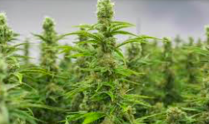
Why not potency? Sampling!
Notes:
The answer is that this vegetable matter is not fungible. The trichomes have more THC than other parts of the plant, so two people picking out samples to put in the machine may pick samples with widely different amounts of THC.

Slide 31


Notes:
The y axis shows TCH by weight. Samples from the same plant sent to different labs show results from around 11 to 7 percent. That’s not close enough for government work.

Slide 32


Non-smokeable products – Use potency?
Oui!
O Canada! (Merci.)
Notes:
But chemical processes can produce highly concentrated material that is fungible. Its THC content can be measured reliably.

Slide 33
Tax base – Weight of various parts of plant?
Correlation with potency?

Slide 34
Weight
Report Of The British Indian Hemp Drugs Commission,1893-94, volume 3, page 5
https://digital.nls.uk/indiapapers/browse/archive/74908458

Slide 35


Slide 36


Slide 37

Base: Weight?
CO: Bud (flowers): 25¢/gram v. Trim (leaves): 11¢/gram

Slide 38
Tax Base in Nevada
Flower — 75 cents a gram
Trim — 20 cents a gram
Small bud — 50 cents a gram
Wet whole plant — 7 cents a gram.
By the unit:
immature plants ($15)
seeds (($0.90)
pre-rolls ($0.75)
https://tax.nv.gov/uploadedFiles/taxnvgov/Content/Forms/Retail-Marijuana-Fair-Market-Value-Jan-1-2018.pdf

Slide 39

Base: Canada
National tax: Greater of $1 per gram or 10% of price
Soon: THC for edibles & concentrates
Some provinces: Monopoly profits.
No medical tax break.

Slide 40

Even better? RAND-Vermont
Flower: Greater of $X per gram or $Y per gram of CLAIMED THC

Slide 41
Exceptions?
Medical? Who’s sick, really?
  No other excise tax reads minds.
Homegrown? Leakage into commerce?

Slide 42
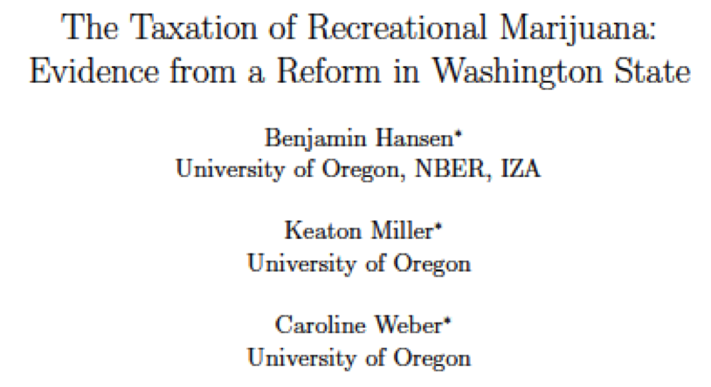
How much?
Even the highest U.S. tax on cannabis “remains on the correct side of the Laffer curve.”

Slide 43
“UCLA Anderson’s Brett Hollenbeck and Yale’s Kosuke Uetake . . . suggest that around the country, states could pull more money from retail weed than their current tax structures allow.”
(Documents/sites/faculty/reviewpublications/research/wa_taxation.pdf)

Slide 46

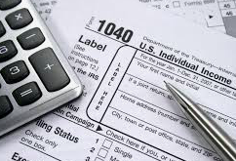
US commercial free speech:
But Federal non-deductibility for income tax
For advertising – 280E
Notes:
I’ll let you read

Slide 47
Wrap-up
Law enforcement is critical.
Taxing only by price is weak.
Don’t try to tax flower by THC.
Big Business is coming (vs. Social Equity).
Government sales are better than taxes.

Slide 48
Thank you!
Patrick Oglesby
Www.newrevenue.org
po@newrevenue.org
@OglesbyPat

Slide 49
Dear Public Officials who legalize weed:
Don’t miss out on revenue your people need.
A price-based percentage tax won’t be secure
‘Cause prices will tumble as markets mature.
The “liberty movement” wants taxes to fall.
But vanishing “price” taxes undermine y’all.
Www.newrevenue.org
@OglesbyPat
\

