Slide 1
Excise taxes, especially on marijuana
Duke Law and Public Policy
Peter Barnes’s VAT and Sales Tax class
2019
Pat Oglesby, M.B.A, J.D.
The Center for New Revenue
www.newrevenue.org
Notes:
Floyd flood – 35 in NC

Slide 2
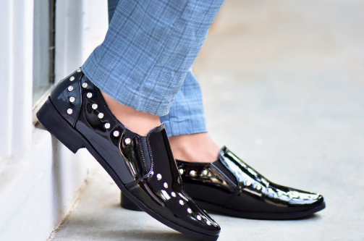

Why excises (EU & UK “duties”)?
Don’t tax everything the same.
Differentiate.

Slide 3
VAT and sales taxes differentiate crudely;
Excises are more sophisticated.

Slide 4
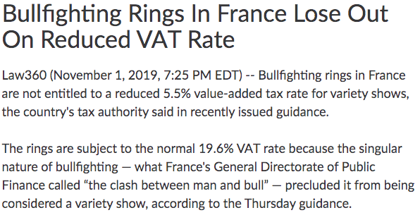

Slide 5

What is an Excise?
A tax (or duty) on specific products or services sold within a jurisdiction.
Derivation:
To cut out
Compared to VAT or sales, excises:
Narrower range of product
Typically heavier burden
-Usually collected only once, unlike VAT
-Often “specific” -- per unit (weight or volume)

Slide 6
Main Advantages of Excises:
1. Can use non-Currency Tax Bases.
2. Over VAT: Collect only once.

Slide 7
Why single out goods or services?
Rationales
“Sin”
Externalities
Internalities
Benefit (“Fee”?)
Luxury/Progressivity
Proxy for income (DST)
Non-residents or unfavored taxpayers

Slide 8
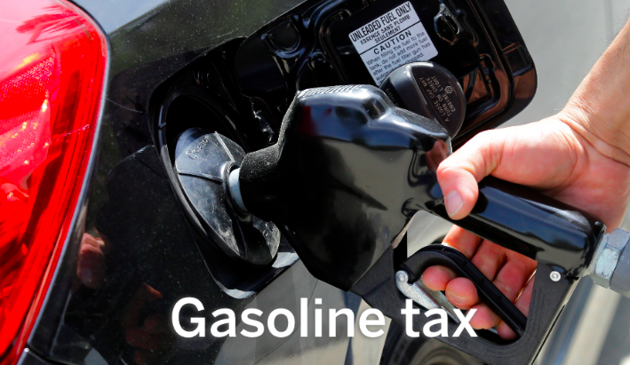
Excise examples
“What are we mad at?”
Tobacco/Alcohol/Marijuana
Sugar
Tanning
Transfers at death
Carbon and Pollution

Slide 9
Problems with excise taxes -- & VAT exceptions
Distrust of government decisions
Not simple: Categorization needed
Unjust categories (soda v. cake)
Like any tax, bad consequences (lost jobs)
Get either $ or changed behavior
Regressivity
State profiting from “sin” – becomes partner

Slide 10
Case study:
Alcohol

Slide 11

Alcohol base history: From primitive to sophisticated
License fees
Duties
Proxy taxes
Alcohol itself

Slide 12

Primitive bases: Still and tavern licenses

Slide 13

Early base: Customs duties

Slide 14
Proxy bases for alcohol
MA 1673: malt
1764 British Sugar Act: Molasses tax
1790s: Still capacity

Slide 15
Alcohol Exceptions: Virginia special interests
1691 liquor customs rates:
4 pence/gal. generally
But
  2 pence/gal. for VA-owned ships
  Zero for VA-built ships.

Slide 16
Federal liquor tax? 8 answers
1790: no
1791: yes
1802: no
1813: yes
1817: no
1862: yes
1919: Prohibition
1934: yes

Slide 17
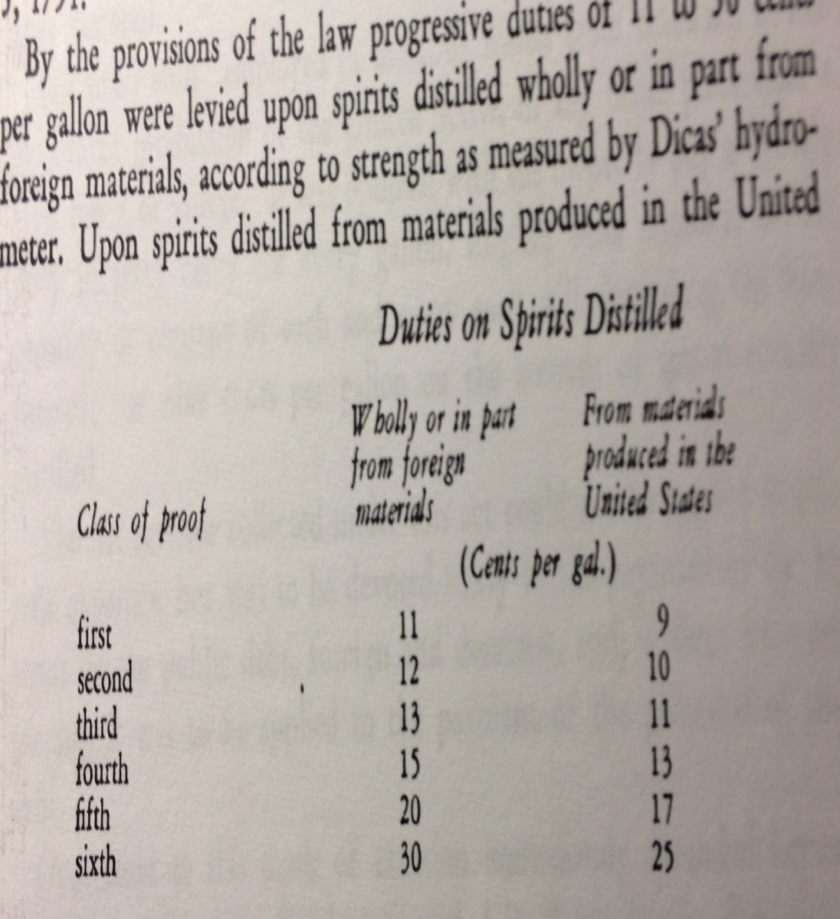

Slide 18
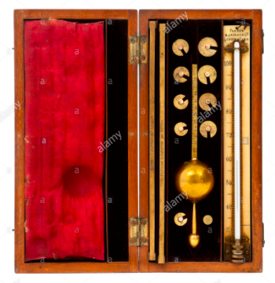
1791 Whisky – Dicas’ hydrometer
Alcohol content (proof)

Slide 19
Alcohol tax revenue yield

Slide 20
Year | Alcohol taxes ($million) | Alcohol taxes over total taxes
1863 | $6 | 6.19%
1864 | $33 | 14.97%
1874 | $59 | 22.14%
1884 | $95 | 30.00%
1894 | $117 | 41.82%
1904 | $185 | 37.41%
1914 | $226 | 33.64%
1924 | $28 | 0.83%
1934 | $259 | 8.67%
1944 | $1,619 | 3.99%

Slide 21
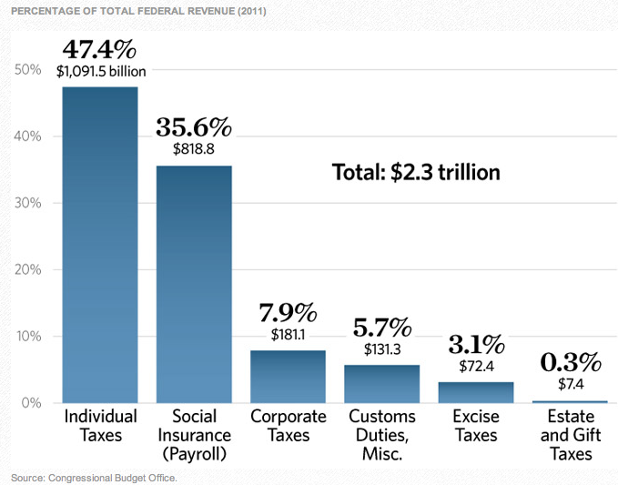

Slide 22
Recent Federal liquor tax rate per proof gallon
1934 | 1938 | 1940 | 1942 | 1944 | 1951 | 1985 | 1991
$2.00 | $2.25 | $3.00 | $6.00 | $9.00 | $10.50 | $12.50 | $13.50

Slide 23
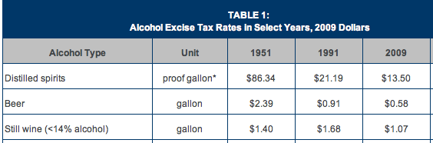
From too much to not enough?

Slide 24
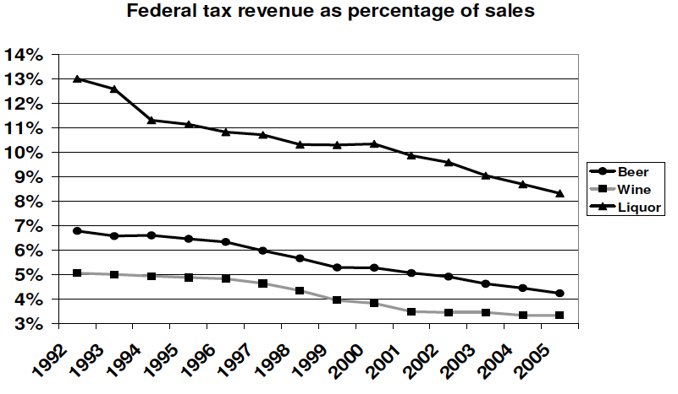

Slide 25


Slide 26
2017 Federal Tax Cut
The TCJA cuts taxes for most alcohol producers by reducing the excise tax from $7.00 to $3.50 on the first 60,000 barrels of beer produced by a seller, from $13.50 to $2.70 on the first 100,000 proof gallons of distilled spirits, and from $0.17 to $0.07 on the first 30,000 gallons of most wine.

Slide 27
Federal taxes pre-phase out
Liquor: Potency: $13.50 per proof gallon ($6.25 per gal. of alcohol)
Beer: Volume: $18/barrel
Wine per gallon:
< 16%: $1.07
16% - 21%: $1.57
> 21% -24%: $3.15
https://www.ttb.gov/tax_audit/taxrates.shtml

Slide 28
Wine taxes per gallon after phase-out
16% alcohol and under: $1.07
16% - 21%: $1.57
Over 21% -24%: $3.15
https://www.ttb.gov/tax_audit/taxrates.shtml

Slide 29
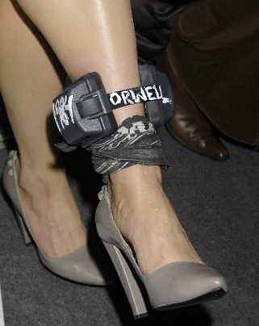
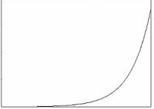
Economists’ Dream
Blood Alcohol Content: “Healthy” drinking
Then taxed exponentially
Genetic testing?

Slide 30
Prologue to MARIJUANA: Vaping taxes
Taxing nicotine in e-cig liquids at $27.81 per gram passes U.S. House Ways & Means.
Tax policy folks on left and right urge taxing all e-cig liquid instead
https://newrevenue.org/2019/10/24/tax-nicotine-or-vaping-liquid/

Slide 31
Case study:
Marijuana (Cannabis)

Slide 32
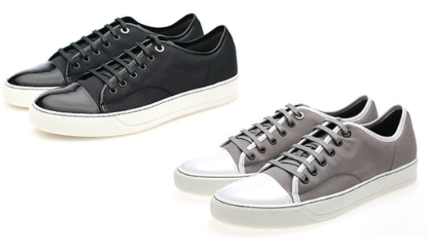
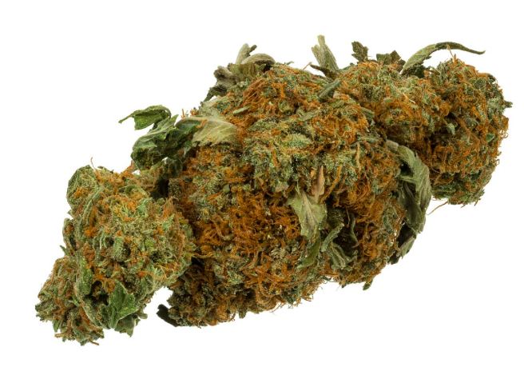
General Sales Taxes on Medical Marijuana – Some states tax it like shoes.
Notes:
Without using the word marijuana, many states collect sales taxes on medical marijuana just like they do on shoes. In Maine, you buy a brownie, you pay 7 percent sales tax. You buy a marijuana brownie, you pay 7 percent sales tax – even though it’s medicine.

Slide 33
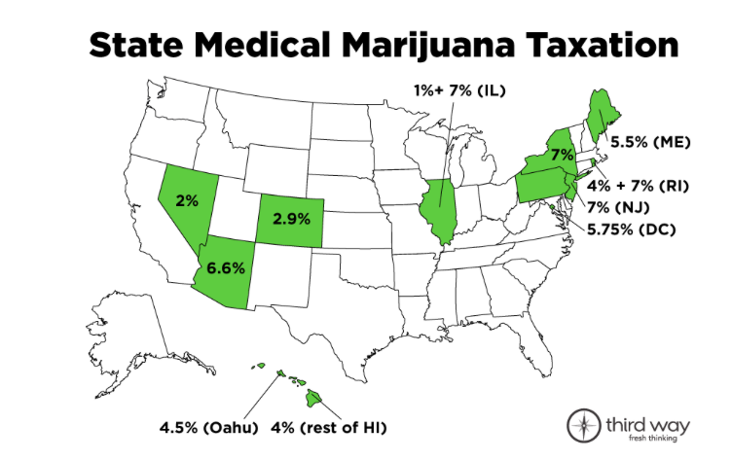
General Sales Taxes on Medical Marijuana
Washington taxes at 37%;
a taxes nominally at 21.85%; California will tax at 15% + $9.25 per ounce.

Slide 34
Marijuana excise taxes
Why?

Slide 35
Why marijuana excise taxes?
So people will agree to legalize
For revenue
Limit “Substance Use Disorder”
Keep price-sensitive Kids and SUD people away
Keep accidents down
Pay for harms
Productivity: “Nation of Stoners”

Slide 36
Canadian negative externalities
The four substances associated with the largest costs were (in order):
• Alcohol, contributing $14.6 billion or 38.1% of the total costs;
• Tobacco, contributing $12.0 billion or 31.2% of the total costs;
• Opioids, contributing $3.5 billion or 9.1% of the total costs; and
• Cannabis, contributing $2.8 billion or 7.3% of the total costs.

Slide 37
Cannabis Law Reform
@MikeDeVillaer
Replying to
@OglesbyPat
There is no financial capture of the "cost" of sleepless nights & near-perpetual agony & stress experienced by family members of someone with drug dependence. And there are millions & millions of them, & it goes on for yrs & yrs.

Slide 38


Slide 39
Marijuana Excise Outline
  Hard to Tax
  Legalization
  Carve-outs
  Base
  Side Issues
  Recap: State of play

Slide 40

Hard to Tax
Light weight
Easy to grow – “Weed”
High pre-legalization prices make illegal sales profitable.

Slide 41
Marijuana Excise Outline
  Hard to Tax
  Legalization
  Carve-outs
  Base
  Side Issues
  Recap: State of play

Slide 42
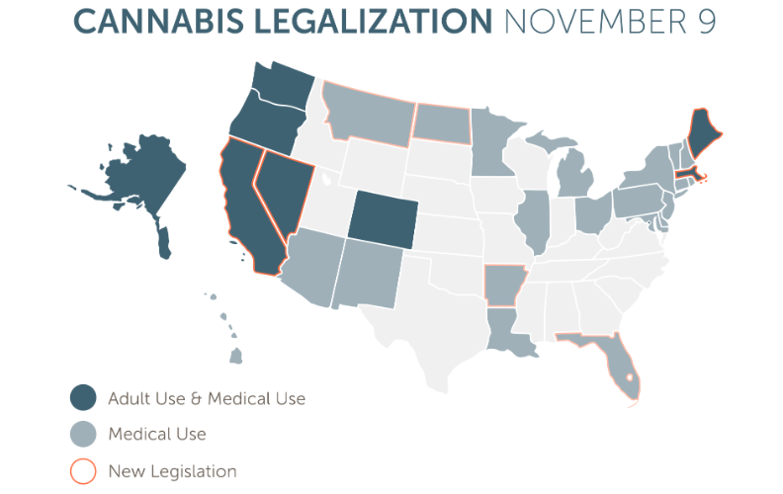
2016

Slide 43


Slide 44

Marijuana activists?

Slide 45


Early on , funded by
Billionaires paying for signature collection

Slide 46
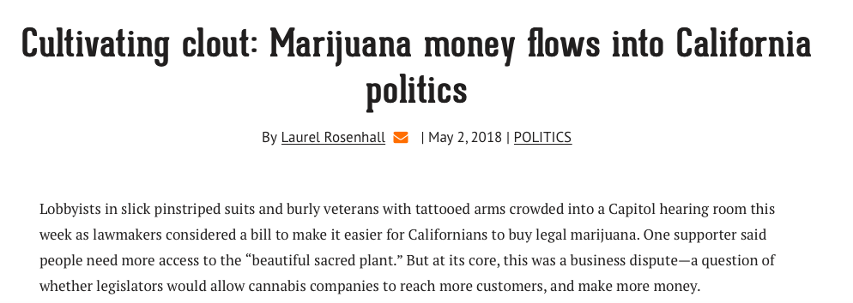
https://calmatters.org/articles/cultivating-clout-marijuana-money-flows-into-california-politics/

Slide 47
Marijuana Excise Outline
  Hard to Tax
  Legalization
  Carve-outs
  Base
  Side Issues
  Recap: State of play

Slide 48
Carve-outs from a marijuana excise tax?
Medical
Homegrown
Small business
Notes:
Here are some categories I’ll let you read.

Slide 49


Slide 50

Argument for tax break
Don’t tax my medicine!
Notes:
I will gleefully stipulate that for some people marijuana is medicine. I’ve heard and read too many stories of miraculous cures and healing. God bless the patients.

Slide 51
Arguments against tax break for medical
Revenue
Impostors
Administrability
Affordability
Self-victimization
Notes:
But if marijuana is legal for everyone, there are arguments to treat the patients like everyone else.

Slide 52

Argument against medical tax break -- Revenue
Notes:
Revenue is not enough of a reason to tax patients. We don’t tax penicillin.

Slide 53

Argument against medical tax break --
Faking sickness
Notes:
If folks get a tax break for lying, they may lie. When the 1040 tax return form started requiring children’s SSNs to be claimed as dependents, millions of dependents disappeared from the tax rolls.

Slide 54

Argument against medical tax break --
Administrability
Laws To Tax, fn 213: Statutory pain levels: “chronic,” “severe,” “severe chronic,” “debilitating,” and “intractable”
Notes:
Who can say whether someone’s pain rises to these statutory thresholds? The pain question is harder than qualification for SS disability, which requires huge numbers of lawyers. At least the stakes aren’t as high for a tax break. But maybe states will do like CA and give up.

Slide 55

Argument against medical tax break -- affordability
And license fees
Notes:
Patients will pay less with full legalization – doctors’ fees and license fees will disappear.

Slide 56

Argument against medical tax break -- affordability
General price decrease with legalization
Notes:
Economies of scale should bring prices down.

Slide 57

Argument against medical tax break --
Self-Victimization
Notes:
If we give you a benefit if you say you’re sick, you might not only SAY you’re sick, you might come to believe you’re sick. Having people feel bad about themselves is not good public policy.

Slide 59
Carve-outs from a marijuana excise tax?
Medical
Homegrown
Small business
Notes:
Here are some categories I’ll let you read.

Slide 60


Homegrown exception?
Liquor: no
Beer & wine: yes
Washington marijuana : no.
Notes:
You can brew 100 gallons tax free
CO 6 plants; WA zero

Slide 61
Carve-outs from a marijuana excise tax?
Medical
Homegrown
Small business
Notes:
Here are some categories I’ll let you read.

Slide 62
Small business rules
Humboldt County, CA, proposal for canopy – under 600 feet, no tax; 600 and over: $1 per foot.
California proposal: lower per-gram rate for small farms (creates cliff).

Slide 63

Favor Big Business?
Section 9.04.136 of the Berkeley CA Municipal Code
Notes:
Berkeley, though, favors bigger operators – ones it can get its arms around to regulate and tax. Collecting tax from a handful of businesses easier than collecting from hundreds.

Slide 64
Marijuana Excise Outline
  Hard to Tax
  Legalization
  Carve-outs
  Base
  Side Issues
  Recap: State of play

Slide 65
Cannabis tax base?
Potency
Price
Weight
Square feet
Electricity

Slide 66

Base: Correlation with intoxication
Potency – most
Price – some
Weight – least
Notes:
If intoxication is what the public doesn’t like about marijuana, potency – THC content – is the best tax base. Price correlates with potency if more powerful product costs more. Weight treats the most powerful concentrate like ditchweed.

Slide 67

Why not potency?

Slide 68

Why not potency?

Slide 69
No jurisdiction taxes tobacco by tar and nicotine content, right?

Slide 70


Why not potency?
Notes:
The answer is that this vegetable matter is not fungible. The trichomes have more THC than other parts of the plant, so two people picking out samples to put in the machine may pick samples with widely different amounts of THC.

Slide 71


Dale Gieringer, CA NORML
Notes:
The y axis shows TCH by weight. Samples from the same plant sent to different labs show results from around 11 to 7 percent. That’s not close enough for government work.

Slide 72
"We’ve all been lured toward high percentages of THC"
but "optimized highs" involve terpenes –
@Leafly Twitter

Slide 73


Fungible concentrate – Use potency?

Slide 74
Cannabis tax base?
Potency
Price
Weight
Square feet
Electricity

Slide 75

Taxing by price (Ad valorem, like sales tax): Advantages
Municipal know-how
Easy to measure
Price is proxy for potency?
Notes:
Towns know
to slap on a percentage tax. That doesn’t require setting up a weight station or a chemistry lab.

Slide 76


World’s first marijuana tax
Oakland, CA, July 21, 2009: 1.8 percent of gross medical receipts
Notes:
A tiny tax at retail – enacted in referendum with 80 percent of voters saying yes. Oakland has its fiscal troubles, and the marijuana community stepped up in a small way.

Slide 77
Nov. 2010 California Price-Based Taxes
Medical retail rates from 2.5 % to 15%
City | Albany | Berkeley | La Puente | Long Beach | Oakland | Rancho Cordova H | Richmond | Sacra-mento | San Jose | Stockton
Medical marijuana tax | 2.5% | 2.5% | 10% |  | 5%, up from 1.8% | 12% to 15% | 5.0% | 4.0% | Up to 10% | 2.5%
Recreational tax (if Prop 19 passed) | 2.5% | 10% | 10.0% | 15.0% | 10% | 12% to 15% | 5.0% | 10.0% | Up to 10% | 10%
Voters in favor | 84.2% | 82.4% | 68.0% | 73.1% | 70.8% | 68.5% | 78.2% | 71.8% | 77.7% | 66.7%
Notes:
You can see this data in the handout. Nobody has a rate as low as Oakland’s initial rate. Oakland is up to 5 percent

Slide 78
Price (Ad valorem) base problems
Relationship & quantity discounts
Predictable price collapse
Free pot with pipe (bundling)

Slide 79


Slide 80

http://www.huffingtonpost.com/2013/04/20/marijuana-per-ounce-price_n_3094520.html

Slide 81
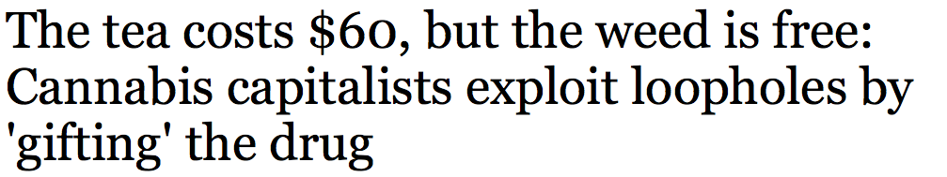
https://www.chicagotribune.com/business/ct-biz-free-marijuana-loopholes-20180201-story.html

Slide 82
Illinois 2019
Cannabis products “not intended to be smoked” (e.g., beverage, food, oil, ointment, tincture, topical formulation) will carry a 20% tax rate regardless of THC content.
Products intended to be smoked (dabs, vaping cartridges, and flower or bud) will be taxed either at 10% or 25%, depending on THC content. If THC content is below 35%, a tax of 10% will apply, while products at or above 35% will be taxed at 25%.

Slide 83
Cannabis tax base?
Potency
Price
Weight
Square feet
Electricity

Slide 84


Why not weight?
Weight base would encourage high potency.
Notes:
If an ounce of ditchweed and an ounce of highly potent concentrate bear the same tax, the seller delivers more bang for the buck to the customer by selling only powerful product. That’s maybe why the tax on a pint of liquor is many times the tax on a pint of beer.

Slide 85
Why not weight?
All marijuana is not created equal.
So categories proliferate.
Notes:
If an ounce of ditchweed and an ounce of highly potent concentrate bear the same tax, the seller delivers more bang for the buck to the customer by selling only powerful product. That’s maybe why the tax on a pint of liquor is many times the tax on a pint of beer.

Slide 86

CO: Bud (flowers) – 25 cents/gram v. Trim (leaves) -- 11 cents/gram

Slide 87
Nevada
Flower — 75 cents a gram
Trim — 20 cents a gram
Small bud — 50 cents a gram
Wet whole plant — 7 cents a gram.
NV taxes by the unit
immature plants ($15)
seeds (($0.90)
pre-rolls ($0.75)
https://tax.nv.gov/uploadedFiles/taxnvgov/Content/Forms/Retail-Marijuana-Fair-Market-Value-Jan-1-2018.pdf

Slide 88
Alaska
(1) mature bud will be taxed at $50 an ounce
(2) immature bud will be taxed at $25 an ounce;
(3) abnormal bud will be taxed at $25 an ounce;
(4) the remainder of the plant will be taxed at $15 an ounce; and
(5) clones will be taxed at $1 per plant.

Slide 89
Alaska
11) “abnormal bud” . . .
  (A) failed a microbial testing required by 3 AAC 306.645(b); or
  (B) contains observable seeds;

Slide 90
Alaska
(14) “immature bud” means an immature flower formed on a flowering marijuana plant, . . . that generally
  (A) appear loose, wispy, or leafy; and
  (B) are not dense to sight or touch;

Slide 91
Cannabis tax base?
Potency
Price
Weight
Square feet
Electricity

Slide 92

California canopy taxes on medical marijuana
Square footage taxes from $10 to $900
Some are indexed for inflation
Notes:
Taxes on grow areas. They can grow a lot of profitable product in a tiny area.

Slide 93
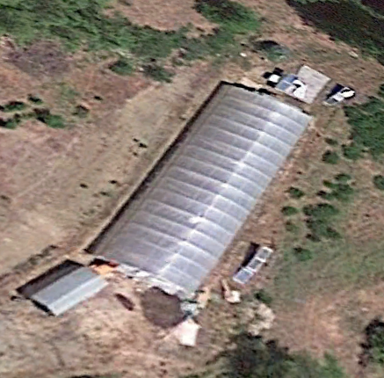
Google Earth Garberville, California

Slide 94
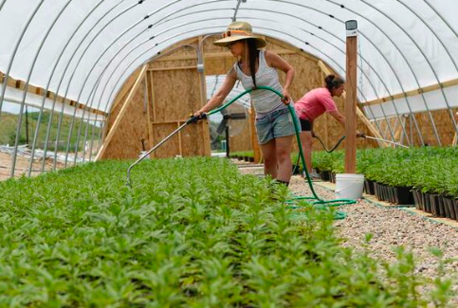

Slide 95

Mendocino: $50 per plant
Notes:
Put a RFID zip-tie tag on each plant, and charge for it.

Slide 96
Cannabis tax base?
Potency
Price
Weight
Square feet
Electricity

Slide 97

All electricity usage over 600% of Baseline – Arcata California tax
Notes:
Another way of taxing marijuana without using the word marijuana is to tax indoor grow operations that use a lot of electricity – In the case of Arcata, more than 6 times the average for that size building.

Slide 98

http://evan-mills.com/energy-associates/Indoor_files/420-HSU-Talk-abbreviated.pdf
Notes:
Some highlights: Grow lights; Dehumidification
Ventilation
Last line: data center like Google has in Lenoir: notoriously energy intensive.

Slide 99
Cannabis tax base?
Potency
Price
Weight
Square feet
Electricity
Combinations

Slide 100
Combinatory Workarounds Proposed for Cannabis

Slide 101
New York PROPOSAL for potency proxy
$50 per ounce for plant matter, $200 per ounce for concentrates

Slide 102
Canada
By ounce for plant matter, by ounce of THC for concentrates

Slide 103
Alternative Minimum Tax
Backup for price or weight:
Stated THC, forcing seller to
  Pay more tax or
  Tell buyers product is “weak”

Slide 104
EU tobacco taxes
  Specific – weight
  Ad valorem
  VAT

Slide 105
Marijuana Excise Outline
  Hard to Tax
  Legalization
  Carve-outs
  Base
  Side Issues
  Recap: State of play

Slide 106
How much? Considerations:
Illegal market
Youth and abusers
Dynamic market – dropping price

Slide 107
Government Monopolies?
North Bonneville, Washington
Louisiana State University
Canadian provinces

Slide 108

Collection point
Choke point
Notes:
Ideally, where commerce is naturally concentrated.

Slide 109

Notes:
This consumer will not be paying tax on this shoplifted merchandise.

Slide 110
Subnational producer taxes eventually fail
North Carolina doesn’t tax tobacco farmers or manufacturers.
Eric Garner NY cigarette case
National tax can deter
  interior smuggling
  race to the bottom

Slide 111
Marijuana Excise Outline
  Hard to Tax
  Legalization
  Carve-outs
  Base
  Side Issues
  Recap: State of play

Slide 112
Canada
Tax: Greater of $1 per gram or 10% of retail
Provincial wholesale (and retail) monopolies

Slide 114
Carbon
Taxing pollutants or BTUs
Border tax adjustments
Chlorofluorocarbon precedent

Slide 115
Takeaways, Via Case Studies of Alcohol and Marijuana
Why excises (EU & UK “duties”)? The ideal is not tax everything the same. Differentiate.
Use Tax Bases beyond Currency.

Slide 116
At your service
Pat Oglesby
po@newrevenue.org
Www.newrevenue.org

Slide 117
The End.

Slide 118
SCRAPS follow this

Slide 119

$79.92 - $0.62 = $79.30/oz.

Slide 120
Why not weight?
Weight base would encourage high potency.
Notes:
If an ounce of ditchweed and an ounce of highly potent concentrate bear the same tax, the seller delivers more bang for the buck to the customer by selling only powerful product. That’s maybe why the tax on a pint of liquor is many times the tax on a pint of beer.

Slide 121
Marijuana Excise Outline
  Hard to Tax
  Legalization
  Carve-outs
  Base
  Side Issues
  Recap: State of play

Slide 122
Specific vs. ad valorem
Specific:
Barrels of beer
Liquor – proof
Cigarettes – pounds
Carbon
Soda: ounces or sugar content
vs. ad valorem

Slide 125
