Slide 1
Taxing Marijuana
NTA 2019
Pat Oglesby
Center for New Revenue
Www.newrevenue.org

Slide 2

Pat Oglesby in 1984

Slide 3
Marijuana taxation
Voters
Medical marijuana
280E
Price-weight Bud-trim
Illinois THC notch

Slide 4


Slide 5
Typical results:
Initiatives to legalize cannabis ≤ 57% of votes
Standalone cannabis tax initiatives > 75%.
https://www.leafly.com/news/industry/opinion-theres-a-better-way-to-tax-legal-cannabis

Slide 6

Tax medical cannabis?
How do we know it’s medical?
  $
  Exernalities
  Internalites

Slide 7


Exempt medical from tax?
!
Notes:
I will gleefully stipulate that for some people marijuana is medicine. I’ve heard and read too many stories of miraculous cures and healing. God bless the patients.

Slide 8
Goals of revenue tools:
Price – keep it up
Products – nudge toward safer ones
Promotion – keep it down
[Revenue for programs]
BUT marginalize illegal market
Notes:
Rabbi
John Prine

Slide 9
IRC § 280E & Ads
1982: For federally illegal drugs, no income tax deduction except cost of goods sold
Images from Lynn Silver

Slide 10
280E violates the principle of taxing all income the same

Slide 11
Section 162
(e) Denial of deduction for certain lobbying and political expenditures
(1) In general
No deduction shall be allowed under subsection (a) for any amount paid or incurred in connection with—
(A) influencing legislation
https://www.law.cornell.edu/uscode/text/26/162

Slide 12
Photos by Lynn Silver, California Public Health Institute
PPh

Slide 13
Happiness

Slide 14
Appeal to youth

Slide 15

Sex Appeal

Slide 16
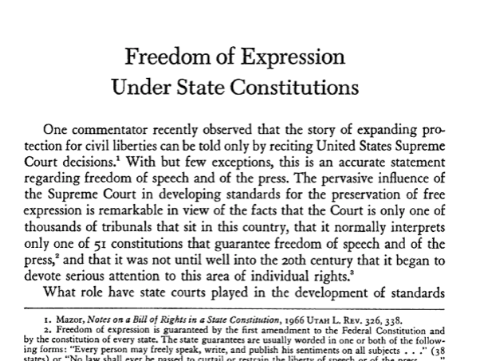

Slide 17
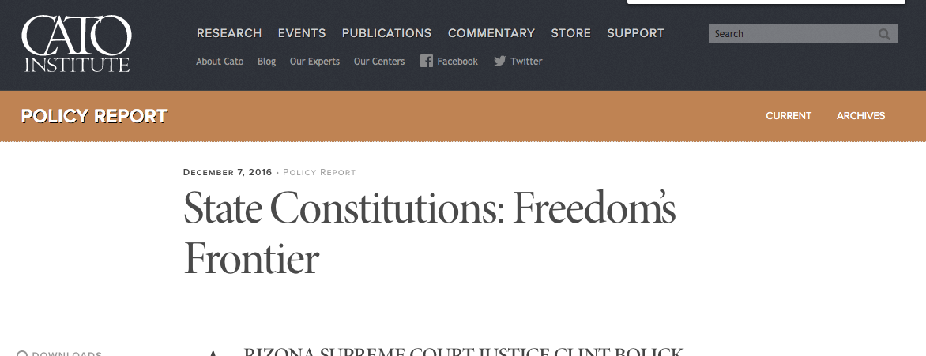

Slide 18

NORML supports the continuation of non-tax-deductibility of marijuana business advertising expenses.
For some citizens, advertising is a distraction, or can be a red flag that can cause them to hesitate to support the sound policy of legalization. . . .
maintaining the non-deductibility of advertising costs can act as a preemptive move against well funded corporate controlled marijuana companies, which can afford extensive advertising.

Slide 19


Slide 20
Price and Weight bases

Slide 21


New World’s first marijuana tax
Oakland, CA, July 21, 2009: 1.8 percent of gross medical receipts
Notes:
A tiny tax at retail – enacted in referendum with 80 percent of voters saying yes. Oakland has its fiscal troubles, and the marijuana community stepped up in a small way.

Slide 22
Taxing by price
E.g.,15% of retail price
Easy to start
Sophisticated methods need pre-collection cash flow
May piggyback on retail sales tax
(Salience – does customer see tax amount?)

Slide 23
Price (Ad valorem) base problems
Relationship & quantity discounts
Predictable price collapse
Free pot with pipe (bundling)

Slide 24


Slide 25


Slide 26
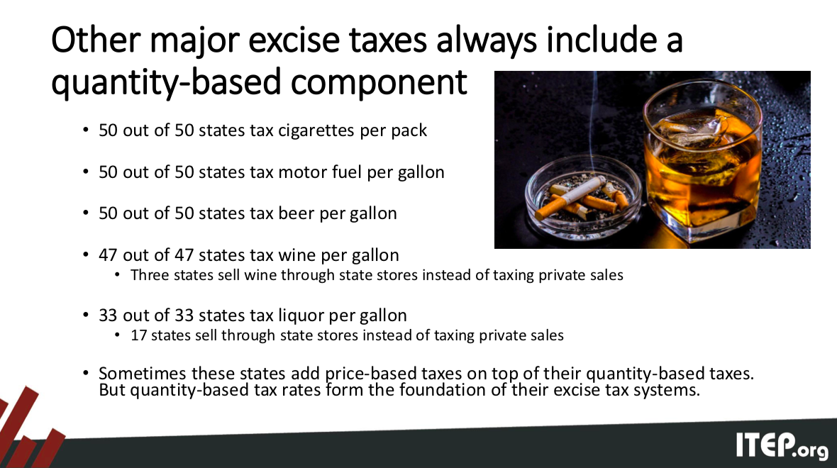

Slide 30

Alaska:
Bud (flower) – $50/ounce v. Trim (leaves) -- $15/ounce

Slide 31
Bud-trim states
Alaska
California
Colorado
Maine
Nevada

Slide 32
Nevada – old rates
Flower — 75 cents a gram
Trim — 20 cents a gram
Small bud — 50 cents a gram
Wet whole plant — 7 cents a gram.
NV taxes by the unit
immature plants ($15)
seeds (($0.90)
pre-rolls ($0.75)
https://tax.nv.gov/uploadedFiles/taxnvgov/Content/Forms/Retail-Marijuana-Fair-Market-Value-Jan-1-2018.pdf

Slide 33
Alaska
(1) mature bud will be taxed at $50 an ounce
(2) immature bud will be taxed at $25 an ounce;
(3) abnormal bud will be taxed at $25 an ounce;
(4) the remainder of the plant will be taxed at $15 an ounce; and
(5) clones will be taxed at $1 per plant.

Slide 34
Alaska
11) “abnormal bud” . . .
  (A) failed a microbial testing required by 3 AAC 306.645(b); or
  (B) contains observable seeds;
http://tax.alaska.gov/programs/documentviewer/viewer.aspx?130n

Slide 35
Alaska
(14) “immature bud” means an immature flower formed on a flowering marijuana plant, . . . that generally
  (A) appear loose, wispy, or leafy; and
  (B) are not dense to sight or touch;

Slide 36
The Illinois THC notch

Slide 37


Notes:
The y axis shows TCH by weight. Samples from the same plant sent to different labs show results from around 11 to 7 percent. That’s not close enough for government work.

Slide 38

Fungible concentrate – Use potency?
Notes:
But chemical processes can produce highly concentrated material that is fungible. Its THC content can be measured reliably.

Slide 39
Illinois 2019
Cannabis products “not intended to be smoked” (e.g., beverage, food, oil, ointment, tincture, topical formulation) will carry a 20% tax rate regardless of THC content.
Products intended to be smoked (dabs, vaping cartridges, and flower or bud) will be taxed either at 10% or 25%, depending on THC content. If THC content is below 35%, a tax of 10% will apply, while products at or above 35% will be taxed at 25%.

Slide 40
The Illinois THC notch
Illinois: If THC content is below 35%, a tax of 10% will apply,
while products at or above 35% THC will be taxed at 25%.

Slide 41
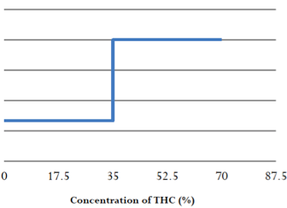

Slide 42
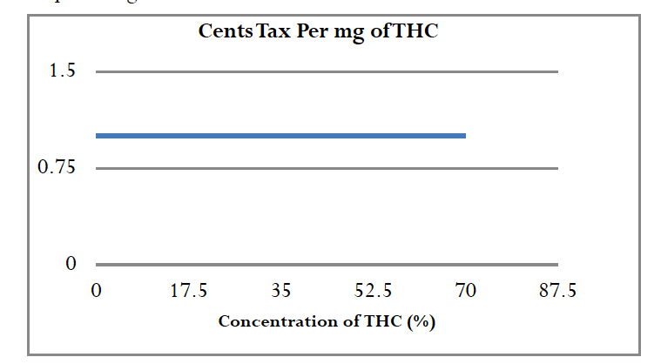

Slide 44
42 U.S. Code section 6295(u)(3) sets a sliding scale for taxing energy use by applying a tax of 0.09 times the ln(x) of the output.

Slide 45

Collection point
Choke point
Notes:
Ideally, where commerce is naturally concentrated.

Slide 46
Government Monopolies?
North Bonneville, Washington
Louisiana State University
Canadian provinces

Slide 47
Subnational producer taxes eventually fail
North Carolina doesn’t tax tobacco farmers or manufacturers.
Eric Garner NY cigarette case
National tax can deter
  interior smuggling
  race to the bottom

Slide 48

Externalities
“how many people can get stoned and still have a great state or a great nation?”

Slide 49
Medical: Positive internalities
But
Recreational: Negative externalities

Slide 50

Internalities?

Slide 51
Cannabis Law Reform
@MikeDeVillaer
Replying to
@OglesbyPat
There is no financial capture of the "cost" of sleepless nights & near-perpetual agony & stress experienced by family members of someone with drug dependence. And there are millions & millions of them, & it goes on for yrs & yrs.

Slide 52
At your service
Pat Oglesby
po@newrevenue.org
Www.newrevenue.org

Slide 54
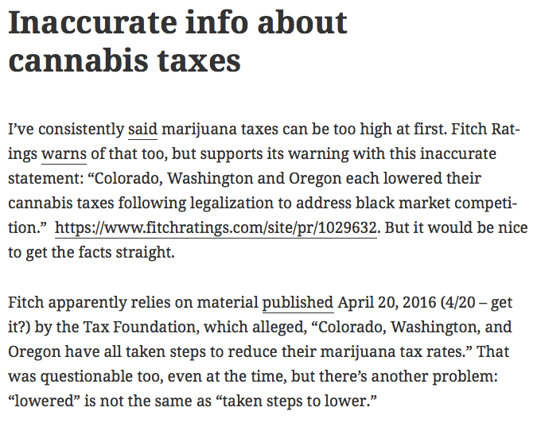
A discontinuous range involves a function with a gap or cliff, like: Income is taxed starting at 10%; all income of taxpayers with income over $1,000,000 is taxed at 30%. Tax liability for income of exactly $1,000,000 is $100,000. Tax liability for income of $1,000,100 is $300,030. The marginal rate of tax on the extra $100 of income is 20,003% ($200,030/$100)

Slide 55
https://newrevenue.org/2017/10/04/inaccurate-info-about-cannabis-taxes/

