Slide 1
The Structure of Marijuana Taxes
Patrick Oglesby
919 619 8838
po@newrevenue.org
Slides at www.newrevenue.org
4 December 2019
Notes:
Floyd flood – 35 in NC

Slide 2
Laboratories of Democracy

Slide 3
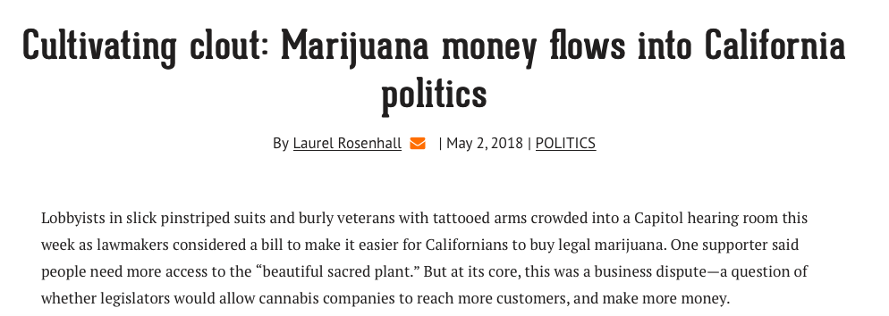
https://calmatters.org/articles/cultivating-clout-marijuana-money-flows-into-california-politics/

Slide 4
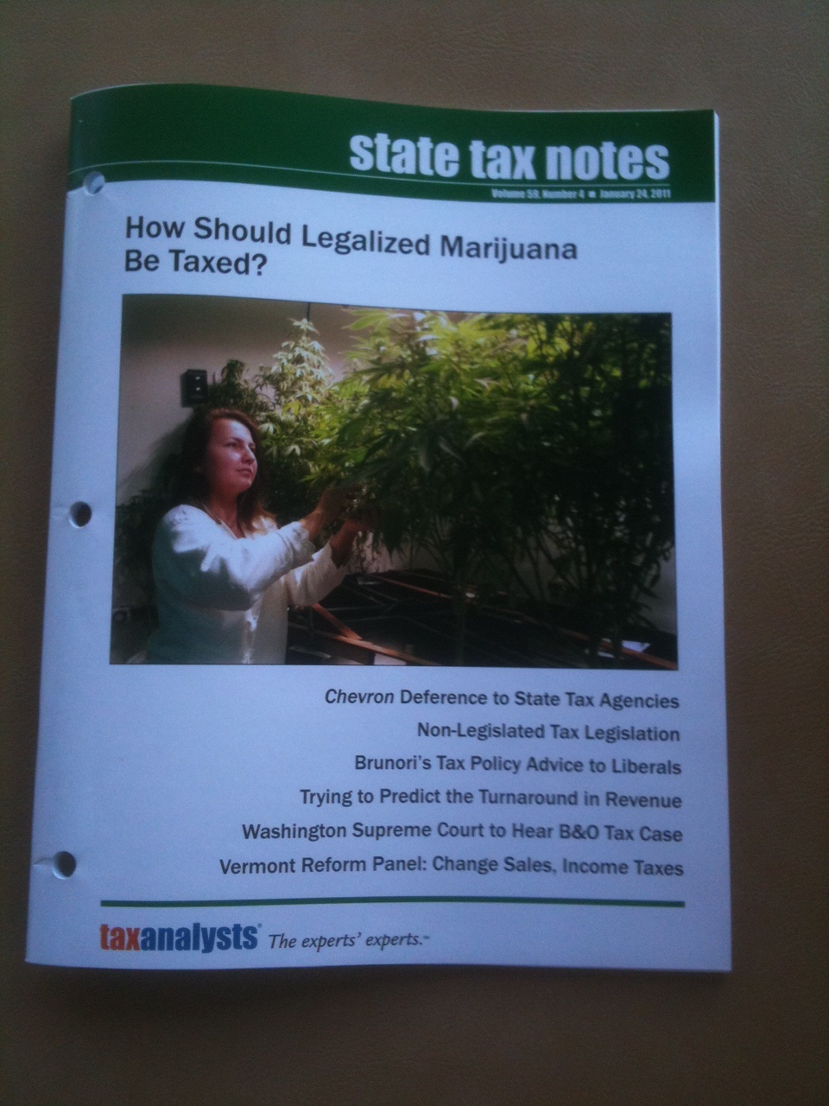
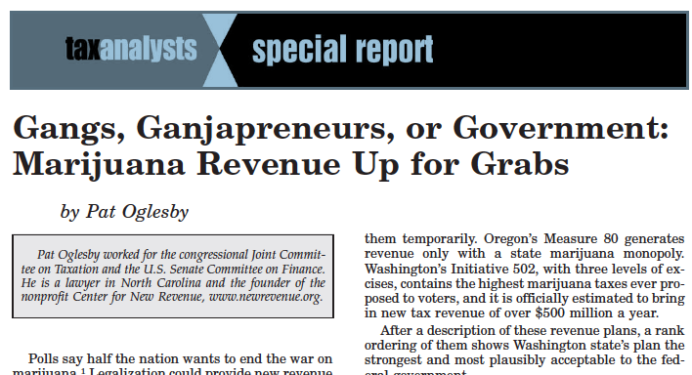
Notes:
2012 article about the details of proposals out west
Also in materials

Slide 5
How Can Revenue Serve Cannabis Policy?
Patrick Oglesby, J.D., M.B.A., Founder, Center for New Revenue

Slide 6
Let’s Tax Weed
Patrick Oglesby, J.D., M.B.A., Founder, Center for New Revenue

Slide 7

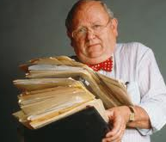
≠

Slide 8
At your service
Pat Oglesby
919 619 8838
po@newrevenue.org

Slide 9

Case study:
Alcohol

Slide 10
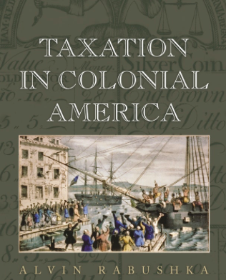
The Evolution of Alcohol Taxes:
Ease of Collection
From primitive to advanced

Slide 11
The Evolution of Alcohol Taxes:
License fees
Tariffs
Proxy taxes
Beverage volume
Alcohol volume
  Lumpy ranges -- Notches
  Exact quantity

Slide 12

Tariffs = Customs duties
Collection only at the border

Slide 13

License fees: Stills and taverns

Slide 14
Proxy taxes for alcohol
Massachusetts 1673: malt
1764 British Sugar Act: Molasses tax
1790s USA: Still capacity

Slide 15
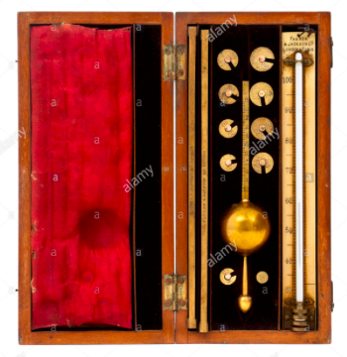
Alcohol content (“proof”)
1791 Whisky – Dicas’ hydrometer

Slide 16
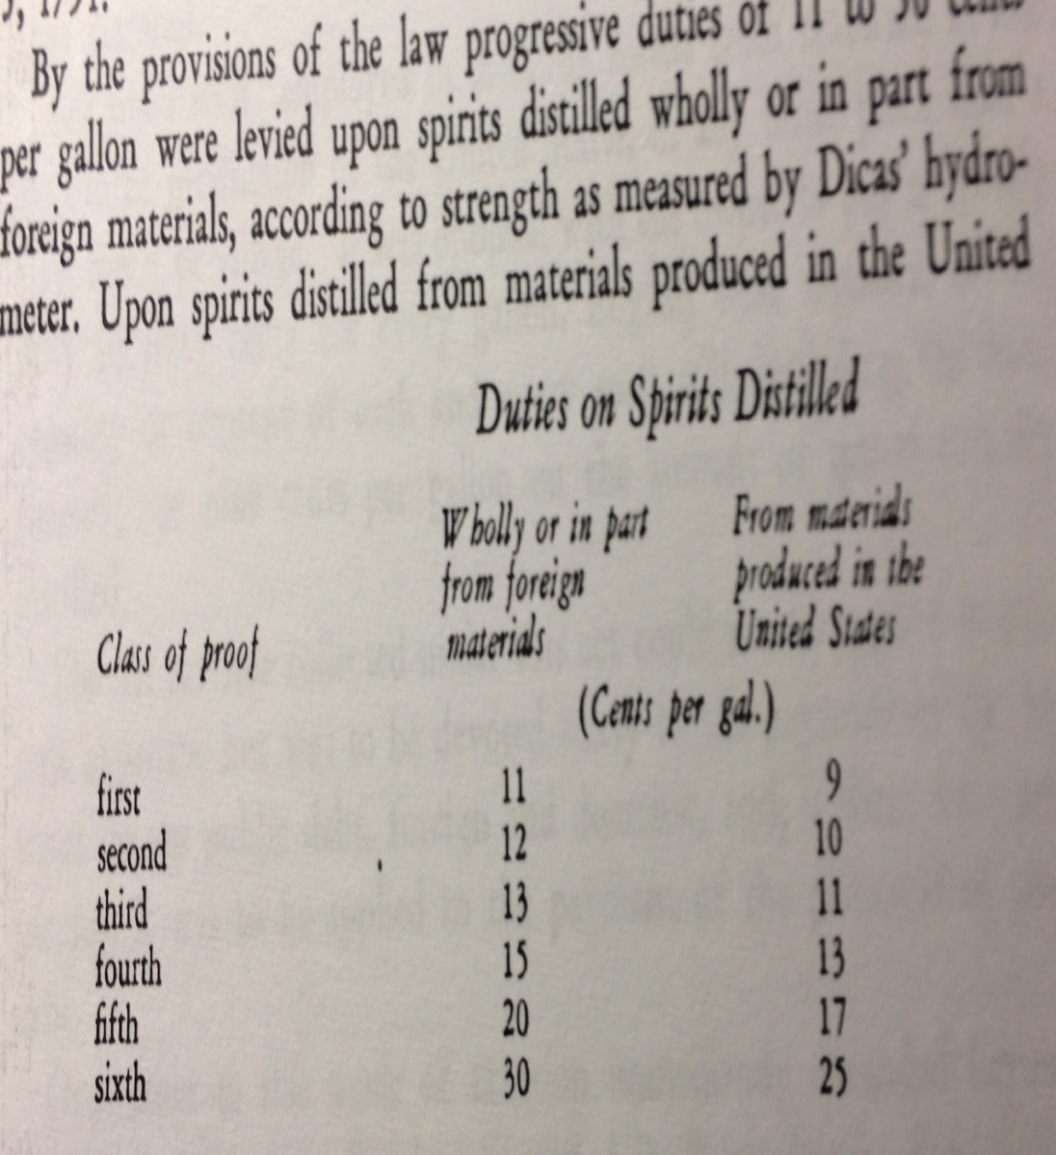

Slide 18
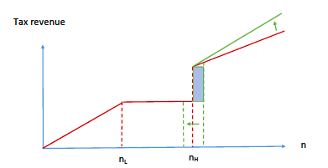
Alcohol volume
  We avoid lumpy ranges -- Notches

Slide 19
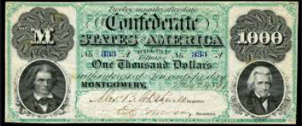
Price-based alcohol taxes
25% on “Brandy and other spirits distilled from grain or other materials, cordials, absynthe, arrack, curacoa, kirschenwesser, liquers, maraschino, ratafia, and other spirituous beverages of a similar character.” https://docsouth.unc.edu/imls/19conf/19conf.html

Slide 20


Slide 21
Marijuana focus: Tax base for plant material
Price (ad valorem)
Potency (THC)
Weight (flower > leaves)
Medical cannabis?
Advertising (state 280E taxes)

Slide 22
Background and State of Play

Slide 23
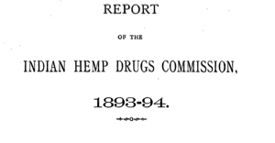
https://digital.nls.uk/indiapapers/browse/archive/74908458

Slide 24


Slide 25


Slide 26


New World’s first marijuana tax
Oakland, CA, July 21, 2009: 1.8 percent of gross medical receipts
Notes:
A tiny tax at retail – enacted in referendum with 80 percent of voters saying yes. Oakland has its fiscal troubles, and the marijuana community stepped up in a small way.

Slide 27
Voters usually like taxes > legalization
Legalization gets ≤ 57%
Taxes get > 67%

Slide 28
PPP

Slide 29

Taxing by price (Ad valorem, like sales tax): Advantages
-- Easy to set up at first
-- “Slightly higher rates on more potent products and/or premium products” -- ITEP.
Notes:
Towns know
to slap on a percentage tax. That doesn’t require setting up a weight station or a chemistry lab.

Slide 30
Price (Ad valorem) base problems
Relationship & quantity discounts
Fake prices: Free pot with pipe
Predictable price collapse

Slide 31


Slide 32

http://www.huffingtonpost.com/2013/04/20/marijuana-per-ounce-price_n_3094520.html

Slide 33

Why not THC potency?

Slide 34
No jurisdiction in the world taxes cigarettes by tar and nicotine content.
-- says po@newrevenue.org.
.

Slide 35


Why not potency?
Notes:
The answer is that this vegetable matter is not fungible. The trichomes have more THC than other parts of the plant, so two people picking out samples to put in the machine may pick samples with widely different amounts of THC.

Slide 36
BOTEC

Slide 37


Dale Gieringer, CA NORML
Notes:
The y axis shows TCH by weight. Samples from the same plant sent to different labs show results from around 11 to 7 percent. That’s not close enough for government work.

Slide 38
"We’ve all been lured toward high percentages of THC"
but "optimized highs" involve terpenes –
Leafly

Slide 39


Concentrates (and products) are more homogenous than flower

Slide 40
Tax by quantity -- weight?
Notes:
If an ounce of ditchweed and an ounce of highly potent concentrate bear the same tax, the seller delivers more bang for the buck to the customer by selling only powerful product. That’s maybe why the tax on a pint of liquor is many times the tax on a pint of beer.

Slide 41
  50 out of 50 states tax cigarettes per pack
  50 out of 50 states tax motor fuel per gallon
  50 out of 50 states tax beer per gallon
  47 out of 47 states tax wine per gallon
    Three states sell wine through state stores instead of taxing private sales
  33 out of 33 states tax liquor per gallon
    17 states sell through state stores instead of taxing private sales
  Sometimes these states add price-based taxes on top of their quantity-based taxes. But quantity-based tax rates form the foundation of their excise tax systems. -- Slide from ITEP.
Notes:
Certain amount of harm per unit. It doesn’t matter if you’re drinking Busch Lite or craft beer. Charge the same amount for the same amount of intoxicant.

Slide 42
That slide was from left-leaning ITEP; right-leaning Tax Foundation warns about price-based marijuana taxes.

Slide 43
Tax Foundation
Only Alaska’s system is safe from the effects of volatile cannabis prices, . . . Generally, excise taxes are imposed at a specific amount regardless of the price, but an ad valorem tax[,] a simpler approach[, risks] losing out on forecasted revenue if prices continue to go down.
https://taxfoundation.org/safe-banking-act-state-marijuana-revenues/

Slide 44

Why not weight?
Weight base would encourage high potency.
So categories proliferate.
Notes:
If an ounce of ditchweed and an ounce of highly potent concentrate bear the same tax, the seller delivers more bang for the buck to the customer by selling only powerful product. That’s maybe why the tax on a pint of liquor is many times the tax on a pint of beer.

Slide 45

CO: Bud (flowers) – 33 cents/gram v. Trim (leaves) -- 11 cents/gram

Slide 46
California indexed taxes
$9.65 for an ounce of flower,
$2.87 for an ounce of leaves,
$1.35 for an ounce of fresh marijuana plant material

Slide 47
Alaska
(1) mature bud will be taxed at $50 an ounce
(2) immature bud will be taxed at $25 an ounce;
(3) abnormal bud will be taxed at $25 an ounce;
(4) the remainder of the plant will be taxed at $15 an ounce; and
(5) clones will be taxed at $1 per plant.

Slide 48
Alaska
11) “abnormal bud” . . .
  (A) failed a microbial testing required by 3 AAC 306.645(b); or
  (B) contains observable seeds;

Slide 49
Alaska
(14) “immature bud” means an immature flower formed on a flowering marijuana plant, . . . that generally
  (A) appear loose, wispy, or leafy; and
  (B) are not dense to sight or touch;

Slide 50
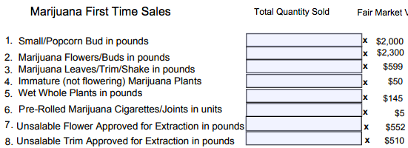
Nevada – 15% conversion

Slide 52
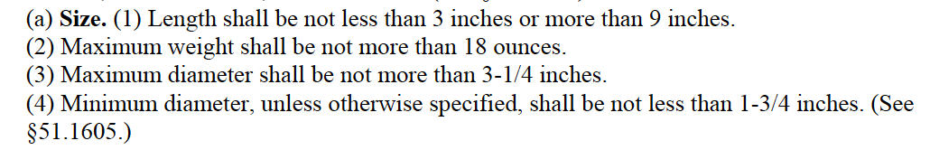
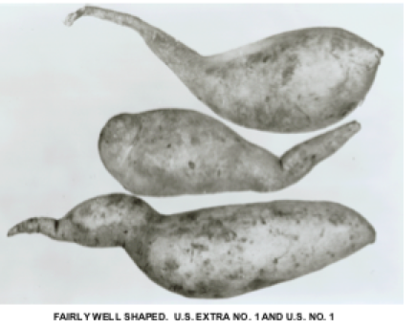
Grade 1 Sweet Potatoes

Slide 53
Flower and concentrates:
Combination of methods?

Slide 54
Federal alcohol taxes
Beer: Volume: $18/barrel
Liquor: Potency: $13.50 per proof gallon ($6.25 per gal. of alcohol)
https://www.ttb.gov/tax_audit/taxrates.shtml

Slide 55

Weight for flower?
Homogenous concentrates – Use potency?

Slide 56
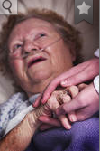
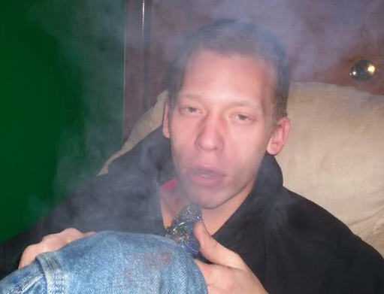
Exempt medical from tax?
!
Notes:
I will gleefully stipulate that for some people marijuana is medicine. I’ve heard and read too many stories of miraculous cures and healing. God bless the patients.

Slide 57

Government stores

Slide 58
IRC § 280E & Ads
1982: For federally illegal drugs, no income tax deduction except cost of goods sold
State income tax “conformity”
Images from Lynn Silver

Slide 59
280E violates the principle of taxing all income the same

Slide 60
Section 162
(e) Denial of deduction for certain lobbying and political expenditures
(1) In general
No deduction shall be allowed under subsection (a) for any amount paid or incurred in connection with—
(A) influencing legislation
https://www.law.cornell.edu/uscode/text/26/162

Slide 61
Happiness

Slide 62
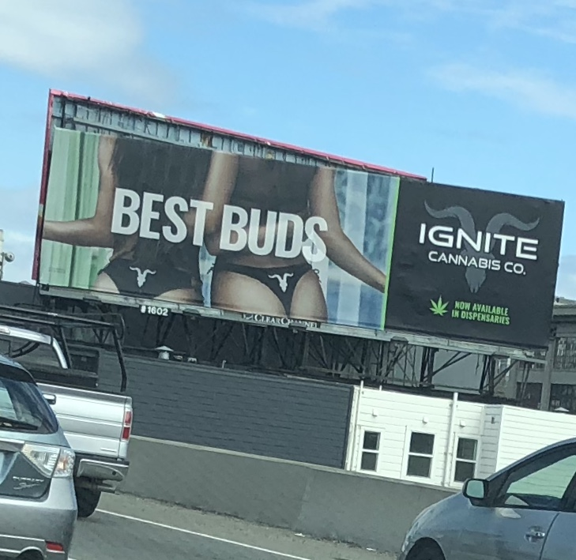
Sex Appeal

Slide 63
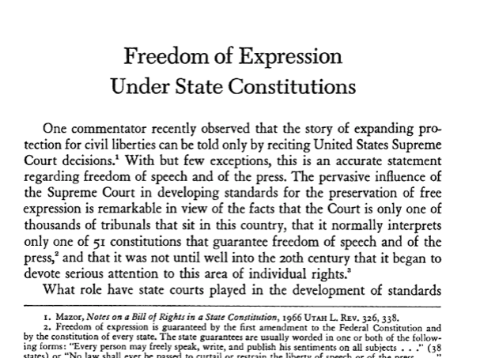

Slide 64
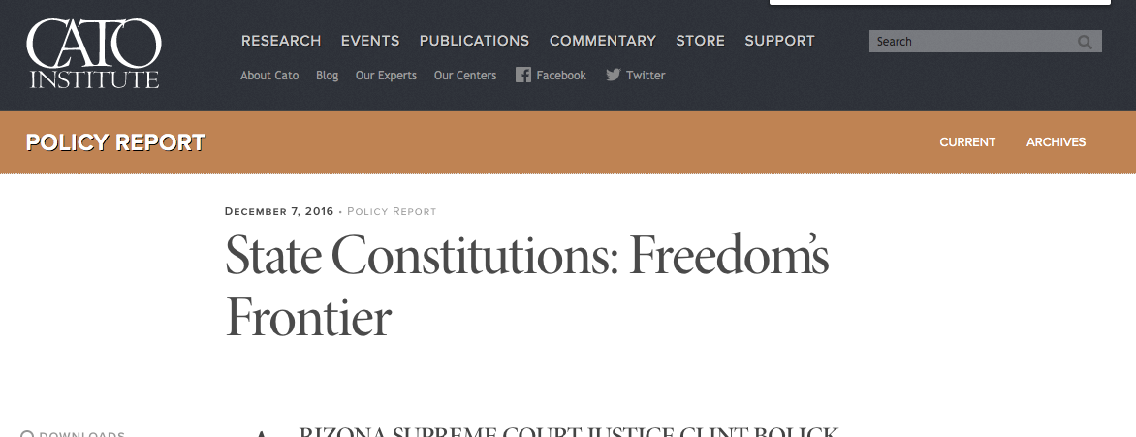

Slide 65

NORML supports the continuation of non-tax-deductibility of marijuana business advertising expenses.
For some citizens, advertising is a distraction, or can be a red flag that can cause them to hesitate to support the sound policy of legalization. . . .
maintaining the non-deductibility of advertising costs can act as a preemptive move against well funded corporate controlled marijuana companies, which can afford extensive advertising.

Slide 66
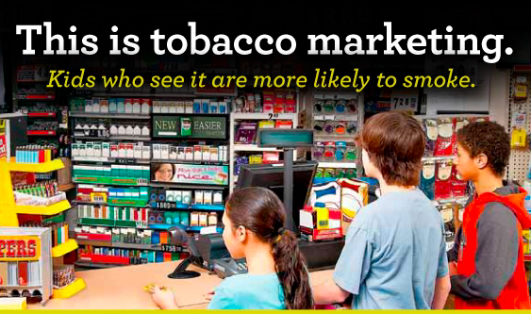

Slide 67
PPP

Slide 68
At your service
Pat Oglesby
919 619 8838
po@newrevenue.org

Slide 69
At your service
Pat Oglesby
919 619 8838
po@newrevenue.org

Slide 70
SCRAPS

Slide 71
Why marijuana excise taxes?
So people will agree to legalize
For revenue
Limit “Substance Use Disorder”
Keep price-sensitive Kids and SUD people away
Keep accidents down
Pay for harms
Productivity: “Nation of Stoners”

Slide 72
Marijuana Excise Outline
  Hard to Tax
  Legalization
  Carve-outs
  Base
  Side Issues
  Recap: State of play

Slide 73

Hard to Tax
Light weight
Easy to grow – “Weed”
High pre-legalization prices make illegal sales profitable.

Slide 74
Illinois 2019
Cannabis products “not intended to be smoked” (e.g., beverage, food, oil, ointment, tincture, topical formulation) will carry a 20% tax rate regardless of THC content.
Products intended to be smoked (dabs, vaping cartridges, and flower or bud) will be taxed either at 10% or 25%, depending on THC content. If THC content is below 35%, a tax of 10% will apply, while products at or above 35% will be taxed at 25%.

Slide 75

California canopy taxes on medical marijuana
Square footage taxes from $10 to $900
Some are indexed for inflation
Notes:
Taxes on grow areas. They can grow a lot of profitable product in a tiny area.

Slide 76
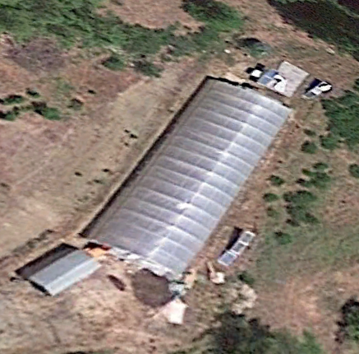
Google Earth Garberville, California

Slide 77
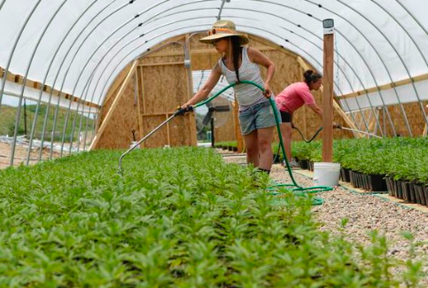

Slide 78

Mendocino: $50 per plant
Notes:
Put a RFID zip-tie tag on each plant, and charge for it.

Slide 79

All electricity usage over 600% of Baseline – Arcata California tax
Notes:
Another way of taxing marijuana without using the word marijuana is to tax indoor grow operations that use a lot of electricity – In the case of Arcata, more than 6 times the average for that size building.

Slide 80
New York PROPOSAL for potency proxy
$50 per ounce for plant matter, $200 per ounce for concentrates

Slide 81
EU tobacco taxes
  Specific – weight
  Ad valorem
  VAT

Slide 82
How much? Considerations:
Illegal market
Youth and abusers
Dynamic market – dropping price

Slide 83
Government Monopolies?
North Bonneville, Washington
Louisiana State University
Canadian provinces

Slide 84
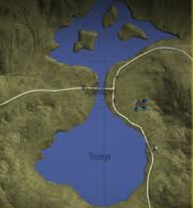
Collection point
Choke point
Notes:
Ideally, where commerce is naturally concentrated.

Slide 85

Notes:
This consumer will not be paying tax on this shoplifted merchandise.

Slide 86
Subnational producer taxes eventually fail
North Carolina doesn’t tax tobacco farmers or manufacturers.
Eric Garner NY cigarette case
National tax can deter
  interior smuggling
  race to the bottom

Slide 87
Canada
Tax: Greater of $1 per gram or 10% of retail
Provincial wholesale (and retail) monopolies

Slide 88

$79.92 - $0.62 = $79.30/oz.

Slide 89
Specific vs. ad valorem
Specific:
Barrels of beer
Liquor – proof
Cigarettes – pounds
Carbon
Soda: ounces or sugar content
vs. ad valorem

Slide 90
Year | Alcohol taxes ($million) | Alcohol taxes over total taxes
1863 | $6 | 6.19%
1864 | $33 | 14.97%
1874 | $59 | 22.14%
1884 | $95 | 30.00%
1894 | $117 | 41.82%
1904 | $185 | 37.41%
1914 | $226 | 33.64%
1924 | $28 | 0.83%
1934 | $259 | 8.67%
1944 | $1,619 | 3.99%

Slide 91
At your service
Pat Oglesby
919 619 8838
po@newrevenue.org
Www.newrevenue.org

Slide 92
Case study:
Alcohol

Slide 93
The Evolution of Alcohol Taxes:
Ease of Collection
From primitive to advanced

Slide 94
The Evolution of Alcohol Taxes:
License fees
Tariffs
Proxy taxes
Beverage volume
Alcohol volume
  Lumpy ranges -- Notches
  Exact quantity

Slide 95
Tariffs = Customs duties
Collection only at the border

Slide 96
License fees: Stills and taverns

Slide 97
Proxy taxes for alcohol
Massachusetts 1673: malt
1764 British Sugar Act: Molasses tax
1790s USA: Still capacity

Slide 98
Beverage volume
By the gallon of beer

Slide 99
Alcohol volume
  Lumpy ranges -- Notches

Slide 100
1791 Whisky – Dicas’ hydrometer
Alcohol content (proof)

Slide 103
Alcohol volume
Exact quantity – no notches

Slide 105
Recent Federal liquor tax per proof gallon
1934 | 1938 | 1940 | 1942 | 1944 | 1951 | 1985 | 1991
$2.00 | $2.25 | $3.00 | $6.00 | $9.00 | $10.50 | $12.50 | $13.50

Slide 106
Price-based alcohol taxes
25% on “Brandy and other spirits distilled from grain or other materials, cordials, absynthe, arrack, curacoa, kirschenwesser, liquers, maraschino, ratafia, and other spirituous beverages of a similar character.” https://docsouth.unc.edu/imls/19conf/19conf.html

Slide 108
Canadian negative externalities
The four substances associated with the largest costs were (in order):
• Alcohol, contributing $14.6 billion or 38.1% of the total costs;
• Tobacco, contributing $12.0 billion or 31.2% of the total costs;
• Opioids, contributing $3.5 billion or 9.1% of the total costs; and
• Cannabis, contributing $2.8 billion or 7.3% of the total costs.

Slide 109
Cannabis Law Reform
@MikeDeVillaer
Replying to
@OglesbyPat
There is no financial capture of the "cost" of sleepless nights & near-perpetual agony & stress experienced by family members of someone with drug dependence. And there are millions & millions of them, & it goes on for yrs & yrs.

Slide 110
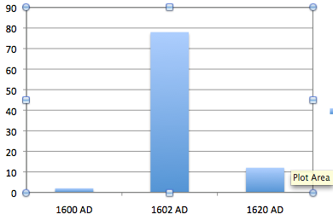
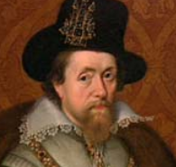
Adjusting rates – English tobacco tax
In pence/lb. 1600, 1602, 1620
Notes:
It’s almost inevitable that we will get rates wrong. There was another case when a new smoking material hit the market. King James I hated tobacco, so he raised the tax from 2 pence to 78 pence in 1602. Tax evasion was so widespread that the rate went down to 12 pence in 1620.

Slide 111
Nicotine vape taxes
Tax Foundation and Tax Policy Center: milliliter of fluid
U.S. House Ways & Means: milliliter of nicotine
https://newrevenue.org/2019/10/24/tax-nicotine-or-vaping-liquid/

