Slide 1
Cannabis Taxes
For Chief Judge Foley’s Class
University of San Diego
Pat Oglesby
po@newrevenue.org
Www.newrevenue.org
30 June 2021

Slide 2
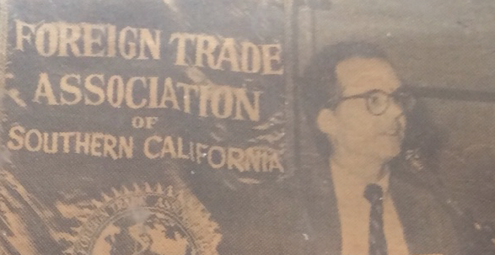
In 1984 – Joint Tax

Slide 3
Overview
What is cannabis?
Why tax it?
What precedents do we have?
So what should the tax base be?

Slide 4
What is cannabis?
-- Chemistry: ≥ 545 compounds
-- Consumption: 3 main product categories

Slide 5
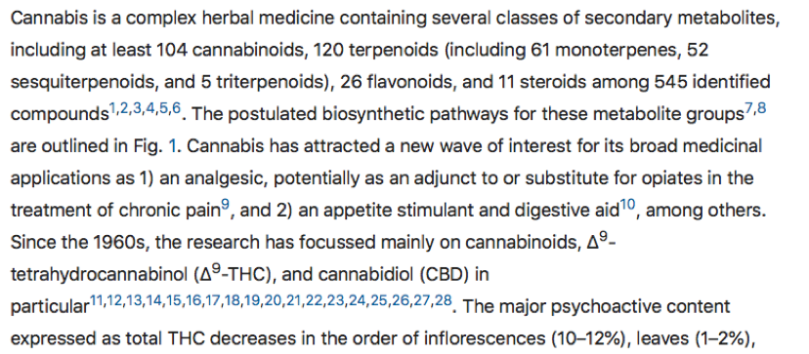
Cannabis has 545 “compounds”
https://www.nature.com/articles/s41598-020-60172-6

Slide 6
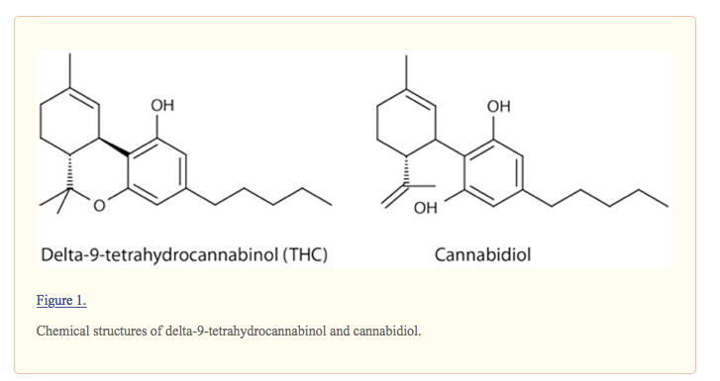
https://www.ncbi.nlm.nih.gov/pmc/articles/PMC3736954/
(THC is the target; Cannabidiol = CBD is not)

Slide 7
545 compounds +
-- THC -- intoxicant
-- CBD – over-the-counter potion
-- ≥ 543 others
-- AND new engineered intoxicants (delta-8; “CBD-derived THC”)

Slide 8
The “entourage effect”:
“one molecule [THC] is unlikely to match the . . . potential of [whole] Cannabis”
“The plant does it better.” https://www.ncbi.nlm.nih.gov/pmc/articles/PMC6334252/

Slide 9
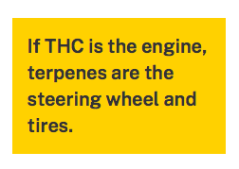
"We’ve all been lured toward high percentages of THC"
but "optimized highs" involve terpenes.
https://www.leafly.com/news/science-tech/beyond-thc-asserting-benefits-effects-terpenes

Slide 11
Consumer: 3 main product categories
-- Raw plant matter
-- Flower
-- Trim
-- Edibles
-- Other products

Slide 12


All but cannabis flower go through a concentrated or homogeneous stage.

Slide 13

Taxed differently: Bud (flower) and Trim (leaves)

Slide 14

Bud or flower

Slide 15
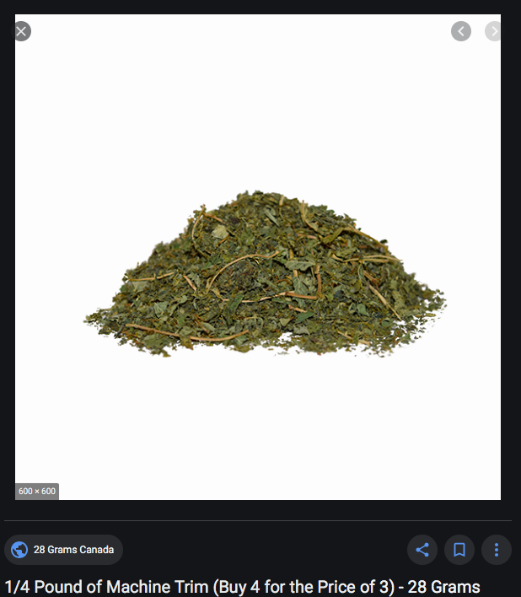
Trim or leaves

Slide 16
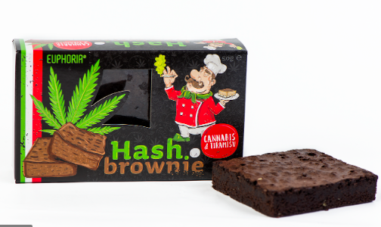
Edible

Slide 17
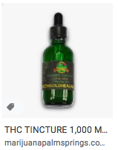
Tincture

Slide 18
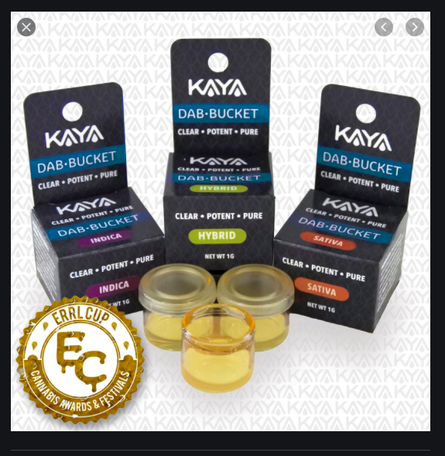

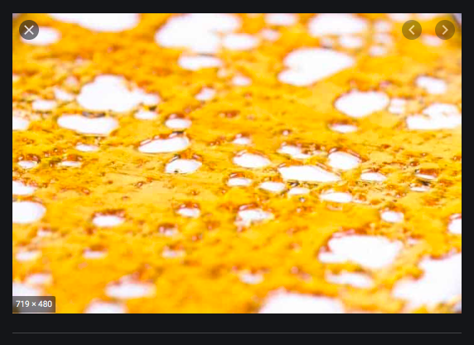
Dabs, shatter, wax, concentrates

Slide 19
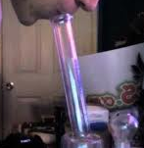
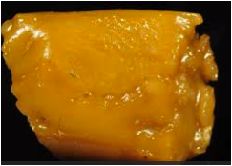
“So high that the user passes out” – sfweekly.com
Notes:
When smoked, it can be very powerful. However we tax plant matter, we may want to tax this wax and edibles made from it by potency.

Slide 20
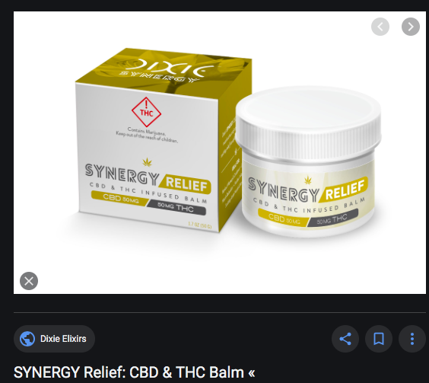
Cream

Slide 21
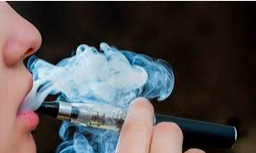
Vaping material

Slide 22
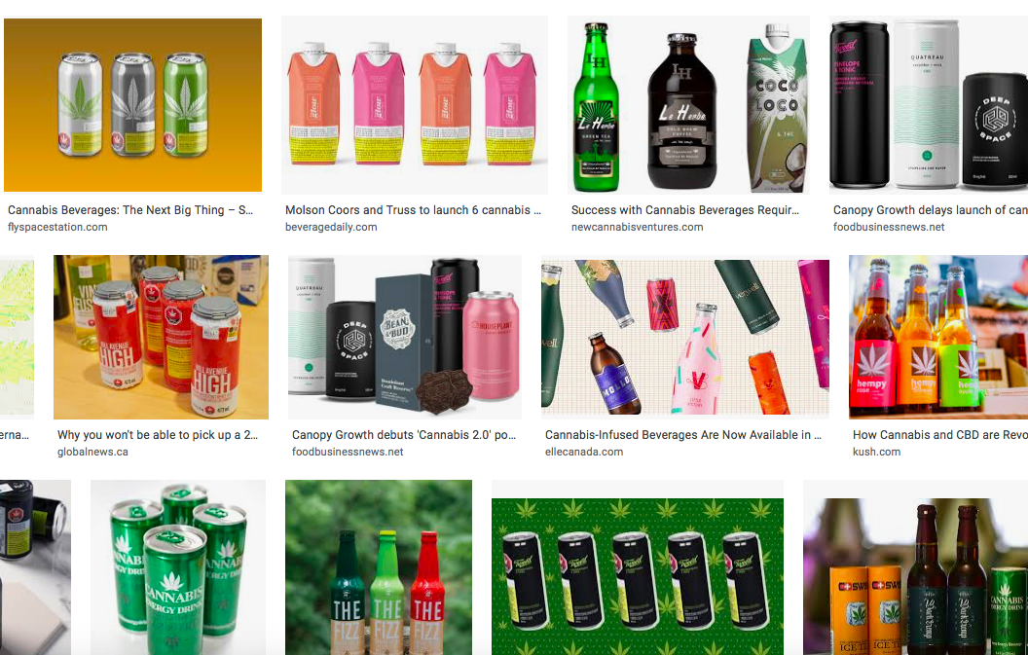
Beverages

Slide 23

Etc.

Slide 24
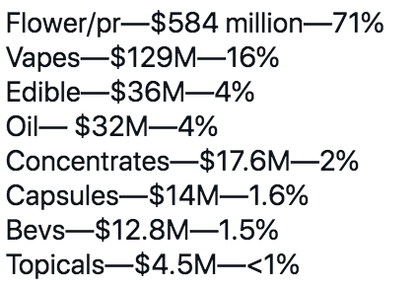
Ontario, Canada 2020

Slide 25
Should we tax cannabis?
You tell me.
Notes:
Towns know
to slap on a percentage tax. That doesn’t require setting up a weight station or a chemistry lab.

Slide 26
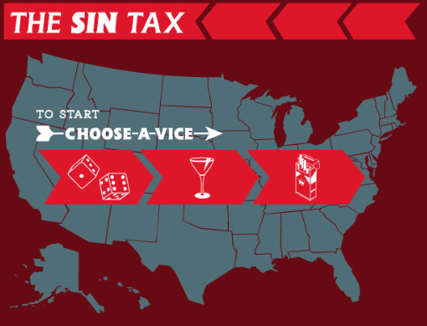
Notes:
Particularly interested in taxing things everyone doesn’t approve of
Gambling, alcohol, tobacco

Slide 27
Tax foes and friends:
Libertarians
Medical marijuana consumers
Legal sellers
Consumers
Ordinary taxpaying citizens
Tax workers
Frustrated prohibitionists
Spending advocates
Notes:
Towns know
to slap on a percentage tax. That doesn’t require setting up a weight station or a chemistry lab.

Slide 28
What tax burden is right?
Subsidize (negative tax)
Exempt (no tax)
Use general rules only (like shoes)
Offset current harm
Offset past harm, too
Maximize revenue
Notes:
Towns know
to slap on a percentage tax. That doesn’t require setting up a weight station or a chemistry lab.

Slide 29
https://www.youtube.com/watch?v=RdbQcJrIP68&t=1708s

Slide 30
Why single out cannabis?
[Revenue]
What are we mad at?
Externalities?
Internalities?
Voters?
Notes:
Towns know
to slap on a percentage tax. That doesn’t require setting up a weight station or a chemistry lab.

Slide 31
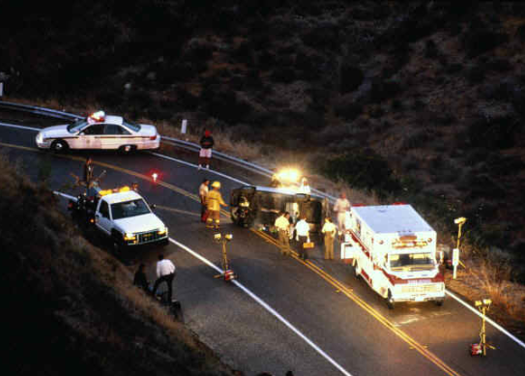
Externalities
“Dangerous”

Slide 32

Externalities
“how many people can get stoned and still have a great state or a great nation?”

Slide 33
Other Externalities
Kids
Substance Use Disorder
Smell
  But advocates say it makes you more creative – a positive externality.

Slide 34

Internalities?

Slide 35

Internalities?
  -- Allegation: it makes you
  “lazy . . . and stupid.”
  https://ahp.expoplanner.com/index.cfm?do=expomap.sess&event_id=1&session_id=236

Slide 36
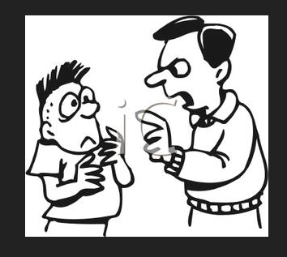
Internalities
Is paternalism OK?
Do users understand future danger?
What about positive internalities, like fun? (Kill-joy tax policy?)

Slide 37
Practical politics
Initiatives to legalize and tax cannabis tend to max out at around 57% of the vote, if they pass at all.
Standalone cannabis tax initiatives routinely get 75% to 80%.

Slide 38



2013 slide: Dedicated Revenue
WA: health and drug abuse
CO school construction
Notes:
Since lots of people hate taxes, the drafters of the initiatives sent tax proceeds straight into popular programs. As if money weren’t fungible.

Slide 39

Tax medical cannabis?
!
Notes:
I will gleefully stipulate that for some people marijuana is medicine. I’ve heard and read too many stories of miraculous cures and healing. God bless the patients.

Slide 40
Product level?
Some cannabis is medical, some isn’t?

Slide 41
Blumenauer bill product level medical tax exemption
“approved by the Food and Drug Administration for sale for therapeutic purposes and is marketed and sold solely for such purpose.” -- H.R. 1823, last Congress

Slide 42

Tax medical cannabis?
!
Notes:
I will gleefully stipulate that for some people marijuana is medicine. I’ve heard and read too many stories of miraculous cures and healing. God bless the patients.

Slide 43

Problem with medical tax break --
Faking sickness
Notes:
If folks get a tax break for lying, they may lie. When the 1040 tax return form started requiring children’s SSNs to be claimed as dependents, millions of dependents disappeared from the tax rolls.

Slide 44

Argument against medical tax break --
Administrability
Laws To Tax, fn 213: Statutory pain levels: “chronic,” “severe,” “severe chronic,” “debilitating,” and “intractable”
Notes:
Who can say whether someone’s pain rises to these statutory thresholds? The pain question is harder than qualification for SS disability, which requires huge numbers of lawyers. At least the stakes aren’t as high for a tax break. But maybe states will do like CA and give up.

Slide 45
So, 4 answers for medical marijuana:
No tax
Just sales tax
Less tax than recreational
Full tax, like recreational
Notes:
Rabbi
John Prine

Slide 46


Slide 47
California’s answer for medical marijuana:
No tax if it’s given away, not sold.
Notes:
Rabbi
John Prine

Slide 48

Regressivity is a problem with taxing cannabis
Especially for medicine
Notes:
Any consumption tax imposes the same dollar burden on the poor and on the rich, but it hurts the poor and doesn’t bother the rich.
Another association of bad fortune with the bald man. Harmless, and

Slide 49
Possible goals of revenue tools:
Price – keep it up
Products – favor safer ones
Promotion – keep it down
[Revenue for programs]
BUT marginalize illegal market
BUT protect patients (and the poor)
Notes:
Rabbi
John Prine

Slide 50
Models
  Alcohol and tobacco
  Early cannabis taxes
  $
  Exe

Slide 51

Beer
Federal: $18 a barrel (31 gallons) – not alcohol content
Small brewer exception
Notes:
We tax Bud Light the same as Belgian beer that’s 11 percent alcohol.

Slide 52

Federal liquor tax -- potency
Fifth of liquor:
100 proof: $13.50/5= $2.70
80 proof : $2.70 X .80 = $2.14
Notes:
For liquor, we tax only alcohol. 80 proof liquor has 80 % of the alcohol of 100 proof liquor, so it bears 80 percent of the tax.

Slide 53
Federal tobacco tax -- weight
-- Everything -- Cigarettes, cigars, snuff,
chewing tobacco – ALL by the pound
-- EXCEPT Large cigars (> 3 lbs. per 1,000):
52.75% of the manufacturer’s price,
capped at 40.26 cents
per cigar.
Notes:
For liquor, we tax only alcohol. 80 proof liquor has 80 % of the alcohol of 100 proof liquor, so it bears 80 percent of the tax.

Slide 54
No jurisdiction in the world taxes cigarettes by tar or nicotine content.
-- Right?
.

Slide 55
Except for cannabis, state excise taxes include a quantity-based component
  50 out of 50 states tax cigarettes per pack
  50 out of 50 states tax motor fuel per gallon
  50 out of 50 states tax beer per gallon
  47 out of 47 states tax wine per gallon
    Three states sell wine through state stores instead of taxing private sales
  33 out of 33 states tax liquor per gallon
    17 states sell through state stores instead of taxing private sales
  Sometimes these states add price-based taxes on top of their quantity-based taxes. But quantity-based tax rates form the foundation of their excise tax systems. -- Slide from ITEP.
Notes:
Certain amount of harm per unit. It doesn’t matter if you’re drinking Busch Lite or craft beer. Charge the same amount for the same amount of intoxicant.

Slide 56
Cannabis tax history
  $
  Exe

Slide 57
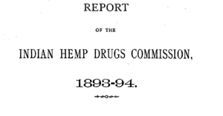
World’s first cannabis taxes and fees
https://digital.nls.uk/indiapapers/browse/archive/74908458

Slide 58


Slide 59

R
Rupees per ser (about 1 kg) in Bengal
Rupee

Slide 60
1982 Section 280E
Tax Court let drug dealer deduct travel
Congress: No deduction for selling expenses – just for cost of goods sold
Covers all illegal drugs

Slide 61


2009: New World’s 1st marijuana-only tax
Oakland, CA, July 21, 2009: 1.8 percent of gross receipts
Notes:
A tiny tax at retail – enacted in referendum with 80 percent of voters saying yes. Oakland has its fiscal troubles, and the marijuana community stepped up in a small way.

Slide 62
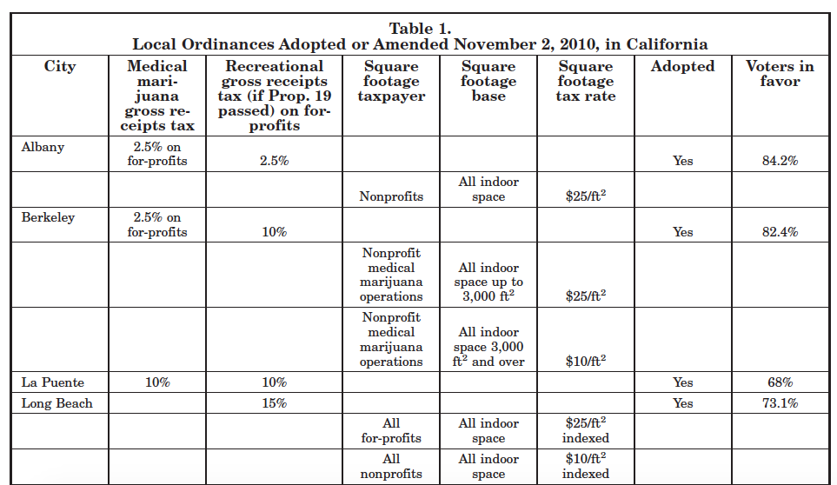
2010 California initiatives

Slide 63
Alaska 2014
Weight-based tax -- $50 per ounce for flower, less for other parts by regulation

Slide 64
Canada 2018
THC Content in processed products:
  1 cent per milligram
Weight-based tax for raw matter:
  $1 per gram for flower
  $.25 per gram for trim
  Full tax on medical

Slide 65
Illinois 2019 ad valorem:
-Smokeable:
≤ 35% THC (proxy for flower): 10%
> 35% THC (proxy for concentrates): 25%
-Non-smokeable: 20%

Slide 66
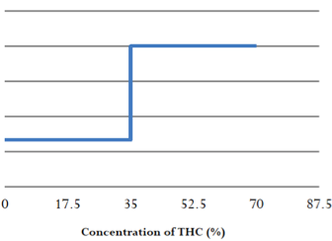
Illinois smokeable notch

Slide 67
New Jersey 2019
-- up to $10 per ounce, as established by the commission, if the average retail price of an ounce of usable cannabis was $350 or more;
-- $30 per ounce, if the price was between $350 and $250;
-- $40 per ounce, between $250 and $200;
-- $60 per ounce, less than $250.

Slide 68
New York 2021 per milligram of THC
(1) Flower 0.5 cents;
(2) Concentrated cannabis 0.8 cents; and
(3) Edibles 3 cents

Slide 69
Source of NY ratios: Colorado study
“one milligram of THC in edible form is equivalent to 5.71 milligrams of THC in smokable form.” https://www.researchgate.net/publication/316977045_Marijuana_Equivalency_in_Portion_and_Dosage

Slide 70
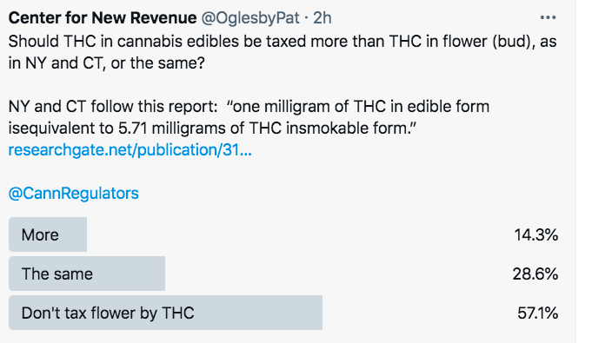
Unscientific poll

Slide 71
So, WHAT to tax?
  Price – “Ad valorem”?
  Weight of plant parts?
  THC?
  Selling expenses (280E)
  Number of plants?
  Square feet of canopy?
  Electricity used?
  $
  Exe

Slide 72
Pros and Cons
Drilling down on tax bases

Slide 73
Taxing by price
E.g.,15% of retail price
Easy to start
Doesn’t need pre-collection cash flow
May piggyback on retail sales tax
(Salience – does customer see tax amount?)

Slide 74
Price (Ad valorem) Base: Problems
Relationship & quantity discounts
Free pot with pipe (bundling)
Predictable price collapse

Slide 75
Price (Ad valorem) Base: Problems
Relationship & quantity discounts
  Employees, friends
  But tax on 1 gallon of liquor = tax on 8 pints

Slide 76
Price (Ad valorem) Base: Problems
Bundling discounts: (Free pot with pipe or membership deals)

Slide 77
Price (Ad valorem) Base: Problems
Predictable price collapse

Slide 78


Slide 79


Slide 80
Taxing by price
Correlation with potency?
Doubling potency from 10 to 20 percent increases the price by much less than 2X.
-- Drs. Ben Hansen, Keaton Miller, & Caroline Weber:

Slide 81
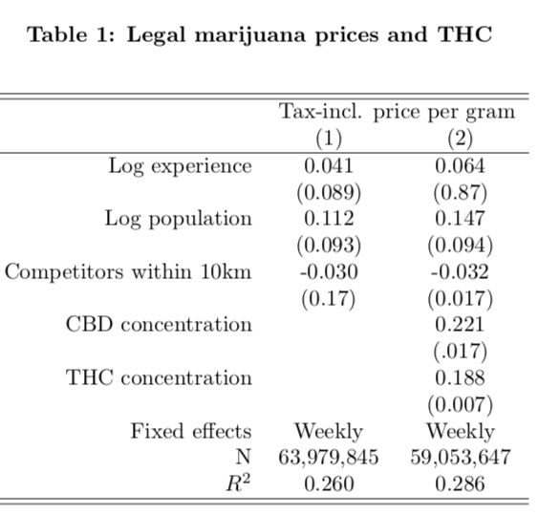

Slide 82
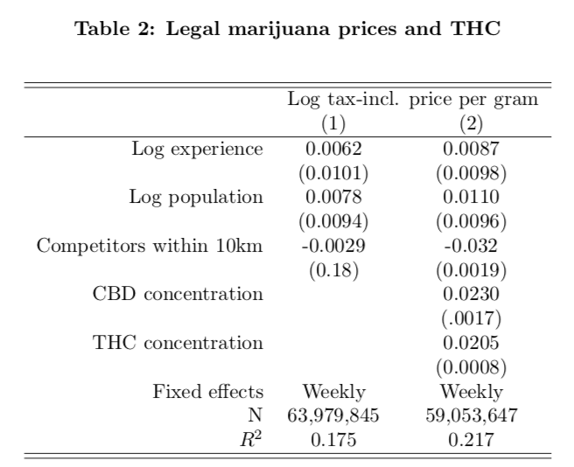

Slide 83
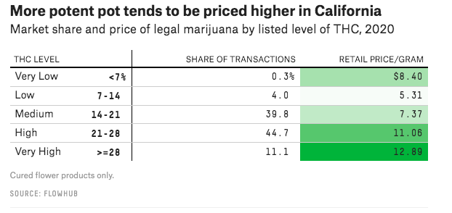
But see . .
https://fivethirtyeight.com/features/americas-pot-labs-have-a-thc-problem/

Slide 84
Ad valorem (price) base PRE-RETAIL
-- Vertical integration requires conversion to weight-based tax because there’s no ACTUAL pre-retail price

Slide 85
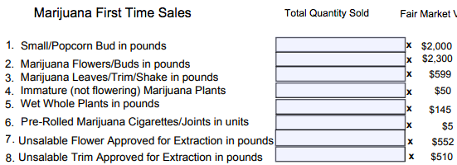
Nevada – 15% conversion

Slide 86
Nevada – rates at a different time
Flower — 75 cents a gram
Trim — 20 cents a gram
Small bud — 50 cents a gram
Wet whole plant — 7 cents a gram.
NV taxes by the unit
immature plants ($15)
seeds (($0.90)
pre-rolls ($0.75)
https://tax.nv.gov/uploadedFiles/taxnvgov/Content/Forms/Retail-Marijuana-Fair-Market-Value-Jan-1-2018.pdf

Slide 87
Taxing by price
Critique of Vermont price-based tax – “knowingly implement a policy which is defective by design simply because any alternative would require the Vermont Department of Taxes to work a little bit harder than they’d like to.”
https://vtdigger.org/2018/11/29/dave-silberman-governors-cannabis-advisory-commission-report-mixed-bag/

Slide 88
Will the federal government tax by price?
If not, states experimenting with other bases can pave the way for federal legalization.

Slide 89
-- Specific bases – 2 of them
  -- Weight for raw plant matter
  -- THC for
    Concentrates
    Raw plant matter

Slide 90

Weight base would encourage high potency.
So categories proliferate.
Bud/flower
Leaves/trim
Fresh/Wet whole plant
Small bud
Abnormal bud
Immature bud
Bud for extraction
Trim for extraction
Notes:
If an ounce of ditchweed and an ounce of highly potent concentrate bear the same tax, the seller delivers more bang for the buck to the customer by selling only powerful product. That’s maybe why the tax on a pint of liquor is many times the tax on a pint of beer.

Slide 91
Raw plant matter taxable articles 2020

Slide 92
CO: Bud (flower) – 33 cents/gram vs. Trim (leaves) -- 10 cents/gram

Slide 93
Alaska
(1) mature bud will be taxed at $50 an ounce
(2) immature bud will be taxed at $25 an ounce;
(3) abnormal bud will be taxed at $25 an ounce;
(4) the remainder of the plant will be taxed at $15 an ounce; and
(5) clones will be taxed at $1 per plant.

Slide 94
Alaska
11) “abnormal bud” . . .
  (A) failed a microbial testing required by 3 AAC 306.645(b); or
  (B) contains observable seeds;

Slide 95
Alaska
(14) “immature bud” means an immature flower formed on a flowering marijuana plant, . . . that generally
  (A) appear loose, wispy, or leafy; and
  (B) are not dense to sight or touch;

Slide 96
Small or popcorn bud
Jorge Pupo, Deputy Executive Director, Marijuana Enforcement Division, Nevada Department of Taxation, in 2019:
lower in THC and mainly used for making pre-rolled joints or mixed with the trim for extraction.
It is pretty well established in industry what “popcorn bud” is. It tends to be a lot smaller than the average flower and found low in the lower part of the plant.
https://newrevenue.org/2019/01/25/taxing-popcorn-bud-by-weight-in-nevada/

Slide 97
Raw plant matter
(typically low dollars per unit)
Pre-rolls
Seeds
Immature plants
(Clones)

Slide 98

Tax THC?

Slide 99


Slide 100
Potency – Taxing THC
THC = Intoxication? Public health rationale.
Sampling and measurement
  Concentrates
  Flower (raw plant matter)

Slide 101
Different tolerance
.15 blood alcohol = drunk
Cannabis affects heavy users less, and isn’t linear

Slide 102
Sampling:
Some taxable articles have homogeneous THC.

Slide 103

Heterogeneity of raw plant matter
Notes:
The answer is that this vegetable matter is not fungible. The trichomes have more THC than other parts of the plant, so two people picking out samples to put in the machine may pick samples with widely different amounts of THC.

Slide 104
BOTEC

Slide 105


Dale Gieringer, CA NORML
Notes:
The y axis shows TCH by weight. Samples from the same plant sent to different labs show results from around 11 to 7 percent. That’s not close enough for government work.

Slide 106
When sampling is harder than for liquor, what errors call for penalties?
.

Slide 107
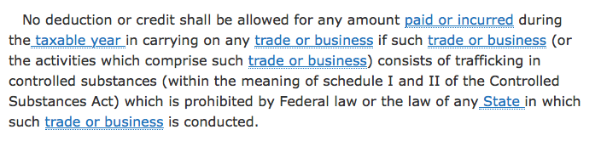
280E

Slide 108
Edmondson v. Comm’r, T.C. Memo 1981-623:
Drug dealer can deduct travel expenses.

Slide 109

Federal nondeductibility
No deduction for advertising or sales function
Notes:
I’ll let you read

Slide 110
-- Ads are protected commercial free speech.
-- Tobacco signed away its right in the Master Settlement Agreement.
Notes:
I’ll let you read

Slide 111
IRC § 280E & Ads
1982: For federally illegal drugs, no income tax deduction except cost of goods sold
Images from Lynn Silver

Slide 112
Happiness

Slide 113
Appeal to youth

Slide 114

Notes:
His wages are not deductible.

Slide 115
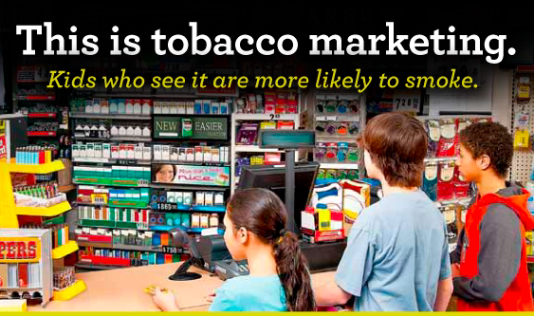
Tobacco power wall

Slide 116
280E tax deductions
  Advertising and marketing
  AND
  Interest, insurance, transportation, retail rent, clerks’ wages

Slide 117
Who gets hurt from nondeductible selling expenses?
  Retailers – high
  Growers – low
  Brands – high

Slide 118
280E conformity and state income tax returns

Slide 119
Steve Arkin in your class: we don’t tax all income the same
Other non-deductible amounts:
Golden parachutes 280G
Luxury autos 280F
Business meals
Lobbying 162(e)

Slide 120
Section 162
(e) Denial of deduction for certain lobbying and political expenditures
(1) In general
No deduction shall be allowed under subsection (a) for any amount paid or incurred in connection with—
(A) influencing legislation
https://www.law.cornell.edu/uscode/text/26/162

Slide 121

NORML supports the continuation of non-tax-deductibility of marijuana business advertising expenses.
For some citizens, advertising is a distraction, or can be a red flag that can cause them to hesitate to support the sound policy of legalization. . . .
maintaining the non-deductibility of advertising costs can act as a preemptive move against well funded corporate controlled marijuana companies, which can afford extensive advertising.

Slide 122
Constitutional challenges to 280E
Excessive fine
Direct tax
Self-incrimination

Slide 123
Other issues
-- Rates
-- Collection point (Who pays?)
-- Fees
-- Home grown
-- State vs. Federal – totally different now

Slide 124

Too much tax: Junior Johnson
“A gallon of whiskey [bore] $11 tax. You could make it for 75 cents to a dollar and sell it for $3 or $4.” Golenbock, American Zoom

Slide 125

Collection point
Choke point
Notes:
Ideally, where commerce is naturally concentrated.

Slide 126

Notes:
This consumer will not be paying tax on this shoplifted merchandise.

Slide 127
Sub-national producer taxes eventually fail
North Carolina doesn’t tax tobacco farmers or manufacturers.
National tax can deter
  interior smuggling
  race to the bottom

Slide 128
Next article
I. Dollars -- Are marijuana tax dollars a big deal?
II. Goals -- Does anything other than money justify marijuana taxes?
III. Share – What’s the range for the public share of marijuana proceeds?
IV. Players -- How much marijuana money do different people want the public to get?
V. Base -- How might we tax marijuana? (What’s the “tax base”?)
VI. Enforcement -- How much enforcement of marijuana tax laws is enough?
VII. Non-tax – Are taxes better than non-tax wealth sharing?

Slide 129
Pat Oglesby
po@newrevenue.org
Www.newrevenue.org
At your service.

Slide 130


Slide 131

Marijuana activists?

Slide 132
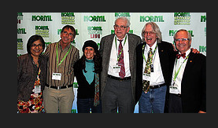

Slide 133


Early on, funded by
Billionaires paying for signature collection

Slide 134
National Cannabis Industry Association
The thousands of American businesses involved in the state-legal cannabis industries represent a tremendous economic force in this country. As the industry’s national trade association, NCIA works every day to ensure our growing business sector is represented in a professional and coordinated way on the national stage.

