Slide 1

Taxation is more popular than legalization
https://www.leafly.com/news/industry/opinion-theres-a-better-way-to-tax-legal-cannabis

Slide 2

Taxes get less primitive:
Liquor tax progression in Colonial America
Flat license fees for producers
Taxes based on the number of gallons a distillery could produce
Taxes on gallons actually produced
Taxes on actual alcohol content

Slide 3
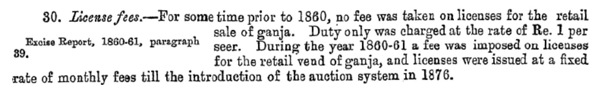
Taxes get less primitive:
Hemp Drugs in Colonial India started at 1 rupee per seer pre-1860

Slide 4
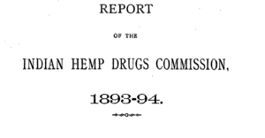
https://digital.nls.uk/indiapapers/browse/archive/74908458

Slide 5

By 1893

Slide 6


Slide 7

First non-prohibition cannabis tax in North America
Ad valorem (1.8% of price) (Oakland 2009, medical)

Slide 8
Taxes get sophisticated:
Alaska started with bud and ”remainder”; Now:
(1) mature bud will be taxed at $50 an ounce
(2) immature bud will be taxed at $25 an ounce;
(3) abnormal bud will be taxed at $25 an ounce;
(4) the remainder of the plant will be taxed at $15 an ounce; and
(5) clones will be taxed at $1 per plant.
Colorado adds Weight of bud & of trim for concentration

Slide 9
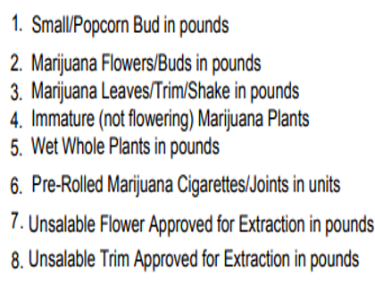
Nevada weight and unit tax categories

Slide 10




Canada:
Flower: Greater of $1 per gram or 10% of retail
Concentrates – Potency

Slide 11
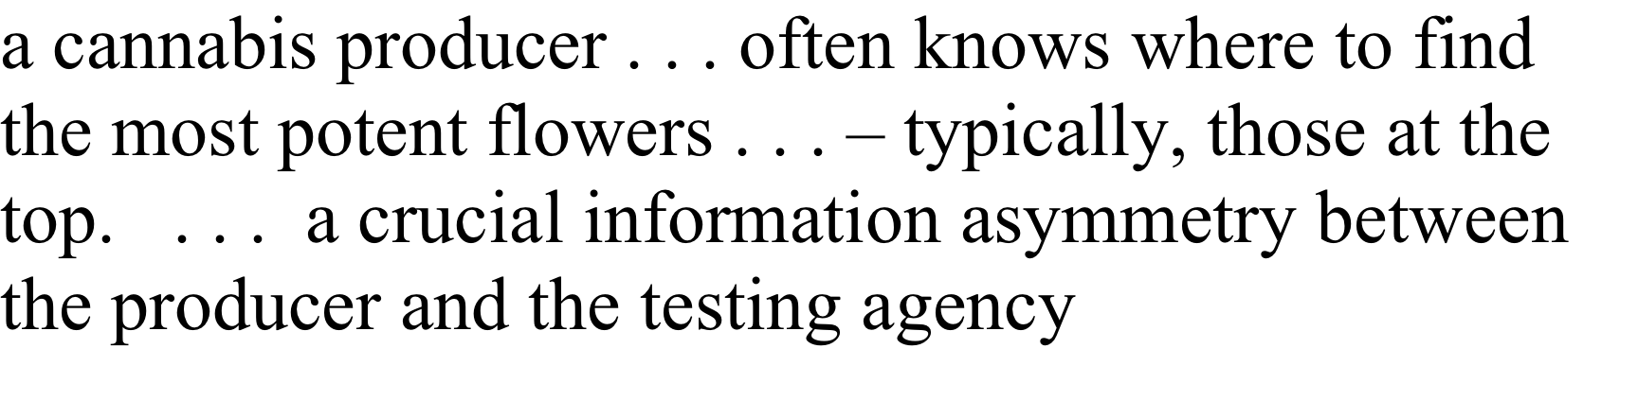
BOTEC
Issues with THC taxation of raw plant material

Slide 12

"We’ve all been lured toward high percentages of THC” but "optimized highs" involve terpenes
(?)
https://www.leafly.com/news/science-tech/beyond-thc-asserting-benefits-effects-terpenes

Slide 13
Stated-THC tax for flower – RAND Vermont
If the producer understates THC to beat taxes, consumers shy away.
If the producer overstates THC to fool consumers, taxes go up.

Slide 14

First in the world
THC in raw plant material (NY, CT)
Unlike nicotine in tobacco

Slide 15
Recap: Taxes get less primitive over time:
Ad valorem (% of price) (Oakland 2009)
Weight of Flower and trim (AK)
Weight of Popcorn Bud, Immature bud, of flower for concentration, etc.
THC in concentrates (Canada)
THC in raw plant material (NY, CT)

Slide 16
Other major excise taxes always include a quantity-based component
  50 out of 50 states tax cigarettes per pack
  50 out of 50 states tax motor fuel per gallon
  50 out of 50 states tax beer per gallon
  47 out of 47 states tax wine per gallon
    Three states sell wine through state stores instead of taxing private sales
  33 out of 33 states tax liquor per gallon
    17 states sell through state stores instead of taxing private sales
  Sometimes these states add price-based taxes on top of their quantity-based taxes. But quantity-based tax rates form the foundation of their excise tax systems. -- Slide from ITEP.
Notes:
Certain amount of harm per unit. It doesn’t matter if you’re drinking Busch Lite or craft beer. Charge the same amount for the same amount of intoxicant.

Slide 17
CAOA (Schumer) eventually
Canadian model
  Concentrates by THC.
  Raw plant material by weight, unless THC is found to be measurable.

Slide 18
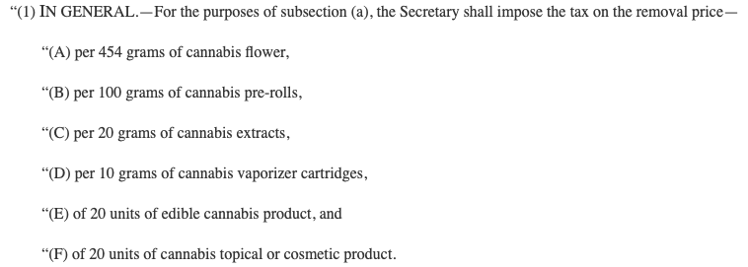
States Act (Mace) – a step backward?
Edibles by weight?

Slide 19
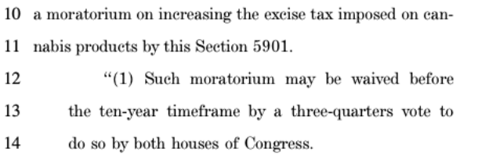
Digression: Mace GOP 3% equivalent tax bill = Anti-tax approach

Slide 20
Mace’s ¾ for 10 years = Just theater
"A legislative supermajority rule simply involves a majority imposing a supermajority requirement upon itself until the majority decides to eliminate it." https://digitalcommons.law.yale.edu/cgi/viewcontent.cgi?article=7651&context=ylj

Slide 21
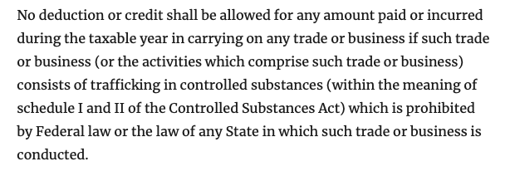
The 280E Selling Expense Tax

Slide 22
Not deductible
§ 162(e). Lobbying
§ 280A. Business use of home
§ 280B. Demolition of structures
§ 280E. Illegal sale of drugs
§ 280F. Luxury automobiles
§ 280G. Golden parachute payments

Slide 23
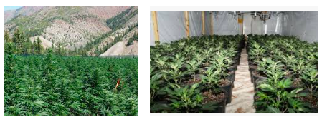
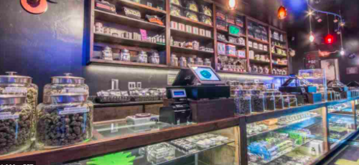
280E says deduct only cost of goods sold
Producers deduct only production costs
Resellers deduct only what they pay for product – not store expenses

Slide 24
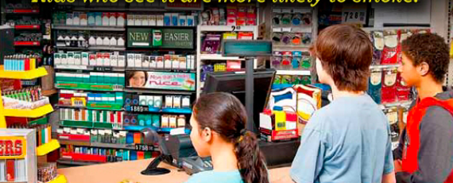
Ads, marketing, branding, not deductible

Slide 25
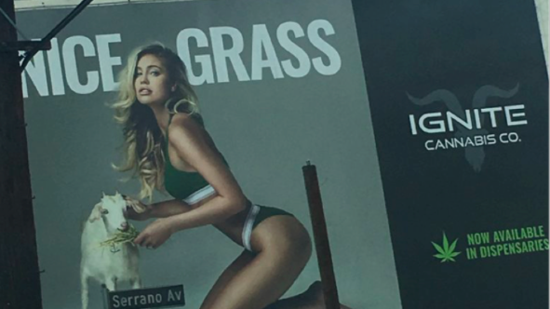
Billboards not deductible

Slide 26


Some selling expenses make parents (voters) angry

Slide 27

Can’t ban “Commercial free speech”
Federal constitution; some state constitutions

Slide 28

Tobacco settled its ad rights away for lying
Constitutionally protected

Slide 29
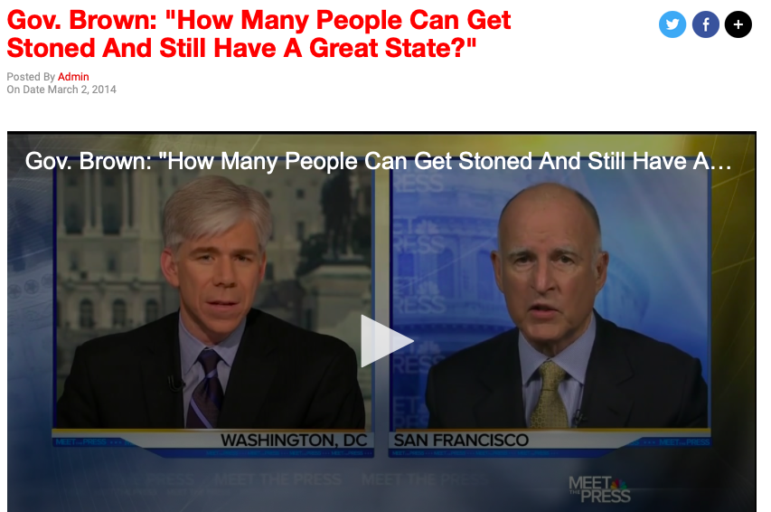
Not everyone likes cannabis –
California’s Jerry Brown

Slide 30
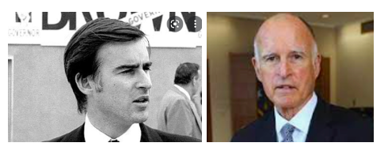
Ads bothered California’s Jerry Brown
“[I]f there's advertising and legitimacy, how many people can get stoned and still have a great state or a great nation?”

Slide 31
280E Selling Expense Tax is progressive, but overbroad
Retail employees’ wages
Store rent
Attorneys’ fees
More

Slide 32
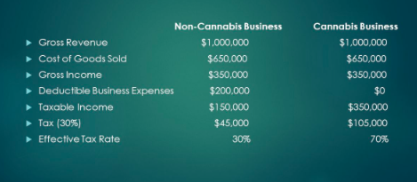
Industry example ≈ 7% ad valorem retail

Slide 33
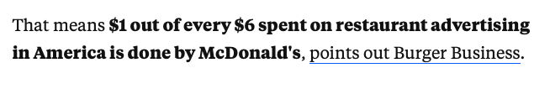
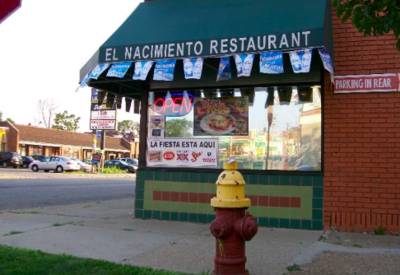
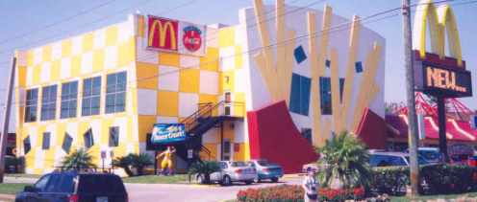
Big Business Advertises > Small Business
https://www.businessinsider.com/this-one-statistic-shows-how-much-
mcdonalds-tries-to-entrench-itself-in-everybodys-minds-2012-3

Slide 34
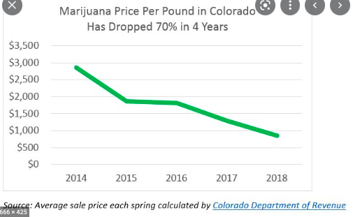
Price collapse = ad valorem taxes ↓

Slide 35
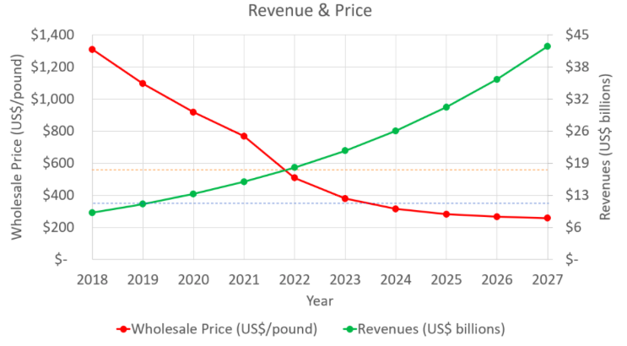
Projected price collapse = ad valorem taxes ↓
https://thaicannabiscorporation.com/2018/11/07/cannabis-global-price-collapse/

Slide 36


Profit Motive and Marketing

Slide 37
Taxing ads alone
Constitutional? Not clear.
Aiming at a specific message is bad constitutionally

Slide 38
Taxes get less primitive:
Cannabis in North America
Ad valorem (% of price) (Oakland 2009)
Weight of Flower and trim and more (AK)
Weight of Popcorn Bud (NV)
Weight of flower for concentration (CO)
THC in concentrates (Canada)
THC in raw plant material (NY, CT)

Slide 39
Taxes get less primitive:
Cannabis in North America
Ad valorem (% of price) (Oakland 2009)
Weight of Flower and trim and more (AK)
Weight of Popcorn Bud (NV)
Weight of flower for concentration (CO)
THC in concentrates (Canada)
THC in raw plant material (NY, CT)

Slide 40
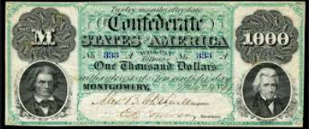
Price-based alcohol taxes
25% on “Brandy and other spirits distilled from grain or other materials, cordials, absynthe, arrack, curacoa, kirschenwesser, liquers, maraschino, ratafia, and other spirituous beverages of a similar character.” https://docsouth.unc.edu/imls/19conf/19conf.html

Slide 41
Why marijuana excise taxes?
So people will agree to legalize
For revenue
Keep price-sensitive Kids and “Substance Use Disorder” people away
Keep accidents down
Pay for harms
Productivity: “Nation of Stoners”

Slide 42
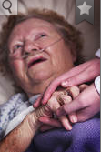

Exempt medical from tax?
!
Notes:
I will gleefully stipulate that for some people marijuana is medicine. I’ve heard and read too many stories of miraculous cures and healing. God bless the patients.

Slide 43
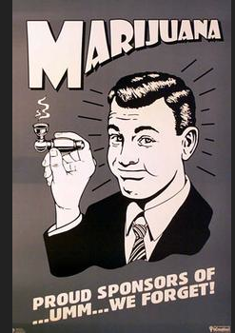
Hard to Tax
Light weight
Easy to grow – “Weed”
High pre-legalization prices make illegal sales profitable.

Slide 44

Collection point
Choke point
Notes:
Ideally, where commerce is naturally concentrated.

Slide 45

Notes:
This consumer will not be paying tax on this shoplifted merchandise.

Slide 46
Illinois 2019
Cannabis products “not intended to be smoked” (e.g., beverage, food, oil, ointment, tincture, topical formulation) will carry a 20% tax rate regardless of THC content.
Products intended to be smoked (dabs, vaping cartridges, and flower or bud) will be taxed either at 10% or 25%, depending on THC content. If THC content is below 35%, a tax of 10% will apply, while products at or above 35% will be taxed at 25%.

Slide 47
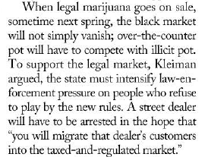
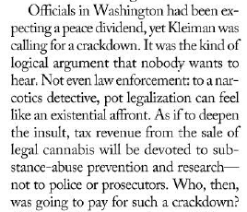
Mark Kleiman on Washington State in 2013

Slide 48
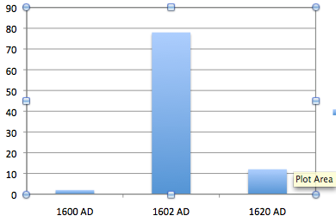
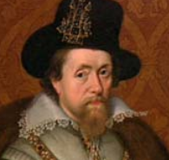
Adjusting rates – English tobacco tax
In pence/lb. 1600, 1602, 1620
Notes:
It’s almost inevitable that we will get rates wrong. There was another case when a new smoking material hit the market. King James I hated tobacco, so he raised the tax from 2 pence to 78 pence in 1602. Tax evasion was so widespread that the rate went down to 12 pence in 1620.

Slide 49
“$35 an eighth.”
While on the California Blue Ribbon Commission on marijuana legalization, I asked a long-time prominent California cannabis figure, what would be a fair after-tax price after legalization.
“$35 an eighth.” With standard quantity discounts, that means an ounce sells for under $250.
https://newrevenue.org/2018/08/26/after-tax-marijuana-price-target-35-an-eighth/

