Slide 1
Marijuana Taxes for Chief Judge Foley’s Class
Pat Oglesby, Attorney
Center for New Revenue
Chapel Hill, NC
Www.newrevenue.org
June 21, 2022

Slide 2
Should we tax drugs?
Which ones?

Slide 3
Marijuana Tax Topics
How much money for the state?
Why single out marijuana?
What products?
Tax form:
  Excise: Price or quantity base?
    Digression (Alcohol)
  Income: Selling Expense Tax (280E)
Medical tax treatment?
Home grow rules?
Enforcement?

Slide 4
Marijuana -- How much tax revenue?

Slide 5
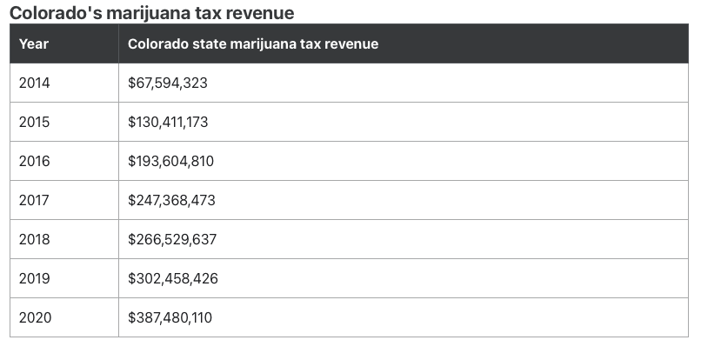
Slow start, then 5X growth

Slide 6
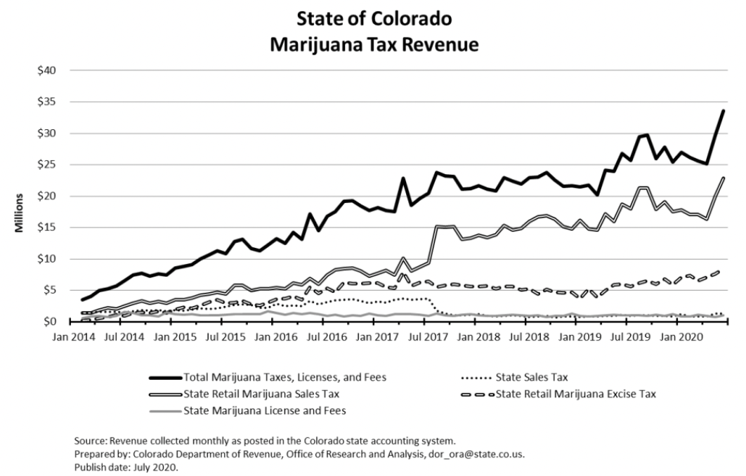
Colorado cannabis revenue

Slide 7
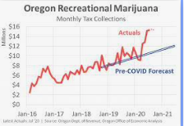

Slide 8
How much $?
State | Revenue Per Capita FY 2021
Alaska | $39.71
California | $19.17
Colorado | $71.30
Illinois | $24.91
Massachusetts | $15.15
Michigan | $7.51
Nevada | $49.75
Oregon | $41.52
Washington | $61.52
https://taxfoundation.org/states-projected-post-higher-marijuana-revenues-2021/

Slide 9
How much $?
North Carolina’s population ≈
10 million
But we consume less than early legalizing states?

Slide 10
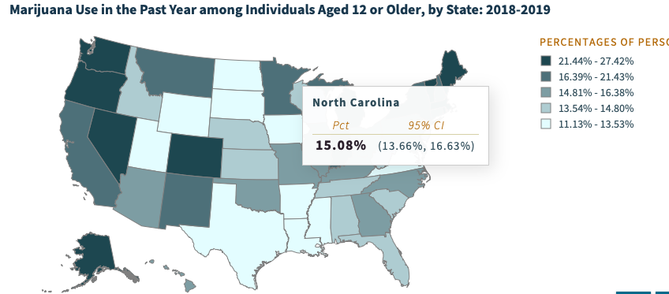
Per capita consumption -- latest
https://pdas.samhsa.gov/saes/state

Slide 11
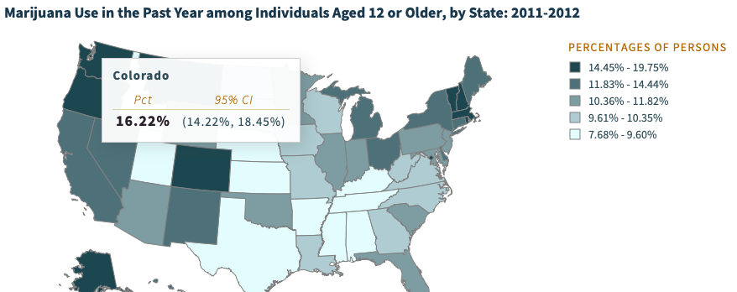
NC now 15% ≈ Colorado pre-legalization

Slide 12
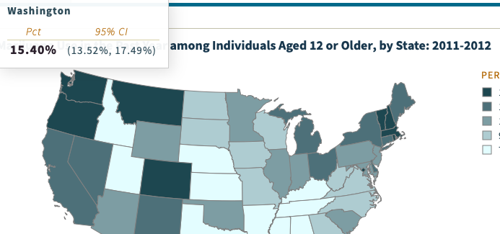
NC now 15% ≈ WA pre-legalization

Slide 13
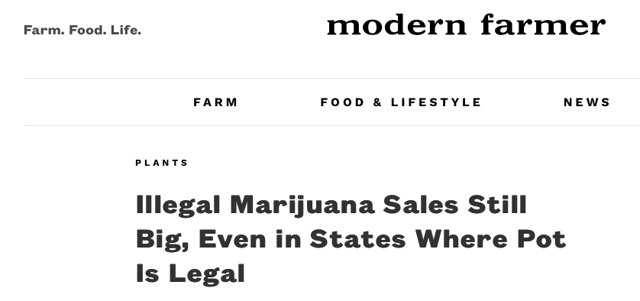
Collections depend on enforcement

Slide 14
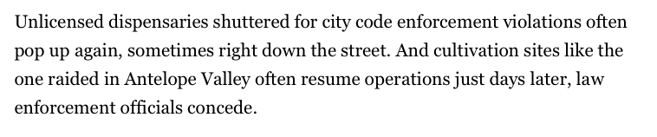
Weak enforcement in California
https://www.politico.com/news/2021/10/23/california-legal-illicit-weed-market-516868

Slide 15


California
“we’ve got the illicit guys who really aren’t facing any enforcement at present”

Slide 16
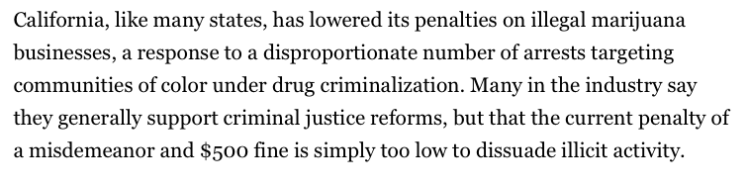
Weak penalties in California
https://www.politico.com/news/2021/10/23/california-legal-illicit-weed-market-516868

Slide 17
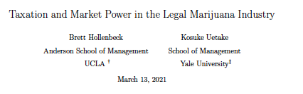
Washington state
”We find three pieces of evidence suggesting there is not widely available black market marijuana
available to consumers.”

Slide 18

Jim Morgan, CFO, Washington Liquor and Cannabis Board
About “assertions that the illicit market has been marginalized . . . [a]ppl[y] mainly to the retail market. . . .
Growers are harder to marginalize.

Slide 19
How much $
State | Revenue Per Capita FY 2021
Alaska | $39.71
California | $19.17
Colorado | $71.30
Illinois | $24.91
Massachusetts | $15.15
Michigan | $7.51
Nevada | $49.75
Oregon | $41.52
Washington | $61.52
https://taxfoundation.org/states-projected-post-higher-marijuana-revenues-2021/

Slide 20
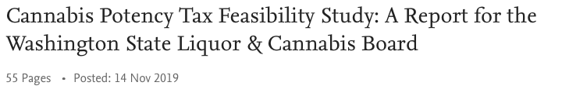
Laffer curve
”Despite [Washington State] having the highest cannabis taxes in the U.S., the evidence suggests that raising taxes would bring in additional tax revenue.”

Slide 21
Why single out marijuana?
Practical politics
Negatives from use

Slide 22
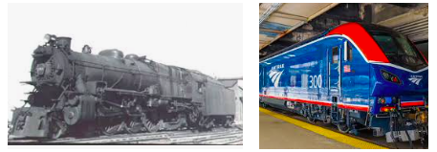
Politics: Taxation can be more popular than legalization
Pre-2020 legalization initiatives tended to max out at around 57% of the vote.
Standalone cannabis tax initiatives routinely get 75% to 80%.

Slide 23
Affinity for taxes, top to bottom:
Spending advocates
Frustrated prohibitionists
Non-consuming citizens
Recreational consumers
Legal sellers
Libertarians
Medical marijuana consumers
Notes:
Towns know
to slap on a percentage tax. That doesn’t require setting up a weight station or a chemistry lab.

Slide 24
Possible negatives from use
-- Youth use
-- Substance Use Disorder
-- DUI
-- Society -- Jerry Brown
-- Internalities

Slide 25

“how many people can get stoned and still have a great state or a great nation?” -- California Governor 1975-83 & 2011-19.

Slide 26

Internalities?
  -- Allegation: it makes you
  “lazy . . . and stupid.”
  https://ahp.expoplanner.com/index.cfm?do=expomap.sess&event_id=1&session_id=236

Slide 27
So what if “negative internalities” hurt the user?

Slide 28
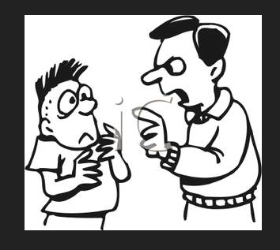
Internalities – harm to user
Is paternalism OK?
Do users understand future danger?
What about positive internalities, like fun? (Kill-joy tax policy?)

Slide 29
Non-revenue goals of revenue tools:
Price – keep it up (or down)
Products – favor safer ones
Promotion – keep it down
BUT marginalize illegal market
BUT protect patients (and poor people)
Notes:
Rabbi
John Prine

Slide 30
What tax burden is right?
Subsidize (negative tax)
Exempt (no tax)
General sales tax only (like shoes)
Offset harm or negatives
Maximize revenue
Notes:
Towns know
to slap on a percentage tax. That doesn’t require setting up a weight station or a chemistry lab.

Slide 31
How do we categorize products for taxes?

Slide 32

Raw plant material: Bud (flower) and Trim (leaves)

Slide 33


All but cannabis flower go through a concentrated or homogeneous stage.

Slide 34
545 compounds +
-- THC -- intoxicant
-- CBD – over-the-counter potion
-- ≥ 543 others
-- AND new engineered intoxicants (delta-8; “CBD-derived THC”; THC-O)

Slide 35
The Tax Base
Excise
Income
But first, a digression (alcohol)

Slide 36
Liquor tax base evolution
Fee per still
Fee per gallon of still capacity
Tax per gallon of liquor
Tax per “proof” gallon of pure alcohol

Slide 37
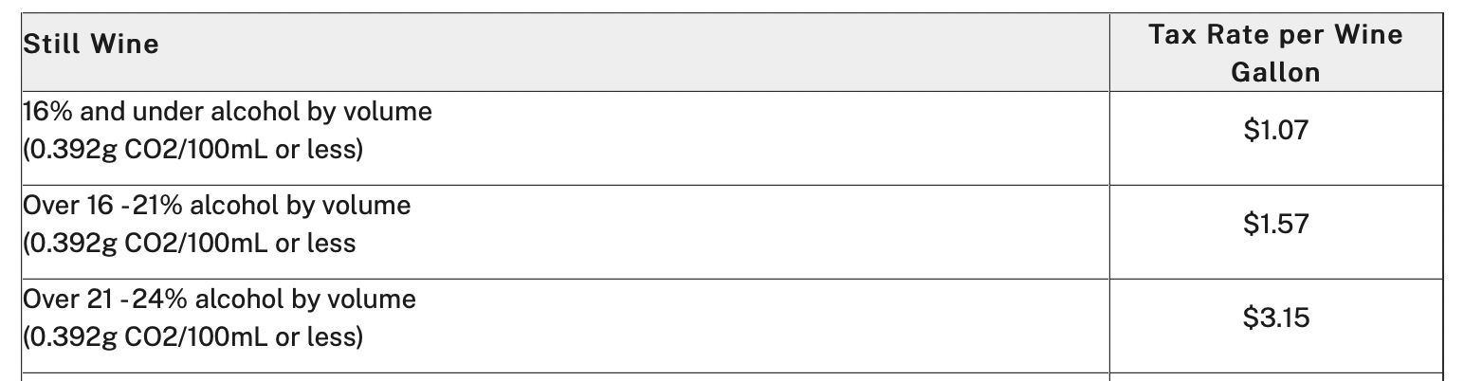
Alcohol today
Beer by the barrel or gallon
Liquor by proof – alcohol content
Wine

Slide 38
Tobacco today
Nicotine or weight?

Slide 39

How much: Junior Johnson’s heyday
“A gallon of whiskey [bore] $11 tax. You could make it for 75 cents to a dollar and sell it for $3 or $4.” Golenbock, American Zoom

Slide 40
Undertaxed?
”Our results suggest that doubling the alcohol tax would reduce alcohol-related mortality by an average of 35%, traffic crash deaths by 11%, sexually transmitted disease by 6%, violence by 2%, and crime by 1.4%.”
https://www.ncbi.nlm.nih.gov/pmc/articles/PMC2951962/

Slide 41
Poll: Is alcohol undertaxed?

Slide 42
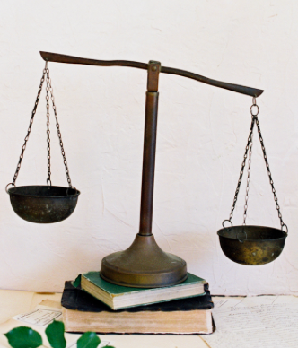

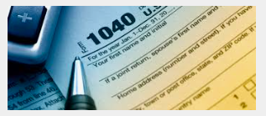
The Tax Base
  Excise: Price or quantity?
  Income: Selling Expense Tax (280E)

Slide 43
WHAT to tax?
  Excise:
    Price – “Ad valorem” %?
    Quantity-based taxes
      Weight of plant parts?
      THC?
      Square feet of canopy?
      Electricity used?
  Income:
  Selling expenses (280E)
  $
  Exe

Slide 44
Taxing by price
E.g., 37% of retail price (WA)
Easy to start
May piggyback on retail sales tax

Slide 45
Price (Ad valorem) Base: Problems
Relationship & quantity discounts
Free pot with pipe (bundling)
Predictable price collapse

Slide 46


Slide 47


Slide 48
Taxing by price
Correlation with potency?
Doubling potency from 10 to 20 percent increases the price by much less than 2X.
-- Drs. Ben Hansen, Keaton Miller, & Caroline Weber:

Slide 49
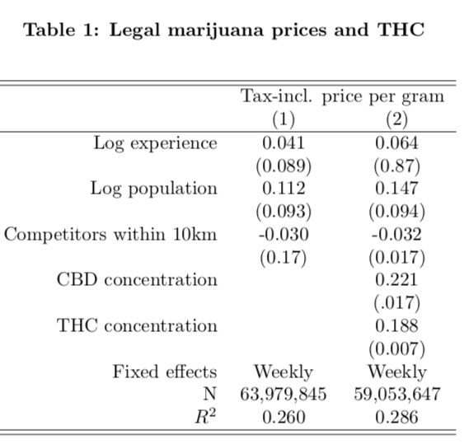

Slide 50
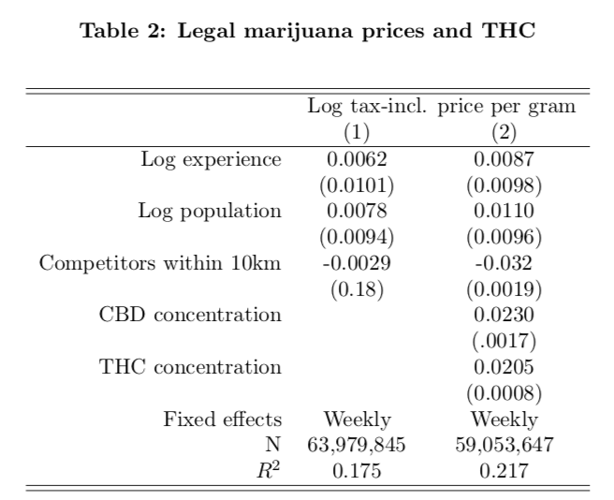

Slide 51
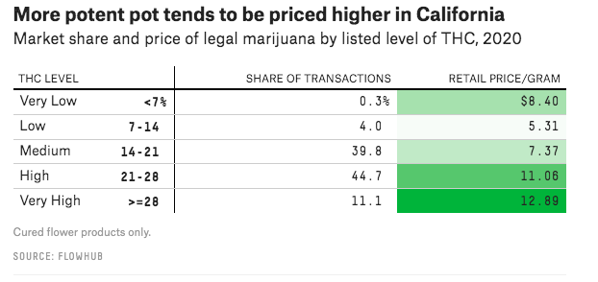
But see . .
https://fivethirtyeight.com/features/americas-pot-labs-have-a-thc-problem/

Slide 52
Ad valorem (price) base PRE-RETAIL doesn’t work
-- Vertical integration requires conversion of producer tax to weight-based (CO, NV) because there’s no ACTUAL pre-retail price

Slide 53
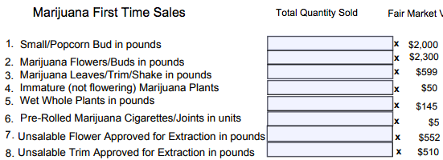
Nevada – 15% conversion

Slide 54
Nevada – rates at a different time
Flower — 75 cents a gram
Trim — 20 cents a gram
Small bud — 50 cents a gram
Wet whole plant — 7 cents a gram.
NV taxes by the unit
immature plants ($15)
seeds (($0.90)
pre-rolls ($0.75)
https://tax.nv.gov/uploadedFiles/taxnvgov/Content/Forms/Retail-Marijuana-Fair-Market-Value-Jan-1-2018.pdf

Slide 55
Will the federal government tax by price?
If not, states experimenting with other bases can pave the way for federal legalization.

Slide 56
Except for cannabis, state excise taxes include a quantity-based component
  50 out of 50 states tax cigarettes per pack
  50 out of 50 states tax motor fuel per gallon
  50 out of 50 states tax beer per gallon
  47 out of 47 states tax wine per gallon
    Three states sell wine through state stores instead of taxing private sales
  33 out of 33 states tax liquor per gallon
    17 states sell through state stores instead of taxing private sales
  Sometimes these states add price-based taxes on top of their quantity-based taxes. But quantity-based tax rates form the foundation of their excise tax systems. -- Institute on Taxation and Economic Policy
Notes:
Certain amount of harm per unit. It doesn’t matter if you’re drinking Busch Lite or craft beer. Charge the same amount for the same amount of intoxicant.

Slide 57
Quantity bases for cannabis -- weight
1. Raw plant material:
Product categories or sampled THC
2. Concentrates: Sampled THC

Slide 58
Alaska: Bud (flower) – $50/pound vs. Trim (leaves) -- $15/pound

Slide 59
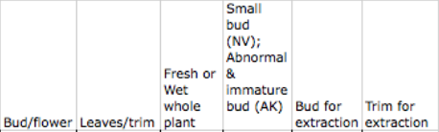

Slide 60
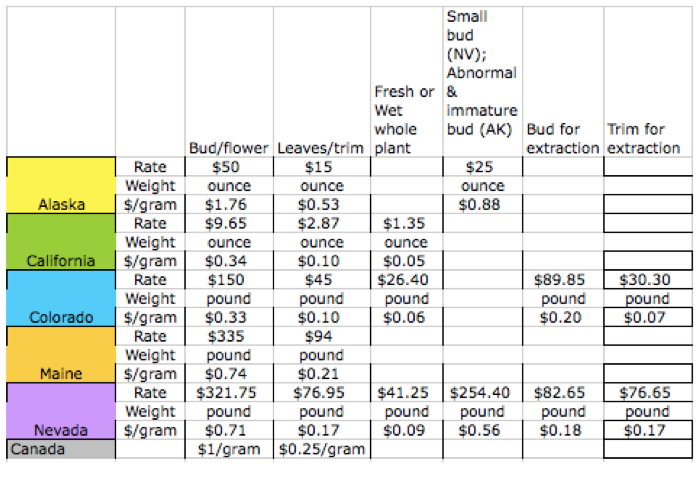
Raw plant matter taxable articles 2020

Slide 61
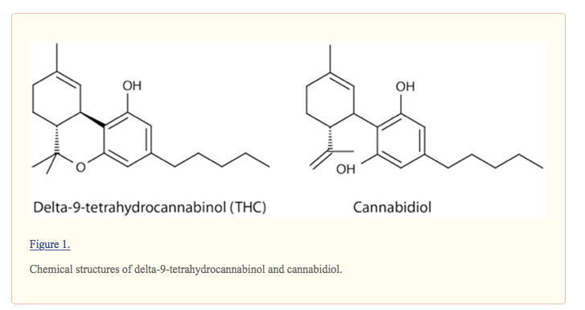
https://www.ncbi.nlm.nih.gov/pmc/articles/PMC3736954/
(THC is the target; Cannabidiol = CBD is not)

Slide 62
The “entourage effect”:
“one molecule [THC] is unlikely to match the . . . potential of [whole] Cannabis”
“The plant does it better.” https://www.ncbi.nlm.nih.gov/pmc/articles/PMC6334252/

Slide 63

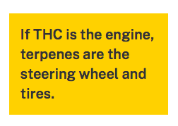
"We’ve all been lured toward high percentages of THC"
but "optimized highs" involve terpenes.
https://www.leafly.com/news/science-tech/beyond-thc-asserting-benefits-effects-terpenes

Slide 64
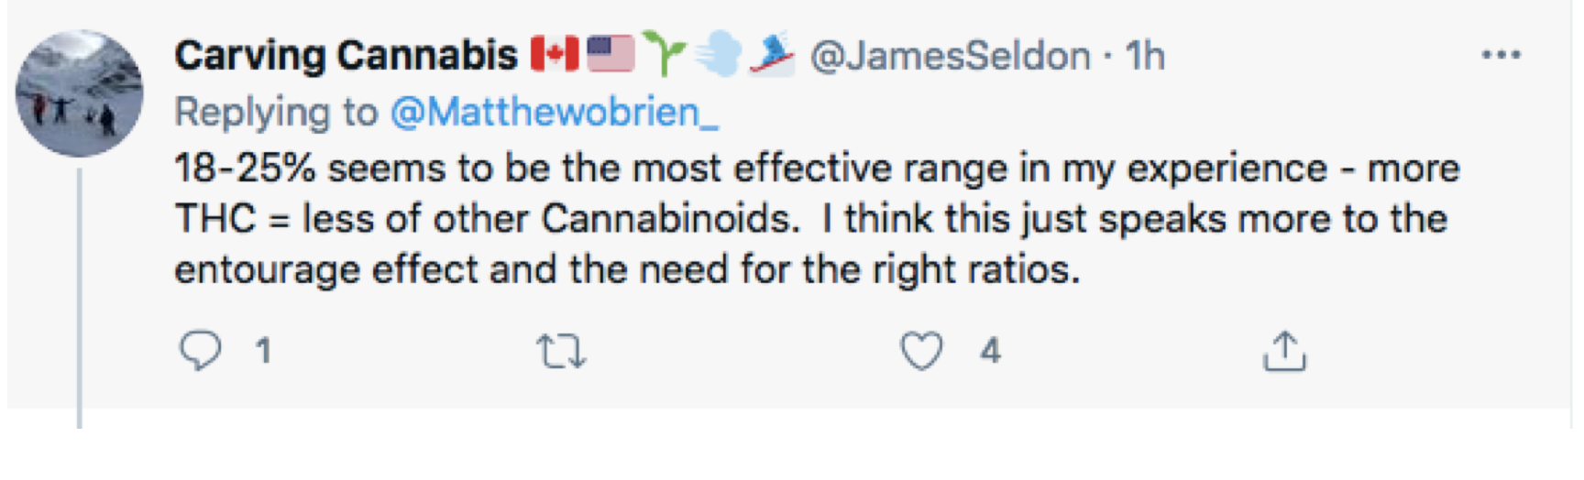

Slide 65


Slide 66
Potency – Taxing THC
Sampling and measurement
  Flower (raw plant matter) -- Hard
  Concentrates -- Easy

Slide 67
Sampling:
Some taxable articles have homogeneous THC.

Slide 68


Heterogeneity of raw plant matter
Notes:
The answer is that this vegetable matter is not fungible. The trichomes have more THC than other parts of the plant, so two people picking out samples to put in the machine may pick samples with widely different amounts of THC.

Slide 69
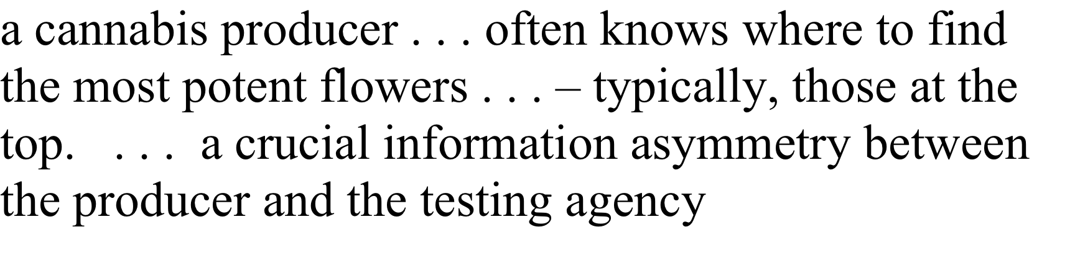
BOTEC

Slide 70


Dale Gieringer, CA NORML
Notes:
The y axis shows TCH by weight. Samples from the same plant sent to different labs show results from around 11 to 7 percent. That’s not close enough for government work.

Slide 71
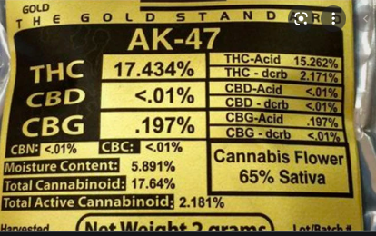
Sampling bias changes if consumers see the amount of THC taxed.
.

Slide 72
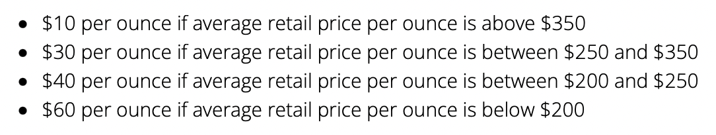
Fighting price collapse
New Jersey

Slide 73
Poll: What’s the easiest tax to collect?
Weight of raw plant material
THC content of raw plant material
THC content of processed products
Price
Grow area
Kilowatt hours

Slide 74
Tax Foundation: State of play
As of March 31, 2021 (a = not started)
State | Tax Rate
Alaska | $50/oz. mature flowers;
 | $25/oz. immature flowers;
 | $15/oz. trim, $1 per clone
Ariz. | 16% excise tax (retail price)
Calif. | 15% excise tax (levied on wholesale at average market rate);
 | $9.65/oz. flowers & $2.87/oz. leaves cultivation tax;
 | $1.35/oz fresh cannabis plant
Colo. | 15% excise tax (levied on wholesale at average market rate);
 | 15% excise tax (retail price)
Ill. | 7% excise tax of value at wholesale level;
 | 10% tax on cannabis flower or products with less than 35% THC;
 | 20% tax on products infused with cannabis, such as edible products;
 | 25% tax on any product with a THC concentration higher than 35%
Maine | 10% excise tax (retail price), $335/lb. flower;
 | $94/lb. trim;
 | $1.5 per immature plant or seedling;
 | $0.3 per seed
Mass. | 10.75% excise tax (retail price)
Mich. | 10% excise tax (retail price)

Slide 75
Mont. (a) | 20% excise tax (retail price)
Nev. | 15% excise tax (fair market value at wholesale);
 | 10% excise tax (retail price)
N.J. (a) | Up to $10 per ounce, if the average retail price of an ounce of usable cannabis was $350 or more;
 | up to $30 per ounce, if the average retail price of an ounce of usable cannabis was less than $350 but at least $250;
 | up to $40 per ounce, if the average retail price of an ounce of usable cannabis was less than $250 but at least $200;
 | up to $60 per ounce, if the average retail price of an ounce of usable cannabis was less than $200
N.Y. (a) | $0.005 per milligram of THC in flower
 | $0.008 per milligram of THC in concentrates
 | $0.03 per milligram of THC in edibles
 | 9% excise tax (retail price)
Ore. | 17% excise tax (retail price)
S.D. (a) | 15% excise tax (retail price)
Vt. (a) | 14% excise tax (retail price)
Wash. | 37% excise tax (retail price)

Slide 76
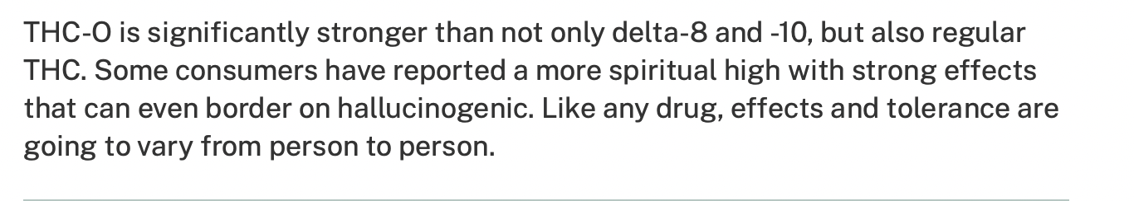
Improving on nature?

Slide 77
280E Selling Expense Tax

Slide 78
Edmondson v. Comm’r, T.C. Memo 1981-623:
Drug dealer can deduct travel expenses.

Slide 79
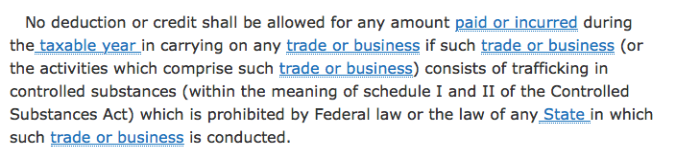
280E

Slide 80
280E Selling Expense Tax
Deduct only cost of goods sold, not selling expenses
Notes:
I’ll let you read

Slide 81

-- Ads = commercial free speech.
-- Tobacco signed away its right in the Master Settlement Agreement.
Notes:
I’ll let you read

Slide 82
IRC § 280E & Ads
1982: For federally illegal drugs, no income tax deduction except cost of goods sold
Images from Lynn Silver

Slide 83
Happiness

Slide 84
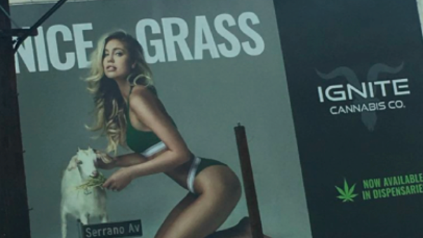
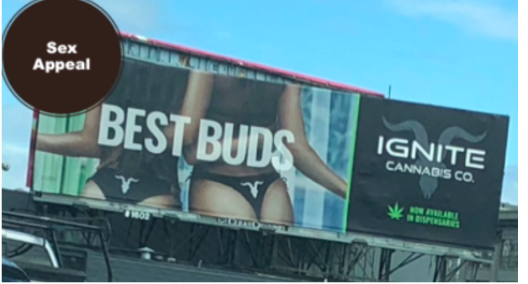

Slide 85

Notes:
His wages are not deductible.

Slide 86
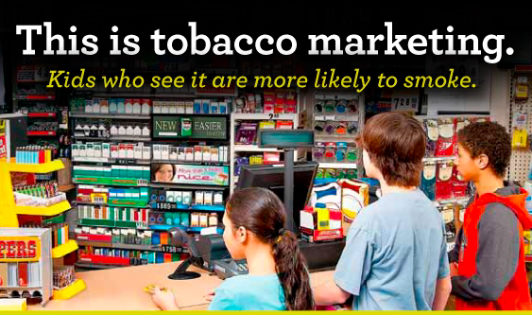
Beyond advertising to marketing -- Tobacco power wall

Slide 87
280E prevents deductions
  Advertising and marketing
  AND
  Interest, insurance, transportation, retail rent, clerks’ wages

Slide 88
Who gets hurt from nondeductible selling expenses?
  Retailers – high
  Growers – low
  Brands – high

Slide 89
280E conformity and state income tax returns

Slide 90
We don’t tax all income the same
Other non-deductible amounts:
Golden parachutes 280G
Luxury autos 280F
Business meals
Lobbying 162(e)

Slide 91
Section 162
(e) Denial of deduction for certain lobbying and political expenditures
(1) In general
No deduction shall be allowed under subsection (a) for any amount paid or incurred in connection with—
(A) influencing legislation
https://www.law.cornell.edu/uscode/text/26/162

Slide 92

NORML supports the continuation of non-tax-deductibility of marijuana business advertising expenses.
For some citizens, advertising is a distraction, or can be a red flag that can cause them to hesitate to support the sound policy of legalization. . . .
maintaining the non-deductibility of advertising costs can act as a preemptive move against well funded corporate controlled marijuana companies, which can afford extensive advertising.

Slide 93
Constitutional challenges to 280E
Excessive fine
Direct tax
Self-incrimination

Slide 94
Medical marijuana

Slide 95
4 answers for medical marijuana:
No tax
Just sales tax
Less tax than recreational
Full tax, like recreational
Notes:
Rabbi
John Prine

Slide 96

States were using all 4 early on

Slide 97
Why do jurisdictions tax medical marijuana?
-- To get it passed
-- To pay for administrative
-- To acknowledge diversion to recreational or abusers or youth

Slide 98
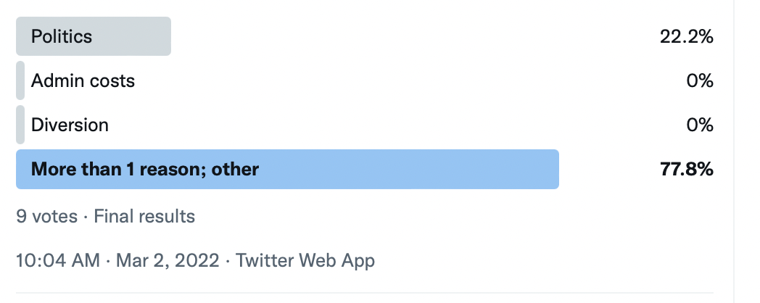

Slide 99


Who is a real patient?
!
Notes:
I will gleefully stipulate that for some people marijuana is medicine. I’ve heard and read too many stories of miraculous cures and healing. God bless the patients.

Slide 100
Blumenauer bill product level medical tax exemption
“approved by the Food and Drug Administration for sale for therapeutic purposes and is marketed and sold solely for such purpose.” -- H.R. 1823

Slide 101


Homegrown exception?
Liquor, no; beer and wine, yes.
Notes:
You can brew 100 gallons tax free
CO 6 plants; WA zero

Slide 102

What else?
https://www.prnewswire.com/news-releases/global-psychedelics-market-is-expected-to-reach-8-billion-by-2029-301553507.html
Notes:
You can brew 100 gallons tax free
CO 6 plants; WA zero

Slide 103
Setting the stage for a carbon tax
Domestic manufacturer – energy consumed
Foreign manufacturer – who knows?

Slide 104
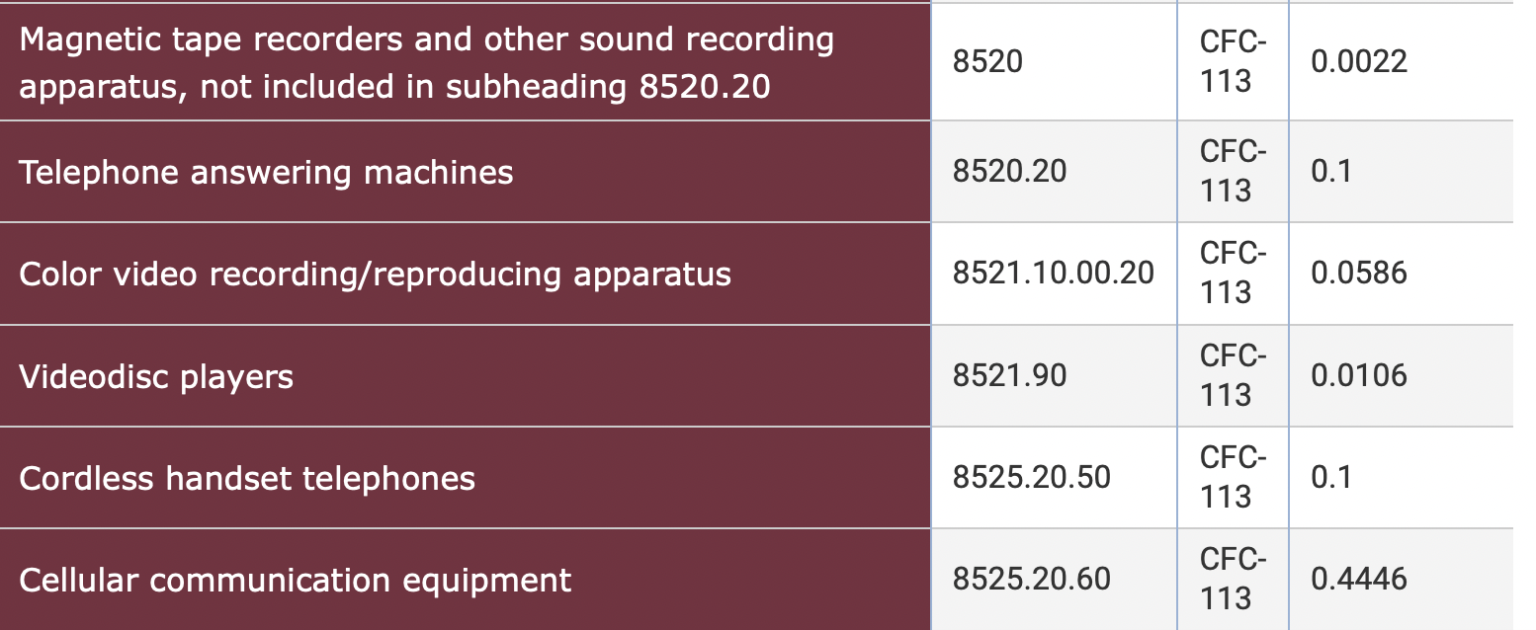
Ozone-depleting chemicals tax
https://www.law.cornell.edu/cfr/text/26/52.4682-3

Slide 105
At your service
Patrick Oglesby, ​MBA, JD, ​Attorney at Law
po@newrevenue.org
The Center for New Revenue
Www.newrevenue.org

Slide 106
Thank you
Pat Oglesby
Www.newrevenue.org
po@newrevenue.org

Slide 107
End draft; SCRAPS follow

Slide 108
Other issues
-- Rates
-- Collection point (Who pays?)
-- Fees
-- Home grown
-- State vs. Federal – totally different now

Slide 109

Collection point
Choke point
Notes:
Ideally, where commerce is naturally concentrated.

Slide 110

Notes:
This consumer will not be paying tax on this shoplifted merchandise.

Slide 111
Sub-national producer taxes eventually fail
North Carolina doesn’t tax tobacco farmers or manufacturers.
National tax can deter
  interior smuggling
  race to the bottom

Slide 112
Issues
I. Dollars -- Are marijuana tax dollars a big deal?
II. Goals -- Does anything other than money justify marijuana taxes?
III. Share – What’s the range for the public share of marijuana proceeds?
IV. Players -- How much marijuana money do different people want the public to get?
V. Base -- How might we tax marijuana? (What’s the “tax base”?)
VI. Enforcement -- How much enforcement of marijuana tax laws is enough?
VII. Non-tax – Are taxes better than non-tax wealth sharing?

Slide 113
Pat Oglesby
po@newrevenue.org
Www.newrevenue.org
At your service.

Slide 114
SCRAPS follow

Slide 115


Slide 116

Marijuana activists?

Slide 117
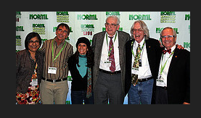

Slide 118


Early on, funded by
Billionaires paying for signature collection

Slide 119
National Cannabis Industry Association
The thousands of American businesses involved in the state-legal cannabis industries represent a tremendous economic force in this country. As the industry’s national trade association, NCIA works every day to ensure our growing business sector is represented in a professional and coordinated way on the national stage.

Slide 120

https://www.youtube.com/watch?v=RdbQcJrIP68&t=1708s
With Gavin Newsom at left, Fresno, 2015

Slide 121
Overview
What are we mad at?
Should we be?
What do we know so far?
What are the big questions?

Slide 122

Internalities?

Slide 123
What is cannabis?
-- Chemistry: ≥ 545 compounds
-- Consumption: 3 main product categories

Slide 124
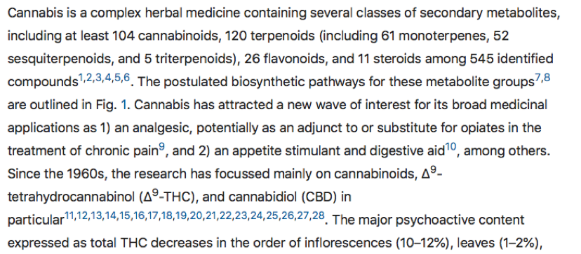
Cannabis has 545 “compounds”
https://www.nature.com/articles/s41598-020-60172-6

Slide 125
Consumer: 3 main product categories
-- Raw plant matter
-- Flower
-- Trim
-- Edibles
-- Other products

Slide 126
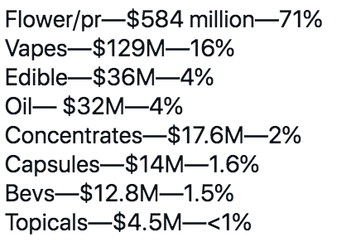
Ontario, Canada 2020

Slide 127
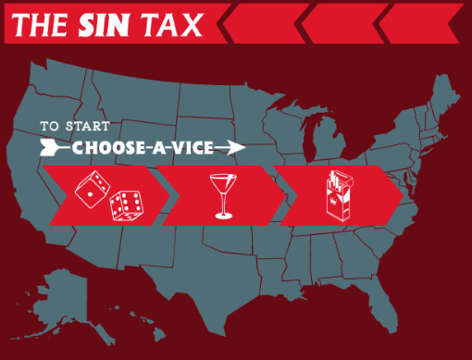
Notes:
Particularly interested in taxing things everyone doesn’t approve of
Gambling, alcohol, tobacco

Slide 128
Bud or flower

Slide 129
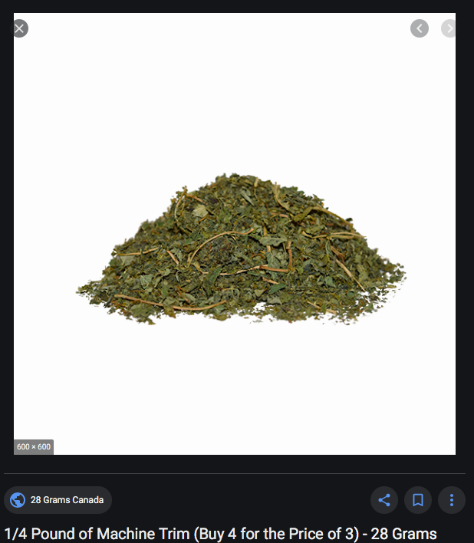
Trim or leaves

Slide 130
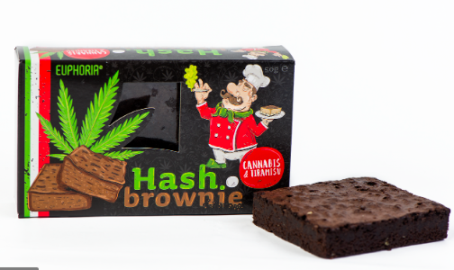
Edible

Slide 131
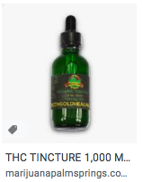
Tincture

Slide 132
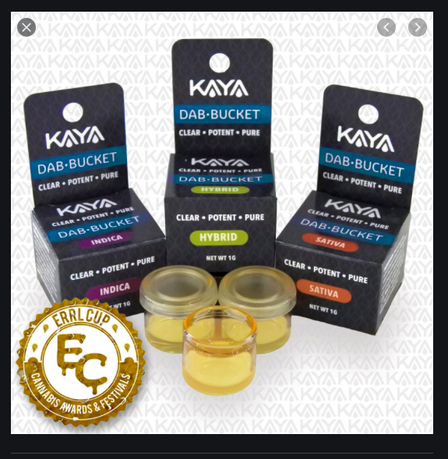
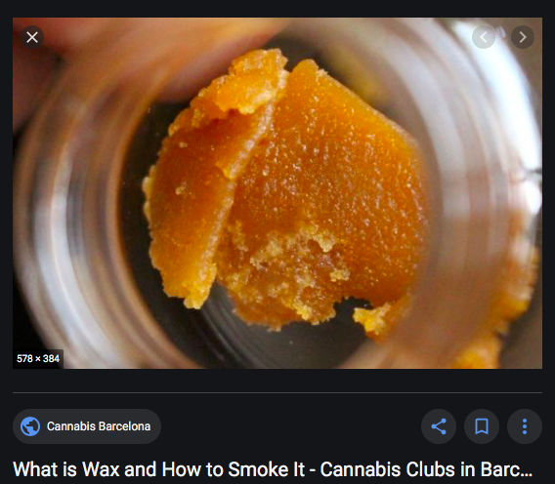
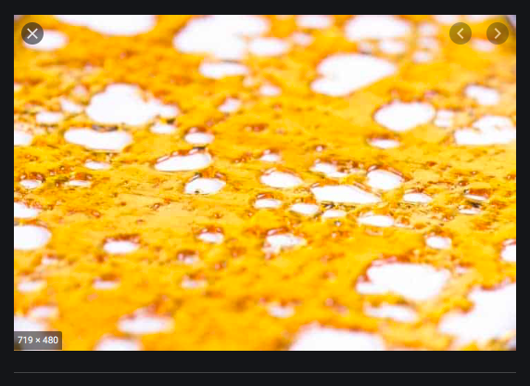
Dabs, shatter, wax, concentrates

Slide 133
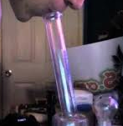
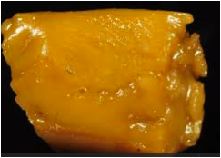
“So high that the user passes out” – sfweekly.com
Notes:
When smoked, it can be very powerful. However we tax plant matter, we may want to tax this wax and edibles made from it by potency.

Slide 134
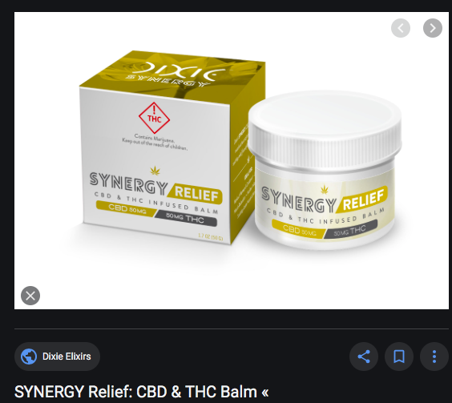
Cream

Slide 135
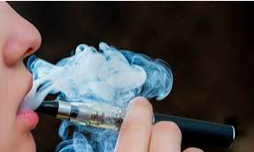
Vaping material

Slide 136
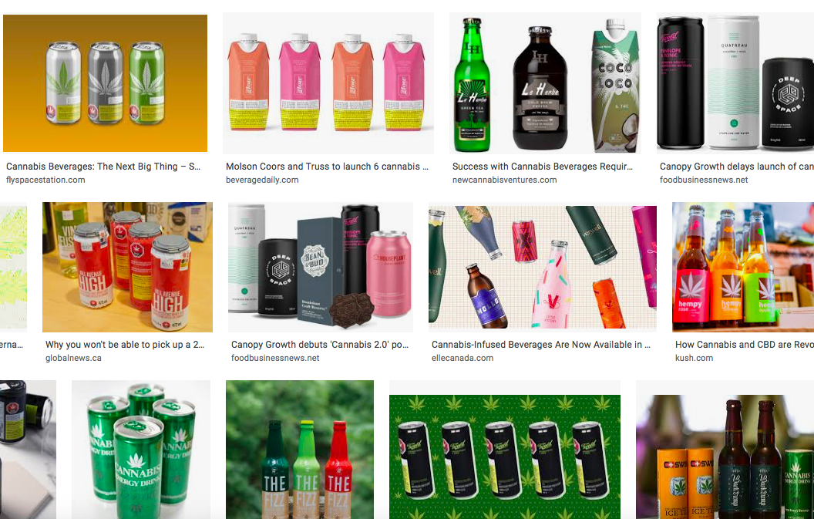
Beverages

Slide 137

Etc.

Slide 138
Why single out cannabis?
[Revenue]
What are we mad at?
Externalities?
Internalities?
Voters?
Notes:
Towns know
to slap on a percentage tax. That doesn’t require setting up a weight station or a chemistry lab.

Slide 139

Practical: Taxation is more popular than legalization
https://www.leafly.com/news/industry/opinion-theres-a-better-way-to-tax-legal-cannabis

Slide 140

Externalities
“Dangerous”

Slide 141
Other Externalities
Kids
Substance Use Disorder
(Smell?)
  But advocates say it makes you more creative – a positive externality.

Slide 142



2013 slide: Dedicated Revenue
WA: health and drug abuse
CO school construction
Notes:
Since lots of people hate taxes, the drafters of the initiatives sent tax proceeds straight into popular programs. As if money weren’t fungible.

Slide 143

Regressivity is a problem with taxing cannabis
Especially for medicine
Notes:
Any consumption tax imposes the same dollar burden on the poor and on the rich, but it hurts the poor and doesn’t bother the rich.
Another association of bad fortune with the bald man. Harmless, and

Slide 144
What are we not mad at?

Slide 145
Tax base:
-- Excise:
Price (ad valorem percentages)
or
Tangible quantities (grams)?
-- Income: Selling Expense Tax -- 280E

Slide 146
In the context of a medical marijuana bill like SB711, I see two clear rationales to justify tax: it costs money to run a new system, and some so-called medical marijuana will slip into the hands of youth and abusers. That’s pretty weak tea, but SB711 has a tax anyway.
Can one justify a medical marijuana tax regime as a structure to have in place when recreational legalization comes, as it inevitably will? Maybe whatever structure is best for recreational is best for medical. Lots of states tax medical for whatever reason, but they all slap a simple and primitive ad valorem tax on it. But since less revenue is at stake for medical, maybe simplicity and getting started quickly are uniquely important in the medical context. By the way, wide-open Oklahoma’s tax on anyone-qualifies medical only is bringing in $37 per capita already – half of the biggest state recreational take, $71 in Colorado. OK has 7-percent ad valorem retail tax in addition to a 4.5 percent standard retail sales tax; I have to check to see if both are counted in the $37 per capita number.
Saying we need a solid tax structure for first medical then recreational leads straight to conceptual and technical issues that bedevil taxing recreational. It’s hard to justify taxing medical, but then no one can prove scientifically that externalities for recreational use are net negative. Then there are tax base (ad valorem, weight, THC, square feet of grow area) issues. All those issues are hard enough to send the listener to state monopoly. I’ve done lots of presentations on those issues, and wouldn’t scratch the surface in the time I have for your webinar.
I have a bunch of images on slides that I’ll send you before long to glance at to see if there are any you love or hate.

Slide 147



Slide 148
Taxing by price
Critique of Vermont price-based tax – “knowingly implement a policy which is defective by design simply because any alternative would require the Vermont Department of Taxes to work a little bit harder than they’d like to.”
https://vtdigger.org/2018/11/29/dave-silberman-governors-cannabis-advisory-commission-report-mixed-bag/

Slide 149

Weight base could encourage high potency.
So categories proliferate.
Bud/flower
Leaves/trim
Fresh/Wet whole plant
Small bud
Abnormal bud
Immature bud
Bud for extraction
Trim for extraction
Notes:
If an ounce of ditchweed and an ounce of highly potent concentrate bear the same tax, the seller delivers more bang for the buck to the customer by selling only powerful product. That’s maybe why the tax on a pint of liquor is many times the tax on a pint of beer.

Slide 150
Taxing by price
E.g.,15% of retail price
Easy to start
Doesn’t need pre-collection cash flow
May piggyback on retail sales tax
(Salience – does customer see tax amount?)

Slide 151
Price (Ad valorem) Base: Problems
Relationship & quantity discounts
  Employees, friends
  But tax on 1 gallon of liquor = tax on 8 pints

Slide 152
Price (Ad valorem) Base: Problems
Bundling discounts: (Free pot with pipe or membership deals)

Slide 153
Price (Ad valorem) Base: Problems
Predictable price collapse

Slide 154
Alaska
(1) mature bud will be taxed at $50 an ounce
(2) immature bud will be taxed at $25 an ounce;
(3) abnormal bud will be taxed at $25 an ounce;
(4) the remainder of the plant will be taxed at $15 an ounce; and
(5) clones will be taxed at $1 per plant.

Slide 155
Alaska
11) “abnormal bud” . . .
  (A) failed a microbial testing required by 3 AAC 306.645(b); or
  (B) contains observable seeds;

Slide 156
Alaska
(14) “immature bud” means an immature flower formed on a flowering marijuana plant, . . . that generally
  (A) appear loose, wispy, or leafy; and
  (B) are not dense to sight or touch;

Slide 157
Small or popcorn bud -- NV
Jorge Pupo, Deputy Executive Director, Marijuana Enforcement Division, Nevada Department of Taxation, in 2019:
lower in THC and mainly used for making pre-rolled joints or mixed with the trim for extraction.
It is pretty well established in industry what “popcorn bud” is. It tends to be a lot smaller than the average flower and found low in the lower part of the plant.
https://newrevenue.org/2019/01/25/taxing-popcorn-bud-by-weight-in-nevada/

Slide 158
Raw plant matter
(typically low dollars per unit)
Seeds
Immature plants
(Clones)

Slide 159

California tax referenda
https://ballotpedia.org/Marijuana_taxes_in_California#2020

Slide 160

World’s first cannabis taxes and fees
https://digital.nls.uk/indiapapers/browse/archive/74908458

Slide 161


Slide 162

R
Rupees per ser (about 1 kg) in Bengal
Rupee

Slide 163
Different tolerance
.15 blood alcohol = drunk
Cannabis affects heavy users less, and isn’t linear

Slide 164


Slide 165
Dominic Corva
@CorvaDr
·
Mar 2
Replying to @OglesbyPat
politics above all else but admin costs are real given strict regulation at every stage (and diversion is politics)

Slide 166

Medical marijuana

