Slide 1
Marijuana and Revenue
Pat Oglesby
Texas Lyceum
October 23, 2024
Center for New Revenue
Www.newrevenue.org

Slide 2
3 topics
Marijuana
Government Revenue
Hemp

Slide 3
Marijuana – What is it?
Medicine
Fun
Danger

Slide 4
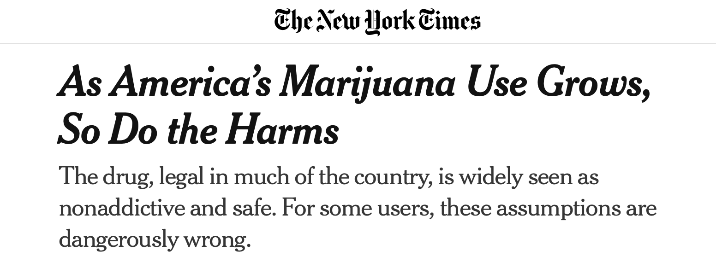
Why tax it?
https://www.nytimes.com/2024/10/04/us/cannabis-marijuana-risks-addiction.html?searchResultPosition=2

Slide 5

“How many people can get stoned and still have a great state or a great nation?” -- California Governor 1975-83 & 2011-19.

Slide 6
Revenue sources
Taxes
Fees
Government monopoly profits

Slide 7
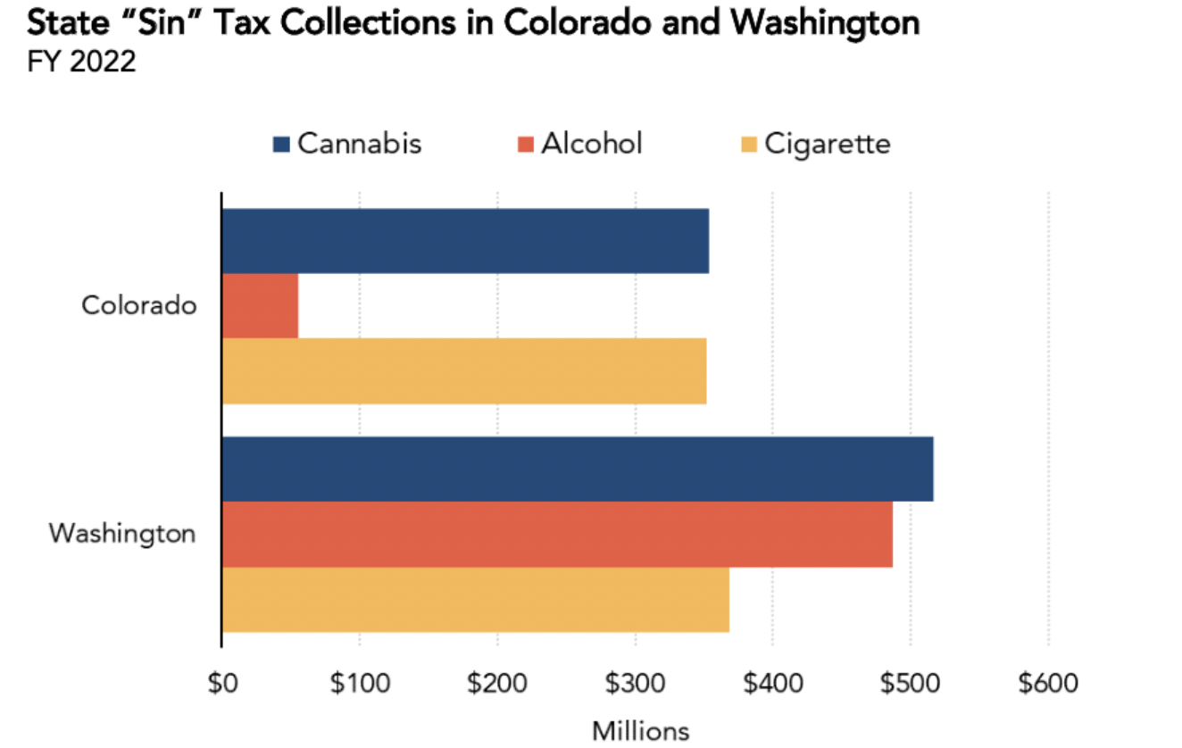
Tax Policy Center

Slide 8
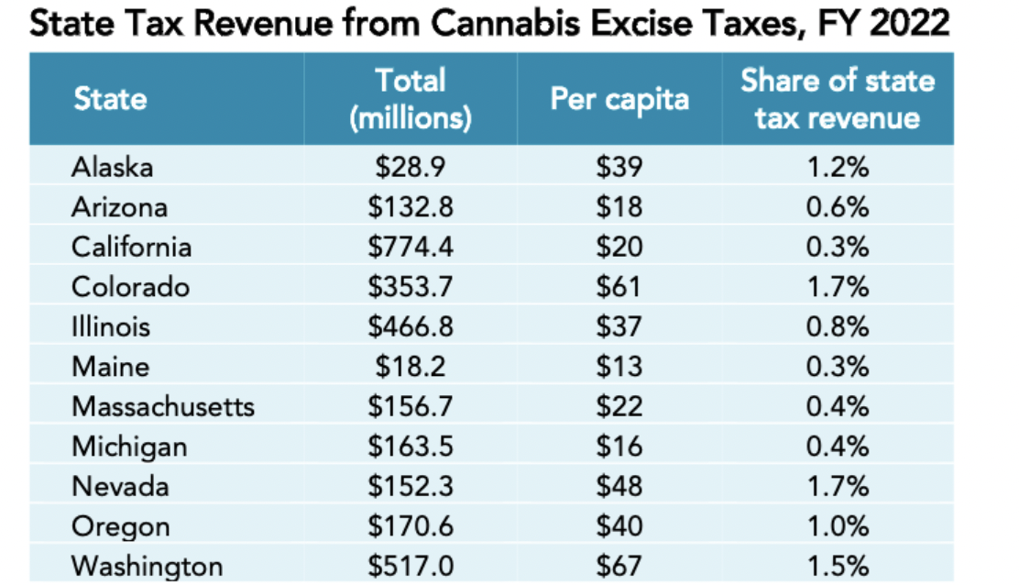
How much tax $?
Tax Policy Center,
https://www.taxpolicycenter.org/publications/pros-and-cons-cannabis-taxes/full

Slide 9
Texas guesses – At peak, enforced
Budget $321 billion – 0.5% = $1.6 billion
Population 25 million -- $40 per capita = $1 billion

Slide 10
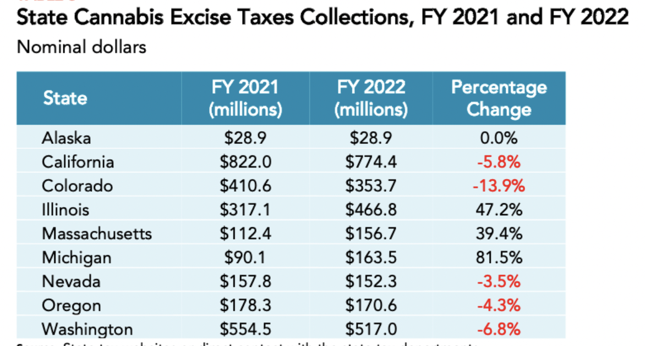
Source: Tax Policy Center

Slide 11
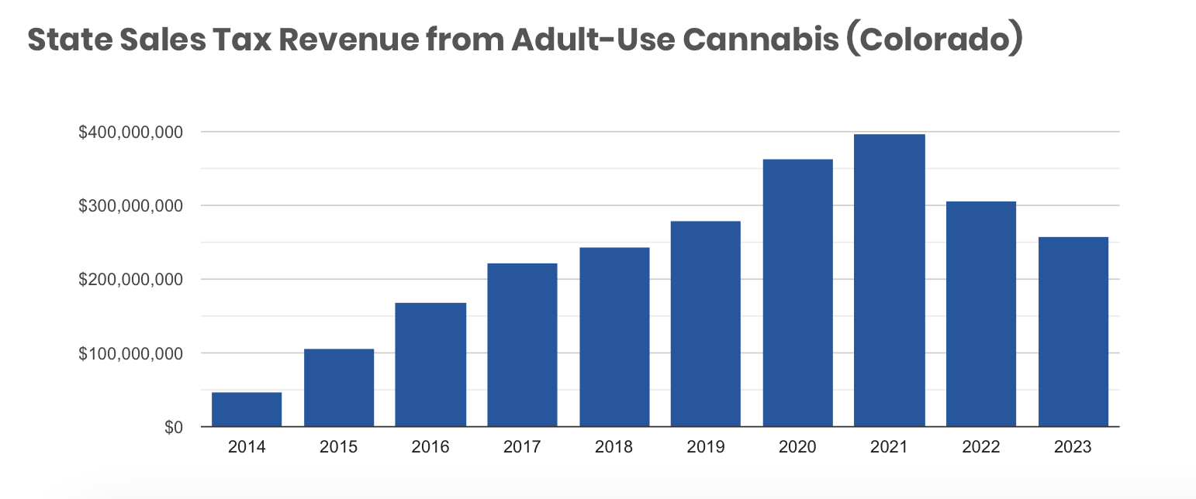
https://www.mpp.org/issues/legalization/cannabis-tax-revenue-states-regulate-cannabis-adult-use/

Slide 12

Government Revenue depends on:
Strong tax law – like 1¢ per mg of THC or 20% of price
AND
Enforcement against black market

Slide 13
Tax design issues
Base
  Price
  Pre-processed weight of flower and trim
  THC
Collection point
  Farm gate
  Retail

Slide 14
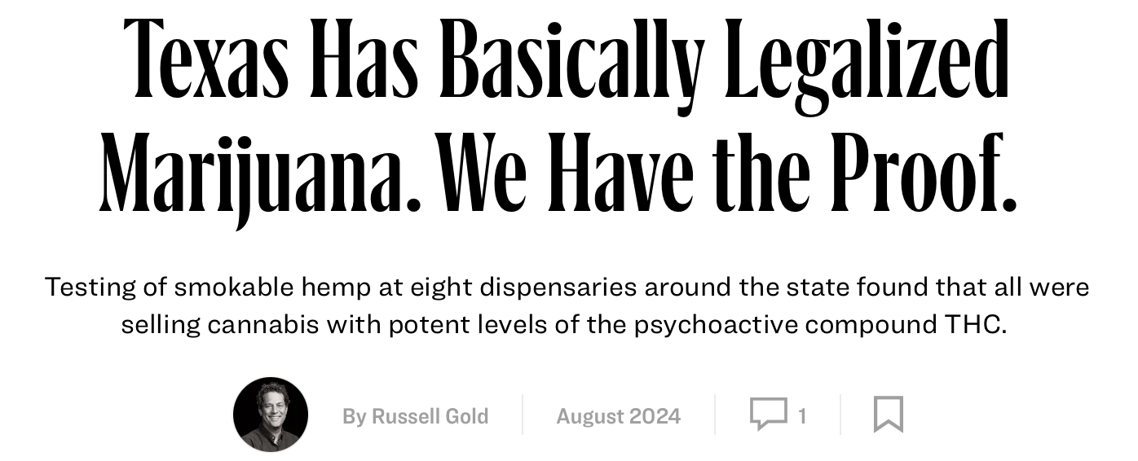
Hemp THC – Texas Monthly
https://www.texasmonthly.com/news-politics/texas-legalized-marijuana-thc-delta-9/

Slide 15
At your service
Www.newrevenue.org
po@newrevenue.org

